Slide 1
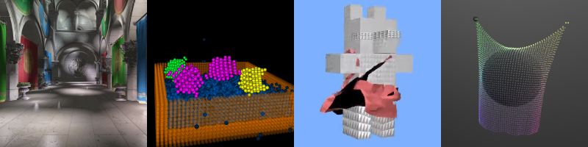
GPU Programming and Architecture: Course Overview
Patrick Cozzi
University of Pennsylvania
CIS 565 - Fall 2016

Slide 2
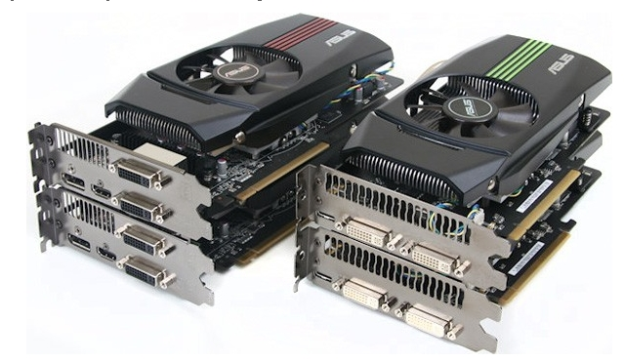
Lectures
Monday
6-9pm
Moore 212
Fall and Spring 2012 lectures were recorded
Attendance is required for guest lectures
Image from http://pinoytutorial.com/techtorial/geforce-gtx-580-vs-amd-radeon-hd-6870-review-and-comparison-conclusion/
Notes:
Lecture are optional, but everyone comes. Students even say they will stay longer because they don’t have class afterwards.
Even though the lectures are not required, come to class for the same reason that you shouldn’t work from home. Will you ever be promoted? Are you surrounding yourself by the best people you can find?

Slide 3
Recitations
Wednesday
6-9pm
Town 305
TA-lead hands-on help with projects
TA-lead hands-on labs
Sometimes I will lecture
Sometimes there will be guest lectures (required attendance)
Image from http://pinoytutorial.com/techtorial/geforce-gtx-580-vs-amd-radeon-hd-6870-review-and-comparison-conclusion/
Notes:
New this semester based on course feedback from last year.
With my industry work, my schedule is busy so sometimes I will lecture in the Wednesday time slot instead of Monday.

Slide 4

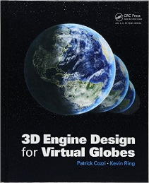















About Me
Started Cesium
Books on Virtual Globes, WebGL, OpenGL
Teach Computer Graphics
Contribute to Open Standards and Formats
Open-Source Geospatial Community Service
See http://www.seas.upenn.edu/~pcozzi/
Notes:
Cesium demos - http://cesiumjs.org/

Slide 5
About Me
Email: pjcozzi+cis565@gmail.com
Twitter: @pjcozzi
Office Hours: by appointment

Slide 6
About Me
Not “Professor”, “Dr.”, “Mr.”, or “Sir”
Not even “instructor”
Perhaps “organizer”, “facilitator”, “coach”, “catalyst”, “enabler”, or “hobbyist”
CIS 565 is a series of projects with supporting lectures.
  Learning can take place without teaching!
Notes:
Perhaps we are a sports team, and each project is an event I am preparing you with. I may bring in specialists, i.e., guest lectures, in some cases just like a football might bring in a defense specialist.
We design this course backwards from the final project. The final project is the purpose of the course, the regular projects provide breadth and a bit of depth to prepare you for the final project, and the lectures prepare you for the projects.

Slide 7
About Me
Here to facilitate inspiration, not really teach
Perhaps you will be inspired by
  Past students
  Your peers
  The TAs
  Yourself
“Education is not the filling of a pail, but the lighting of a fire.” - W. B. Yeats
Notes:
Past students: every year, CIS 565 projects surpass CIS 565 projects from the previous year.

Slide 8
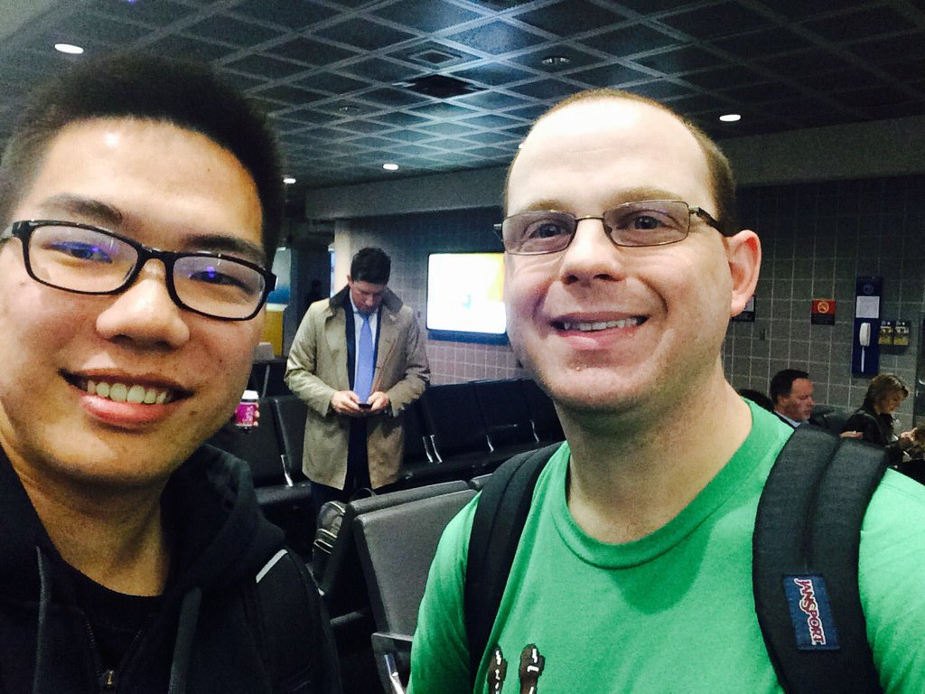
Teaching Assistants
Shuai Shao (Shrek)
  shrekshao@gmail.com
  @shrekshao
Office Hours
  Friday, 5-7pm
  SIG Lab
https://shrekshao.github.io/

Slide 9
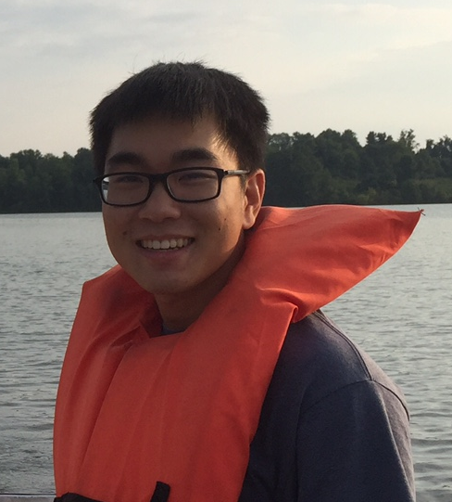
Teaching Assistants
Gary Li
  likang@seas.upenn.edu
Office Hours
  Tuesday, 5-7pm
  SIG Lab
http://likangning93.wixsite.com/home

Slide 10








CIS 565 Alumni
Plus movie studios, game studios, Amazon, Facebook, Microsoft, Oracle, Google, and all the usual cg@penn employers
Notes:
Many companies contact me to directly recruit CIS 565 students

Slide 11
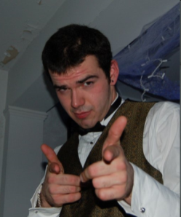
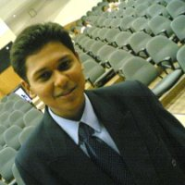
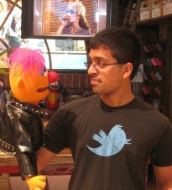
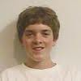

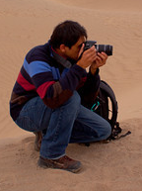
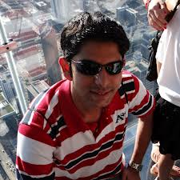
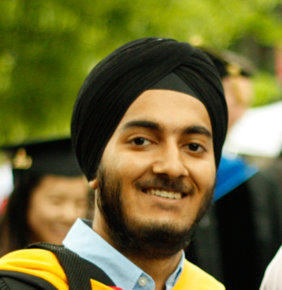
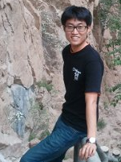
CIS 565 Hall of Fame (retired Fall 2013)
Jon
McCaffrey
Krishnan
Ramachandran
Varun
Sampath
Sean
Lilley
Ian
Lilley
Nop Jiarathanakul
Uriah Baalke
Collin Boots
Yuqin Shao
Sijie Tian
Rohith Chandran
Tiju
Thomas
Zakiuddin Shehzan Mohammed
Gundeep
Singh
Seunghoon Park
Notes:
Students whose futures were significantly influenced, e.g., jobs, etc., by CIS 565. Not based on grades.
There are so many students that I stopped updating this after Fall 2013.
Jon: System Design Engineer, NVIDIA (Android performance)
Krishnan: Character Simulations TD, Blue Sky Studios. Was able to explain how to GPU-accelerate simulations.
Varun: NVIDIA (video bios)
Sean: AMD (internship working on shadows). GPU Pro 4 chapter. Now at PGL doing procedural games.
Ian: AGI (internship working on materials)
Tiju: Microsoft Xbox
Shehzan: AccelerEyes (small GPU computing company; focus on performance)
Gundeep: Qualcomm (Android graphics drivers; tools for testing OpenGL ES 3.0)
Seunghoon Park: Had his CIS 565 OpenCL circular hough transform accepted to OpenCV
Nop Jiarathanakul, WebGL Autodesk
Uriah Baalke, Floored
Collin Boots, Final point-cloud project went into this thesis
Yuqin Shao, Mozilla Hacks article
Sijie Tian, Mozilla Hacks article
Rohith Chandran, ZeniMax Online, had deep graphics pipeline knowledge from implementing the rasterizer
Many more students that either I didn’t teach or have not heard from. (I didn’t teach Jon, but he was a TA). I feel that every student has gained something significant from this course, e.g., motivation, increased passion, etc.

Slide 12
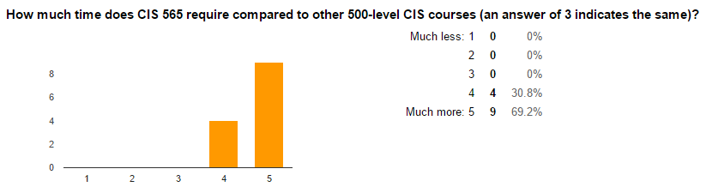
Prerequisites
Willingness to work hard because it is worth it
Notes:
Results from Fall 2015 course survey

Slide 13
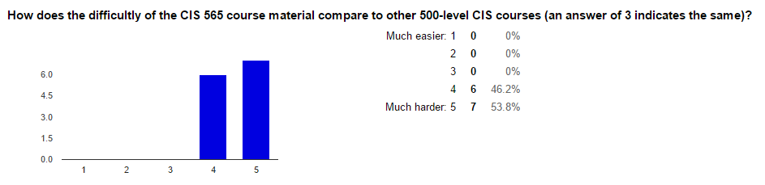
Prerequisites
The material is not that hard
Notes:
Results from Fall 2015 course survey

Slide 14
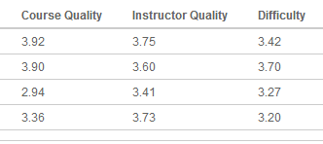
Prerequisites
Correlation between difficultly and quality
Notes:
Numbers lie, but when the course gets harder, generally students like it more. Reached max difficulty in Fall 2016.

Slide 15
Actual Prerequisites
Passion for computer graphics
CIS 460/560. Preferably received an A
Strong C or C++
Also useful: CIS 371 or CIS 501
I don’t check prereqs
Notes:
I don’t officially check prerequisites; the path tracer project will.

Slide 16
FAQ
If I am on the waitlist, will I be able to register?
  Yes
What if I don’t have a graphics background?
  Substitute Projects 4 and 5 with GPU Computing projects we approve. Contact me

Slide 17
Course Website
http://www.seas.upenn.edu/~cis565/
Schedule, reading, projects, slides, etc.

Slide 18
Google Group
Join it ASAP!
  https://groups.google.com/forum/#!forum/cis-565-fall-2016
Send email to cis-565-fall-2016@googlegroups.com
Be active; let’s build a course community
Notes:
Default to ask publically for the benefit of the entire class.
You’ll be involved in many communities throughout your career, let’s start now.

Slide 19

Used for projects
Create an account:
  https://github.com/join
Our GitHub organization:
  https://github.com/CIS565-Fall-2016
Who is new to source control?
Notes:
Everyone needs to learn how to use source control. Learn best practices now while in school. Also better for collaboration and backups.

Slide 20

https://www.linkedin.com/groups/GPU-Programming-Architecture-6540935
Join our group for networking and job openings
  http://www.linkedin.com/groups/GPU-Programming-Architecture-6540935
Notes:
I frequently post GPU and graphics job openings to it. Employers come directly to me requesting CIS 565 students.

Slide 21
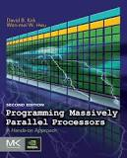
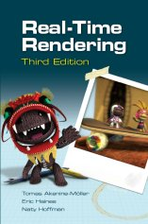
Completely Optional Books
Programming Massively Parallel Processors
2012, David Kirk and Wen-mei Hwu
Old draft: http://courses.engr.illinois.edu/ece498/al/Syllabus.html
Real-Time Rendering
2008, Tomas Akenine-Möller, Eric Haines, and Naty Hoffman
Notes:
If you get only one book, get Real-Time Rendering.
The best people I know read a lot.

Slide 22
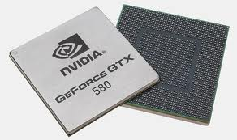
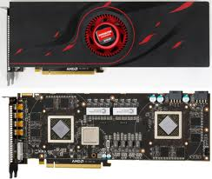
Course Topics
GPU – Graphics Processing Unit
Is it still just for graphics?
Images from http://www.ngohq.com/news/18784-nvidia-launches-geforce-gtx-580-a.html and http://gs7.blogspot.com/2011/09/amd-radeon-hd-6990-worlds-fastest.html
Notes:
The game industry is now larger than the movie industry. The demand for realistic graphics has driven innovation.

Slide 23
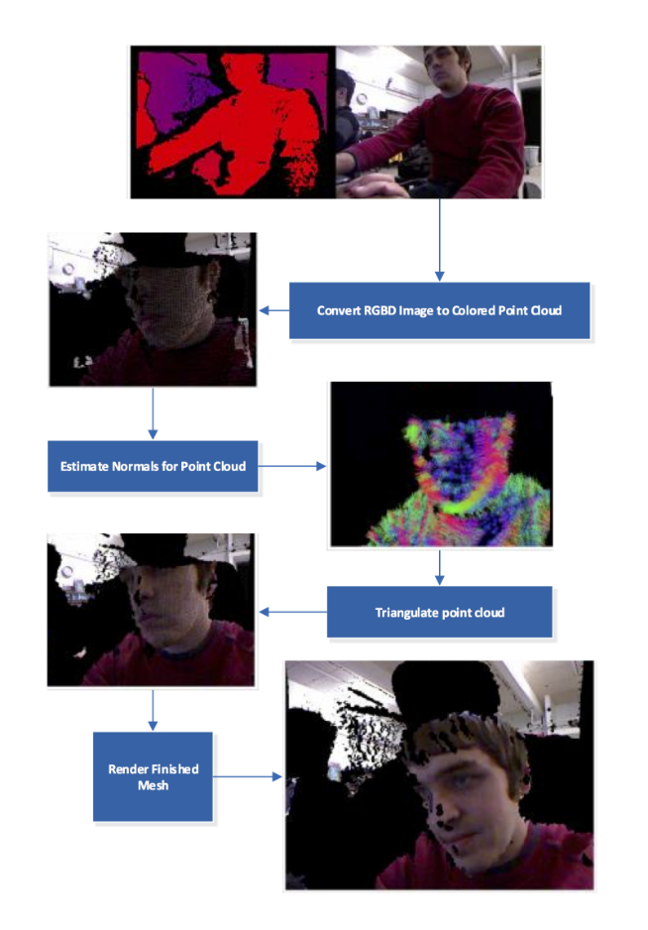
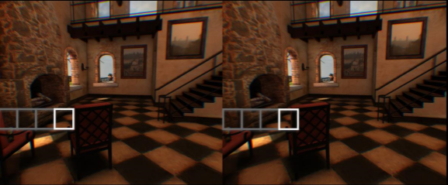
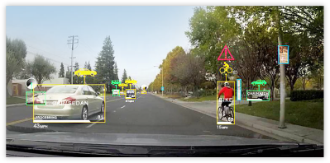
Where are GPUs used?
Graphics
  For games, simulation, etc.
  VR
GPU Computing
  Tango
  Automotive
Images: https://github.com/cboots/RGBD-to-Mesh, http://www.nvidia.com/object/drive-px.html and https://community.arm.com/servlet/JiveServlet/download/96891546-24706/5-mmg-siggraph2016-multiview-cass.pdf
Notes:
VR
Efficient multi-view rendering for each eye, e.g., geometry shader
High framerate
High resolution. 4K x 4K? http://blogs.valvesoftware.com/abrash/when-it-comes-to-resolution-its-all-relative/
Wide FOV requires lens distortion for a float surface – can distort in vertex shader. 90 or 120 degrees.
Need cool and low power for mobile
Tango
Depth-sensing cameras like Kinect
Tegra K1 SoC, 192-core Kepler
GPU runs computer vision algorithms
Automotive
Sensors – cars can “see” – GPS, cameras, lidar, radar, and ultrasonic
GPU – “think” and “learn”, computer vision and Deep Neural Networks (DNN)
Feature detection; path planning; map creation
NVIDIA
Working toward autonomous car

Slide 24
Course Topics
GPU architecture
GPU Architecture
Not to scale
Notes:
Focus GPU memory model and threading.
Differences, and now similarities, between GPU and CPU.

Slide 25

Course Topics
CUDA programming model for GPU Compute
CUDA
GPU Architecture
Not to scale
Notes:
Knowing GPU architecture is key to programming with CUDA.
Compute examples: image processing, computer vision, financial analysis, collision detection, path planning, etc.

Slide 26
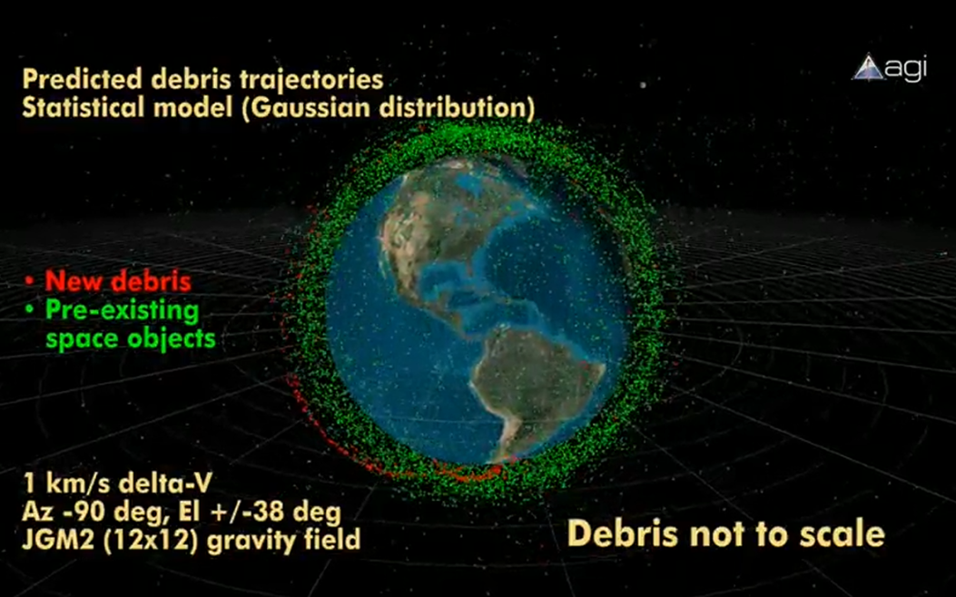
Course Topics
GPU Compute example: conjunction analysis
http://www.youtube.com/watch?v=dtT3pTh_q-8
Notes:
Hardware for a GPU solution is cheaper than a parallel CPU solution.

Slide 27
Course Topics
Parallel algorithms that form building blocks
Parallel Algorithms
CUDA
GPU Architecture
Not to scale
Notes:
Parallel reduction, scan (prefix sums), sorting, searching, and summed area tables.

Slide 28
Course Topics
Parallel Algorithms example: Scan
  Given:
  Compute:
  In parallel!
3
1
7
0
4
1
6
3
0
3
4
11
11
15
16
22

Slide 29
Course Topics
Historical and modern graphics pipeline
Parallel Algorithms
CUDA
Graphics Pipeline
GPU Architecture
Not to scale
Notes:
History of rasterization pipeline.
What the current generation pipeline looks like. Where is it going?

Slide 30
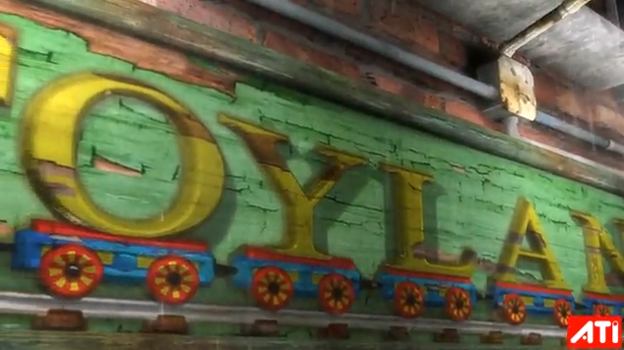
AMD Toyshop Demo
http://www.youtube.com/watch?v=LtxvpS5AYHQ
Notes:
http://developer.amd.com/media/gpu_assets/ToyShop-Eurographics_AnimationFestival.pdf
From 2006 (pre unified shader architecture, wow) – Radeon X1800 at 26-29 fps
Parallax Occlusion Mapping – self-shadows, perspective-correct: bricks, wood letters, sidewalks
28 MB vertex/index. 156 MB for (compressed) textures. 54 MB for framebuffers. Total 240 MB.
500 different shaders.
250 draw calls for 200-500K polygons and 0-22K particles
Post-processing effects for glow, blurry reflections, and rain
Water simulation on GPU using Euler integration (only SM 2.0!)

Slide 31
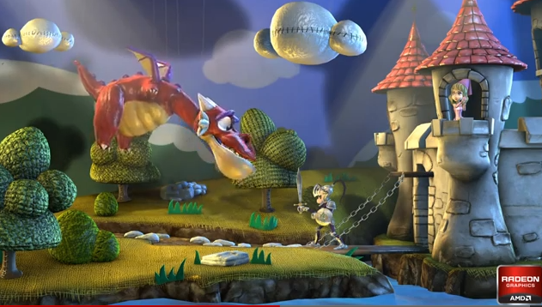
AMD Leo Demo
http://www.youtube.com/watch?v=zYweEn6DFcU
Notes:
http://developer.amd.com/Resources/documentation/samples/demos/pages/AMDRadeonHD7900SeriesGraphicsReal-TimeDemos.aspx
Also see - http://www.youtube.com/watch?v=s2y7e3Zm1xc
Complex materials AND many lights AND many light models.
Use compute to cull lights per tile. Forward shade per tile only with affecting lights.
One bounce global illumination effects by spawning virtual point light sources where light strikes a surface.
Multiple BRDF equations, realistic use of index of refraction, absorption based on wavelength for metals, etc.

Slide 32
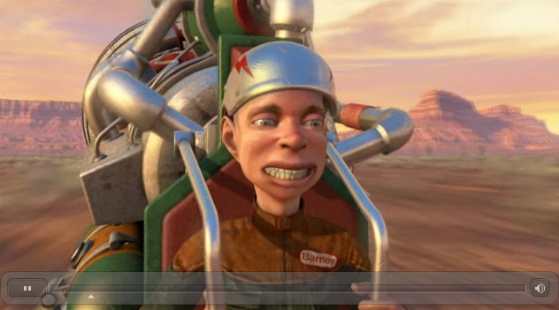
GPU Compute + Rendering
http://www.nvidia.com/object/GTX_400_games_demos.html
Notes:
Smoke - fluid simulation
Compute particles - bridge 1,000,000 particles
Terrain - Tessellation shader

Slide 33

Course Topics
Graphics APIs: WebGL
Parallel Algorithms
CUDA
WebGL
Graphics Pipeline
GPU Architecture
Not to scale

Slide 34
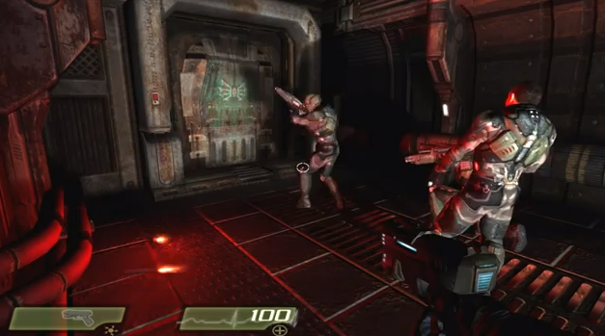
Turbulenz
http://www.youtube.com/watch?v=AJg_BmY9-8o
Notes:
http://www.shader.org/webglcamp/slides/s2_4.pdf
Quake 4 assets
1694 assets – compression and caching
353 lights, 346 particle systems – culling with portals and bounding-box trees
55 shading techniques, 451 materials – sort by technique and material
“huge number of dynamic lights and shadows, high quality animated skinned characters, particle systems with multiple stages, 2D GUIs and animations mapped onto 3D objects, and a great variety of materials and shading effects.”
“portal-based scene manager.”

Slide 35
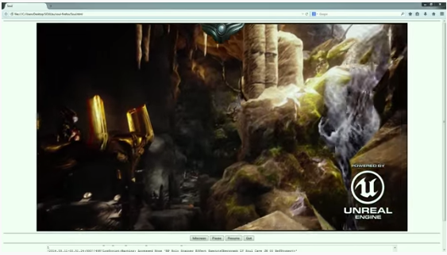
Unreal 4
https://blog.mozilla.org/blog/2014/03/12/mozilla-and-epic-preview-unreal-engine-4-running-in-firefox/

Slide 36
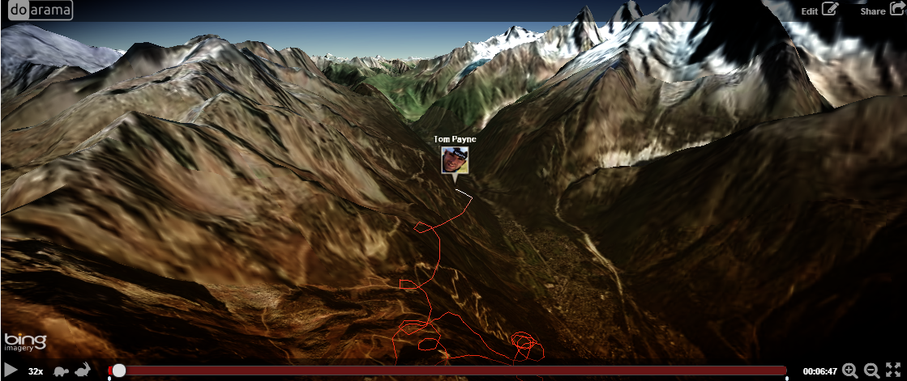
Doarama
http://www.doarama.com/

Slide 37
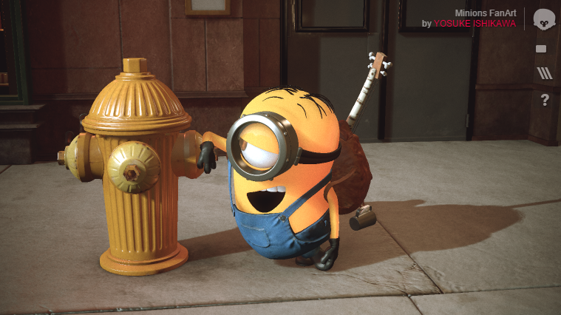
Marmoset Viewer
Notes:
PBR materials
IBL
http://www.marmoset.co/webglbof.html
http://www.marmoset.co/viewer/gallery

Slide 38
Course Topics
Mobile
Parallel Algorithms
CUDA
WebGL
Mobile
Graphics Pipeline
GPU Architecture
Not to scale

Slide 39
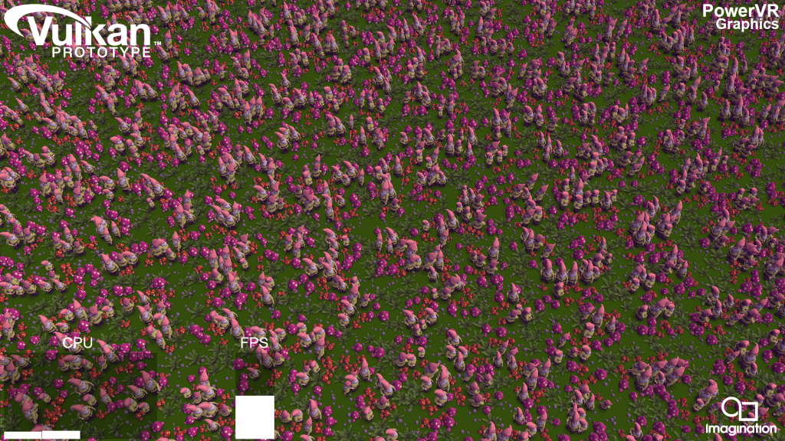

Course Topics
Vulkan
Parallel Algorithms
CUDA
WebGL
Mobile
Graphics Pipeline
GPU Architecture
Not to scale
Notes:
Video: https://www.youtube.com/watch?v=P_I8an8jXuM
Image and video from: http://blog.imgtec.com/powervr/trying-out-the-new-vulkan-graphics-api-on-powervr-gpus
Logo from https://www.khronos.org/news/logos

Slide 40
Course Topics
Performance!
Vulkan
Parallel Algorithms
CUDA
WebGL / OpenGL
Mobile
Graphics Pipeline
GPU Architecture
To scale!
Notes:
GPUs are about doing data-parallel problems quickly!
Walk clock performance. Not theoretical.

Slide 41
Course Topics
Topics are as time permits
We constantly adjust the schedule during the semester
Notes:
For example, we’ll replace a lecture with a guest lecture.

Slide 42
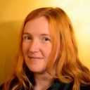
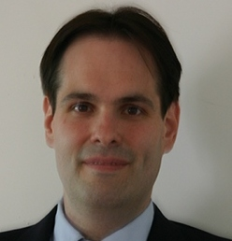
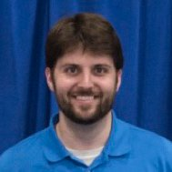
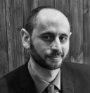

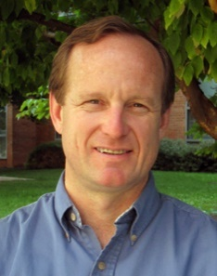
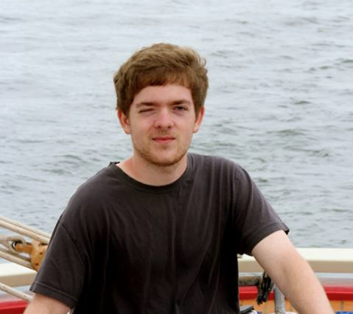

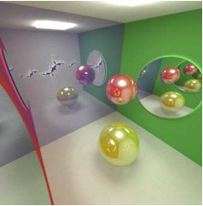
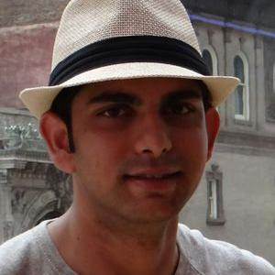
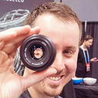

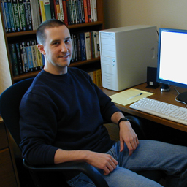



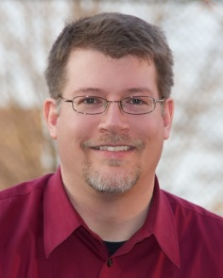
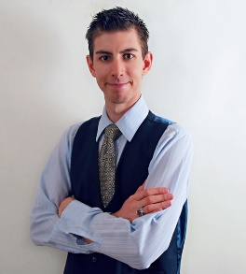
Past CIS 565 Guest Speakers
Shannon Woods
Google
Tim Kaldewey
IBM Research
Dave Kotfis
Bossa Nova Robotics
Tarek Sherif
BioDigital
Nicholas Brancaccio
Floored
David Breen
Drexel University
Sean Lilley
Formerly PGL
Ken Russell
Google
Liam Boone
Sandia National Labs
Shehzan Mohammed
ArrayFire
Jeff Russell
Marmoset
Kevin Ring
Formerly AGI
Eric Lengyel
Terathon Software
Eric Haines
Autodesk
Graham Sellers
AMD
Dave Shreiner
Formerly ARM
Milo Martin
Formerly Penn
Joseph Kider
Formerly Penn
Nicholas Brancaccio
Notes:
Fall 2015
Tarek Sherif, BioDigital
Dave Kotfis, Lockheed Martin (now Bossa Nova Robotics) (Penn alumnus)
Tim Kaldewey, IBM Research
Shannon Woods, Google
Fall 2014
Zakiuddin Shehzan Ayub Mohammed, ArrayFire (Penn alumnus)
Liam Boone, Sandia National Laboratories (Penn alumnus)
Tim Kaldewey, IBM Research
Ken Russell, Google
Sean Lilley, Cesium (formerly Philadelphia Game Lab) (Penn alumnus)
David Breen, Drexel University
Nicholas Brancaccio, Floored
Spring 2014 (CIS 700)
Tim Kaldewey, IBM Research
Jeff Russell, Marmoset
Fall 2013
Zakiuddin Shehzan Ayub Mohammed, ArrayFire (Penn alumnus)
Tim Kaldewey, IBM Research
Eric Haines, Autodesk
Eric Lengyel, Terathon Software
Kevin Ring, Data61 (formerly Analytical Graphics, Inc.)
Fall 2012
Tim Kaldewey, IBM Research
Sean Lilley, Cesium (formerly Philadelphia Game Lab) (Penn alumnus)
Dave Shreiner, ARM
Graham Sellers, AMD
Spring 2012
Tim Kaldewey, IBM Research
Spring 2011
Joseph Kider, Penn (now FL) (Penn alumnus)
Milo Martin, Penn

Slide 43



Fall 2016 Guest Lectures
Tentative

Slide 44
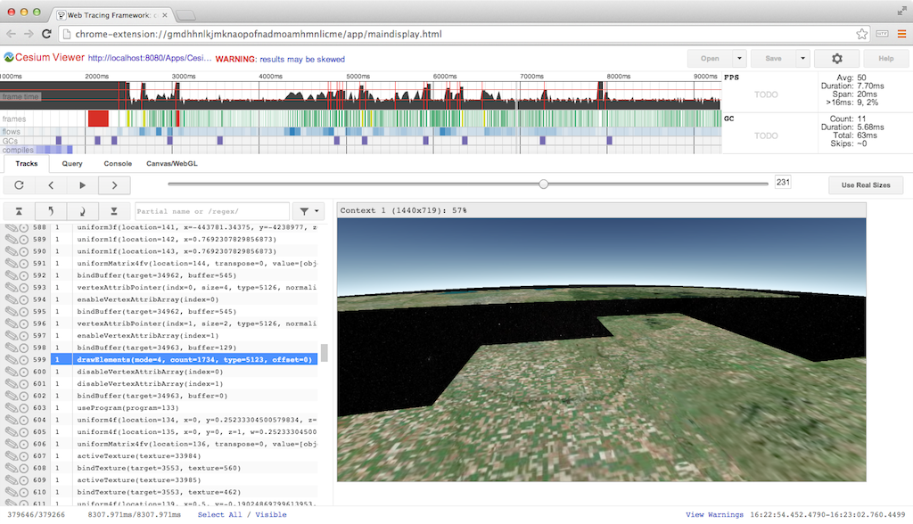
Hands-on Labs in Recitations
Tentatively
  GPU profiling and debugging with NVIDIA Nsight
  Open-source WebGL engines performance analysis
  Ray marching performance analysis
  Jetson TK1

Slide 45
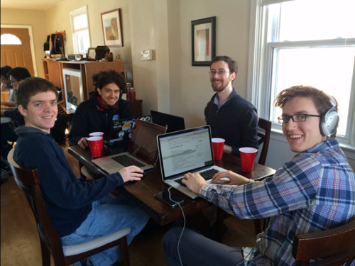
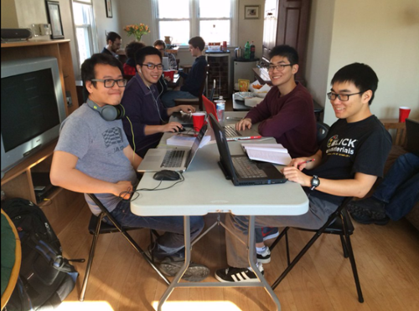
Code sprint
Notes:
http://www.seas.upenn.edu/~pcozzi/projects.html
In the past, have also done hackathons: http://blog.virtualglobebook.com/2012/12/hackathons-in-classroom.html

Slide 46
Grading
Projects 50%
Final Project 50%
Final 0%
“Projects” not “homework”
Notes:
Quest for knowledge vs. question for grades.
Some outstanding students don’t have great grades. Most students with great grades do well outside of school.
This is a pragmatic course about creating outstanding GPU/graphics developers. I don’t care if you can pass a test. No midterm. Mostly no written homework except performance analysis.
Rebrand homework as projects. Change culture. No one wants to do homework.

Slide 47
Projects
Each project has
  Coding
    Pick x of n, e.g., 3 of 5, plus open-ended parts
  Written performance analysis
  Write-up with screenshots and a video/demo
  Random in-class demos. Show, don’t tell.
Notes:
Practice writing and positioning your work.
Everyone needs to learn how to talk in front of a group and sell themselves. The demo will be the class following the due date.
In-class demos should focus on your unique features in the project – not the features everyone else also did.

Slide 48
Projects
Due at midnight on the due date
Submitted using GitHub
Late Policy
  Up to 1 week late: 50% deduction
  Use up to 4 bonus days over the semester to extend the due date without penalty
    Examples
      Extend 4 projects by 1 day each
      Extend 1 project by 4 days
      Extend 2 projects by 2 days each
    Can’t be used for the final project
Notes:
Time is EST. lol.

Slide 49
Intensity
Effort
Effort
Time
Time
Due date
Due date
Notes:
What can we learn from boxing?
Not to scale; ignore integrating to see the area of the region under the curve.
Actually, we can learn a lot more from boxing: continuous feedback, intensity, etc.
Avoid burning out or making mistakes at the very end. Avoid unforeseen problems. “Early and often.”
I suggest to move the peek even sooner. Hit it hard right away. Line up your effort with office hours, so you can get help early and late.

Slide 50
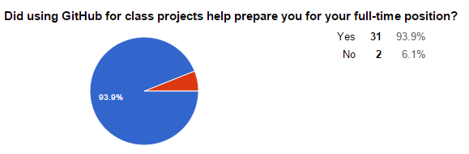
Alumni Survey Results - GitHub
Why didn’t it help?
  “I was familiar with git/github already. My employer uses centralized version control (Perforce).”
  “I am not working in a full-time position yet.”
Notes:
34 responses from CIS 565 alumni over six semesters (5 of which Patrick taught). The course is taught about once a year and has ~20 students.

Slide 51
Survey Results - GitHub
Why did it help?
  “Github is used extensively in the company I work for now. They also listed git as desired skill when recruiting for this position.”
Notes:
Most responses were similar to this. Companies are using git or GitHub, and are looking for students familiar it.

Slide 52

On Interviews…
  “Send me your code and then we’ll talk”
  - Christophe Riccio

Slide 53
Project Advice
Advice from Rich Geldreich (formerly Valve)
  Find (or create) an open source project that game devs use, and contribute to it in a very visible way. For example, we [Valve] recently hired the author/maintainer of the SDL library. Google actively recruits devs who write libraries they use. Intel hires open source driver devs that contribute to MESA.

Slide 54
Project Advice
Advice from Rich Geldreich
  Identify a need and fill it with an open source project (that uses a license liberal enough that devs can actually use it). For example, right now a lot of teams are trying to target OpenGL ES, OpenGL, and D3D9/11 and are struggling with how to write a single set of shaders that can be translated/compiled to all these targets.
  Become an authority on some topic and blog about it in a very
  visible/useful way.
Notes:
Common themes in Rich’s advice:
Find a real need
Be visible

Slide 55
Projects
Can be done as open source
  Build your code portfolio
Want to use private repos? Get an edu account
  https://education.github.com/

Slide 56
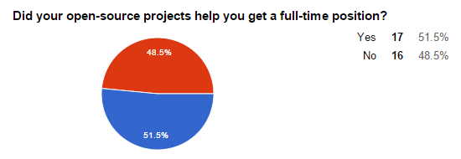
Survey Results – Open Source
Notes:
Keep in mind, it didn’t hurt the students who said No, and it helped 51.5%. I expect this to only increase as recruiting practices continue to change.
Several students also already had jobs before starting the course or received full-time positions based on their internships.

Slide 57
Survey Results – Open Source
“I have my personal website, and I have the github link on it. Employers are interested in the projects, and we had a great discussion. It's actually not about the coding part. I think code portfolio is not that popular when interviewing a candidate. The key part is still about the interview itself.”
Notes:
This quote is representative of many responses:
The project portfolio is useful: demos, videos
Employers generally don’t look at the code (or the student doesn’t realize it)
The interview itself is what matters

Slide 58
Survey Results – Open Source
“One of the companies I interviewed specifically went through my code samples on git and asked me questions based on that”
“A lot of companies are asking for my code sample on git.”
Notes:
Being asked about your own code is a great way to stack the odds in your favor.
I expect more companies to ask for code samples; as a hiring manager, I do.

Slide 59
Academic Integrity
http://www.upenn.edu/academicintegrity/
An academic integrity violation will result in the student receiving an F in this course
Get approval for all code you didn’t write yourself with the TAs in advance
Notes:
Example: for a depth-of-field project, it is OK to use a third-party library to load models, but it is not OK to use a depth-of-field fragment shader found in google.
Copying from another student is not OK. If two students have the same exact code, and it is wrong…
Be ready to explain any part of your code.
Violating academic integrity is bad for you, your peers, and your university. It literally steals time away from making the course better for everyone.

Slide 60
Survey Results – Academic Integrity
Based on your experience, do you think open-source projects increase the chance of academic integrity violations?
  “It is possible but in my experience for such specialized courses like GPU programming, most students are in it to win it.”
  “I do not. If anything it makes them much more blatant and therefore high-risk.”
  “If students want to share code, they can regardless of policies”
  “I also think having rendered images and README files publicly viewable online is great motivation for current students who want to one-up students from previous years.”

Slide 61
Final Projects
Final Projects often become projects
  Path tracer
  Deferred shading
  Forward+ renderer
Notes:
Progress: A half-semester project for a team is now a single-person project for a week!

Slide 62
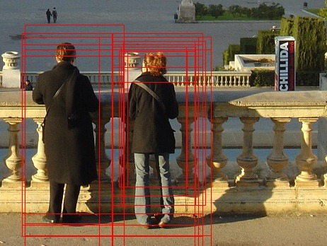
Fast Pedestrian Recognition on the GPU
Fan Deng – Spring 2011

Slide 63

Procedural Infinite City
Alice Yang – Spring 2012
Notes:
Demo: http://glsl.heroku.com/e#2306.2
Blog: http://y-alice.blogspot.com/2012/04/final-submission.html

Slide 64

GPU-Based Physically-Based Photorealistic Unbiased Pathtracer
Peter Kutz and Karl Li – Spring 2012
Notes:
Based on her GPU rasterizer, no OpenGL!

Slide 65

Non-Photorealistic Toon Rendering
Kong Ma – Fall 2012
Notes:
Based on her GPU rasterizer, no OpenGL!

Slide 66

WebGL Water Simulation
Hao Wu and Guanyu He – Fall 2013
Notes:
Demo: http://wuhao1117.github.io/WebGL-Ocean-FFT/
Info: http://www.wuhao.co/webgl-fft-ocean.html

Slide 67

Deferred Shading
Sijie Tian and Yuqin Shao – Fall 2013
Notes:
Demo: http://sijietian.com/WebGL/deferredshading/index.html
Article: https://hacks.mozilla.org/2014/01/webgl-deferred-shading/

Slide 68

Accelerated Stochastic Progressive Photon Mapping On GPU
Ishaan Singh, Yingting Xiao, Xiaoyan Zhu – Fall 2013
Notes:
Showed as student work at SIGGRAPH 2014

Slide 69

Uniform grid and kd-tree in CUDA
Jeremy Newlin and Danny Rerucha – Fall 2014
Notes:
Uniform grid now part of flocking project!

Slide 70

Forward+ Renderer using OpenGL/Compute Shaders
Bradley Crusco and Megan Moore – Fall 2015
Notes:
Uniform grid now part of flocking project!

Slide 71



Twitter
Notes:
Exciting for students to have their work noticed outside of class and the university.
Sometimes, someone famous will notice.
Open source isn’t necessary for twitter, but it helps drive engagement.
Dynamic geometry fractures with WebCL and WebGL by Kai Ninomiya and Jiatong He, https://twitter.com/pjcozzi/status/542364663166824450
Ocean simulation in Unity by Anda Li and Yehua Lyu, https://twitter.com/pjcozzi/status/542007352925642753
Rasterization pipeline byCheng-Tso Lin, https://twitter.com/pjcozzi/status/396613045553623040

Slide 72



Twitter
Notes:
https://twitter.com/pjcozzi/status/675447032836808704 (Brandon Jones liked, project based on his work)
https://twitter.com/thsherif/status/710785800632471556 (talk invite; independent study, not CIS 565, but same idea applies)
https://twitter.com/pjcozzi/status/656145309655957504

Slide 73

Shadertoy
https://www.shadertoy.com/view/4l2SzV

Slide 74

Closing Thoughts
I want CIS 565 to make a disproportional impact on you relative to other courses
Progress – students surpass teachers
Notes:
If an undergrad degree is 40 courses, one course is 2.5%. If an MS is 10 courses, than one course is 10%.
In 2007, I received an A+ in this course. The same work I did today would barely pass.
Through your final projects, everyone should surpass me in _at least_ one area of GPU programming.
https://twitter.com/sportscenter/status/764457750558543877

Slide 75
Reminders
Google Group
  Signup: https://groups.google.com/forum/#!forum/cis-565-fall-2016
Project 0 is out!
  https://github.com/CIS565-Fall-2016/Project0-CUDA-Getting-Started
LinkedIn
  Join our group: https://www.linkedin.com/groups/GPU-Programming-Architecture-6540935
Notes:
SIGGRAPH session on open-source projects in CIS 565: https://github.com/pjcozzi/Articles/tree/master/SIGGRAPH/2015

