Slide 1
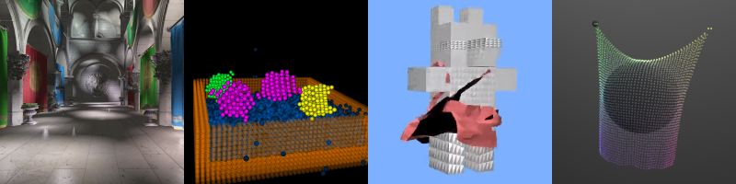
Deferred Shading
Patrick Cozzi
University of Pennsylvania
CIS 565 - Fall 2016

Slide 2
Renderer Design
Design an engine that renders lots of
  Objects with different materials
  Dynamic lights
  Different light types
Cleanly. Efficiently.
Notes:
Light types – point, spot, directional, etc.

Slide 3
Forward Rendering – Multi-Pass
  foreach light
  {
  foreach visible object
  {
  Render using shader for
  this material/light;
  accumulate in framebuffer;
  }
  }
Pros and cons?
Notes:
How do we accumulate? Blending.

Slide 4
Forward Rendering – Multi-Pass
One shader per material/light-type
Performance
  Need to do vertex transform, rasterization, material part of fragment shader, etc. multiple times for each object.
  Occluded fragments are shaded
  Not all lights affect the entire object
Notes:
Front-to-back and/or z-prepass can reduce/eliminate shading occluded fragments
Occluded fragments are shaded without a z-prepass.
Not all lights affect the entire object (performance)

Slide 5
Forward Rendering – Single Pass
  foreach visible object
  {
  find lights affecting object;
  Render all lights and materials using a single shader;
  }
Pros and cons?

Slide 6
Forward Rendering – Single Pass
Lots of shaders
  One shader per material/light-combination
  Hard to author shaders
  May require runtime compile/link
  Long ubershader increase compile times
  More potential shaders to sort by
Same as multi-pass
  Occluded fragments are shaded
  Not all lights affect the entire object
Notes:
Can’t compile in advance since there are so many combinations.
Front-to-back and/or z-prepass can reduce/eliminate shading occluded fragments
Occluded fragments are shaded without a z-prepass.
Not all lights affect the entire object (performance)

Slide 7
Deferred Rendering
  foreach visible object
  {
  write properties to g-buffer;
  }
  foreach light
  {
  compute light using g-buffer;
  accumulate in framebuffer;
  }
Pros and cons?

Slide 8
Deferred Rendering
Decouple lighting from scene complexity
Few shaders
  One per material
  One per light type
Only transform and rasterize each object once
Only light non-occluded objects
Notes:
Lighting does not depend on the number of objects

Slide 9
Deferred Rendering
Memory bandwidth usage - read g-buffer for each light
Recalculate full lighting equation for each light
Limited material properties in g-buffer
MSAA and translucency are difficult
Notes:
Does not handle transparent objects? Why? We only have g-buffer for front-most fragment.

Slide 10
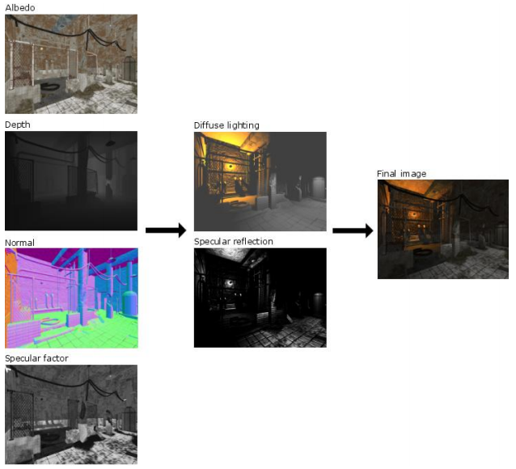
G-Buffer Layout in Leadwerks 2.1
Image from http://www.leadwerks.com/files/Deferred_Rendering_in_Leadwerks_Engine.pdf
Notes:
“Depth, normal, and specular factor are used to calculate diffuse lighting and specular reflection, which is then combined with the albedo color for the final image.”

Slide 11

G-Buffer Layout in Leadwerks 2.1
Image from http://www.leadwerks.com/files/Deferred_Rendering_in_Leadwerks_Engine.pdf
Notes:
The position is reconstructed from the fragment position and depth.

Slide 12
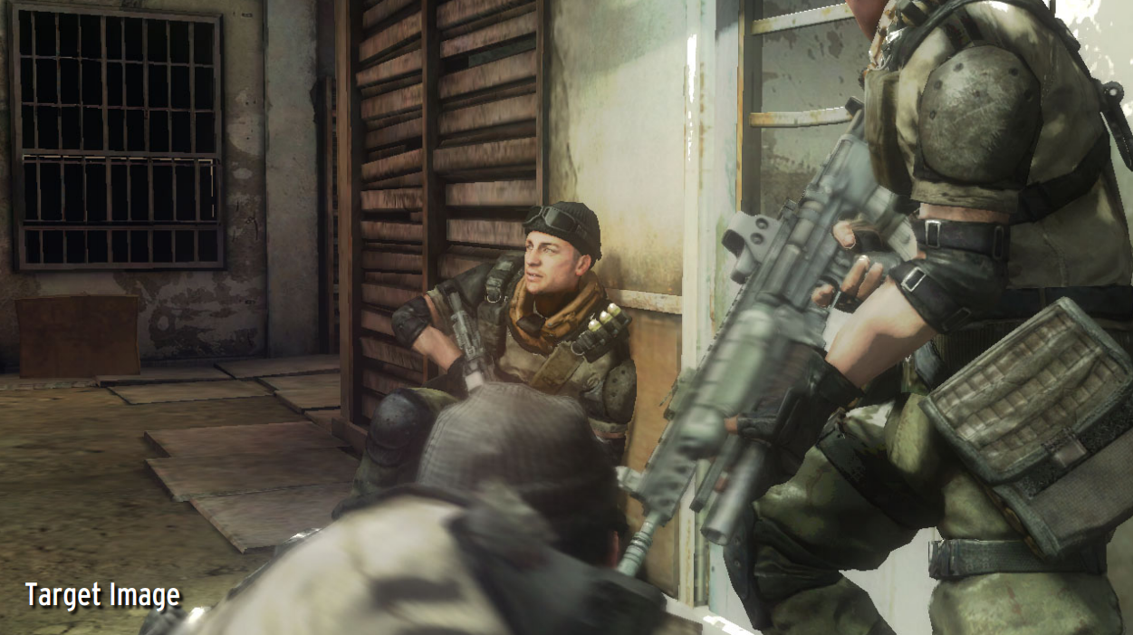
G-Buffer Layout in Killzone 2
Image from http://www.guerrilla-games.com/publications/dr_kz2_rsx_dev07.pdf

Slide 13
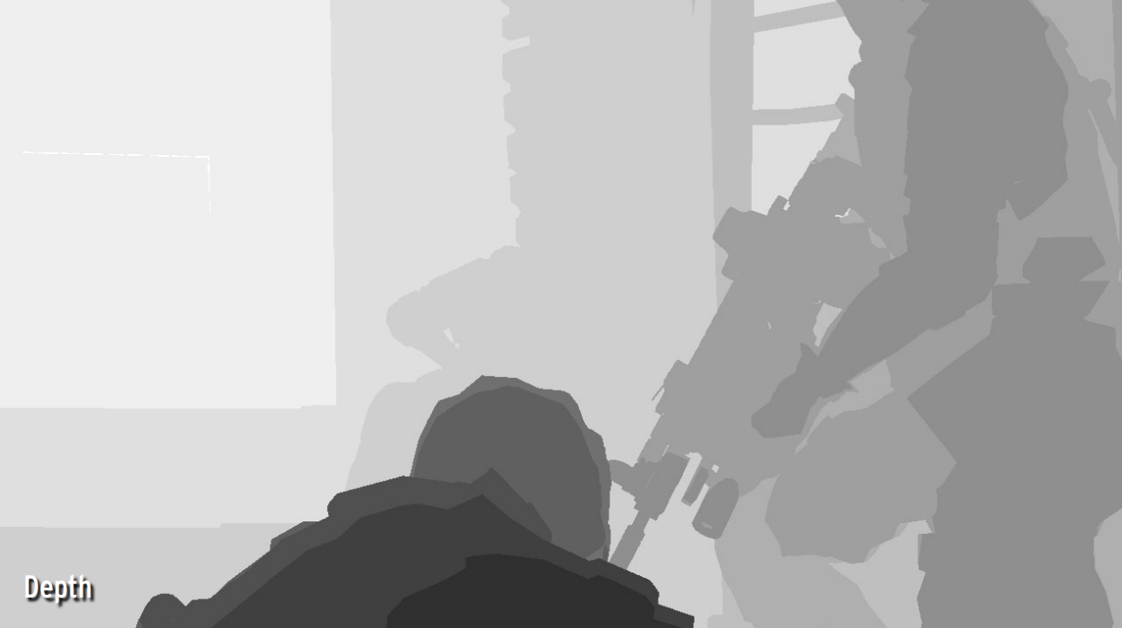
G-Buffer Layout in Killzone 2
Image from http://www.guerrilla-games.com/publications/dr_kz2_rsx_dev07.pdf

Slide 14
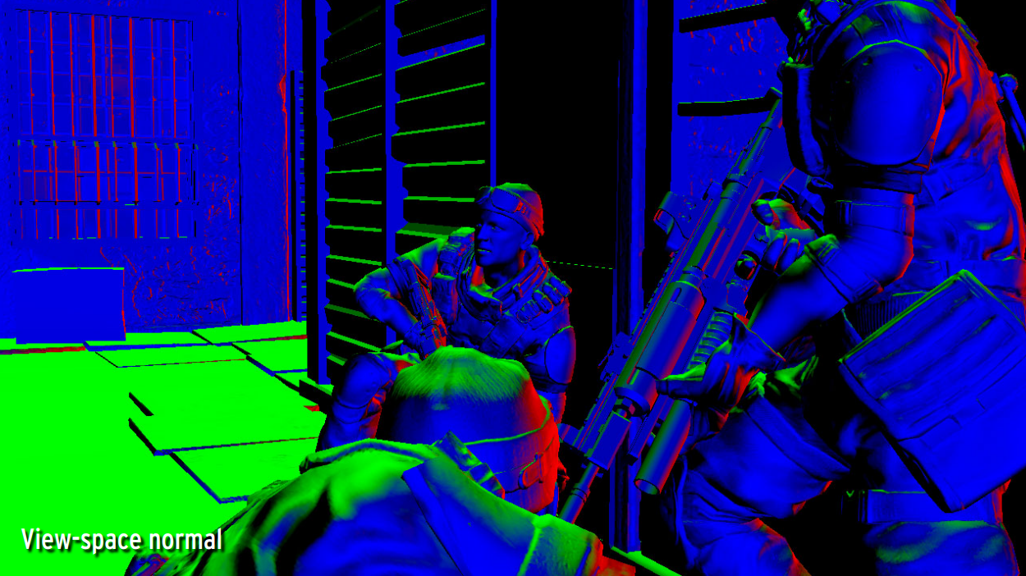
G-Buffer Layout in Killzone 2
Image from http://www.guerrilla-games.com/publications/dr_kz2_rsx_dev07.pdf

Slide 15
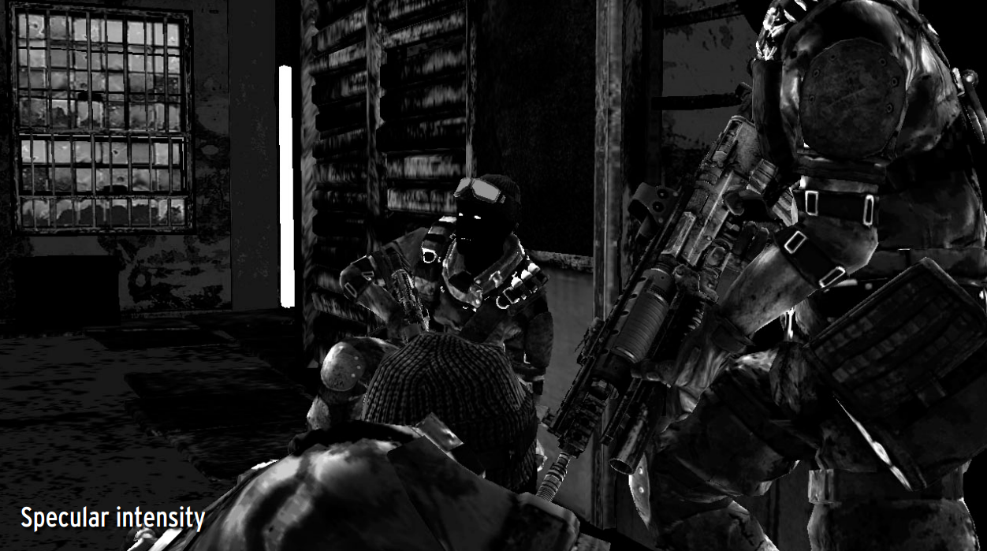
G-Buffer Layout in Killzone 2
Image from http://www.guerrilla-games.com/publications/dr_kz2_rsx_dev07.pdf

Slide 16
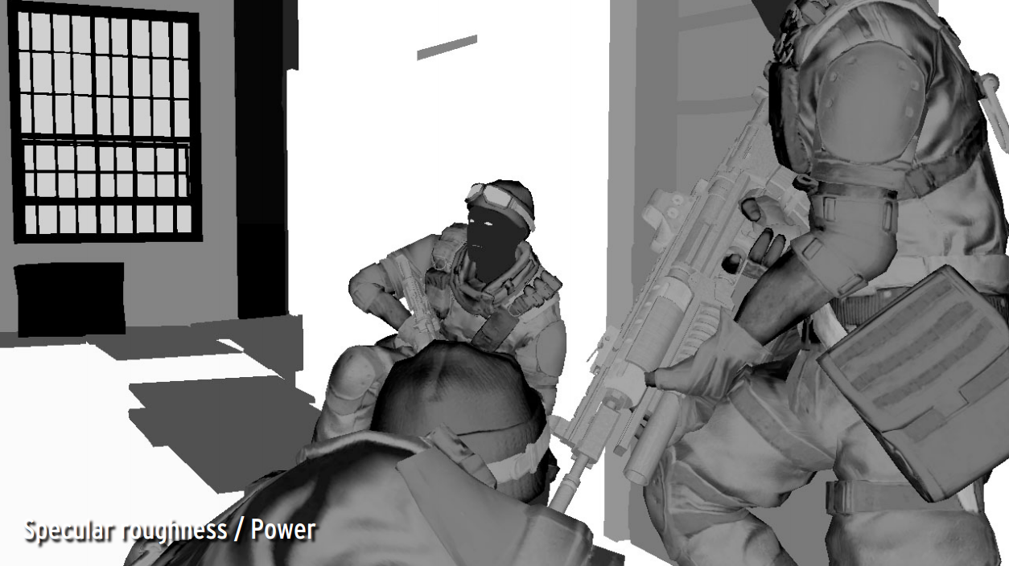
G-Buffer Layout in Killzone 2
Image from http://www.guerrilla-games.com/publications/dr_kz2_rsx_dev07.pdf

Slide 17
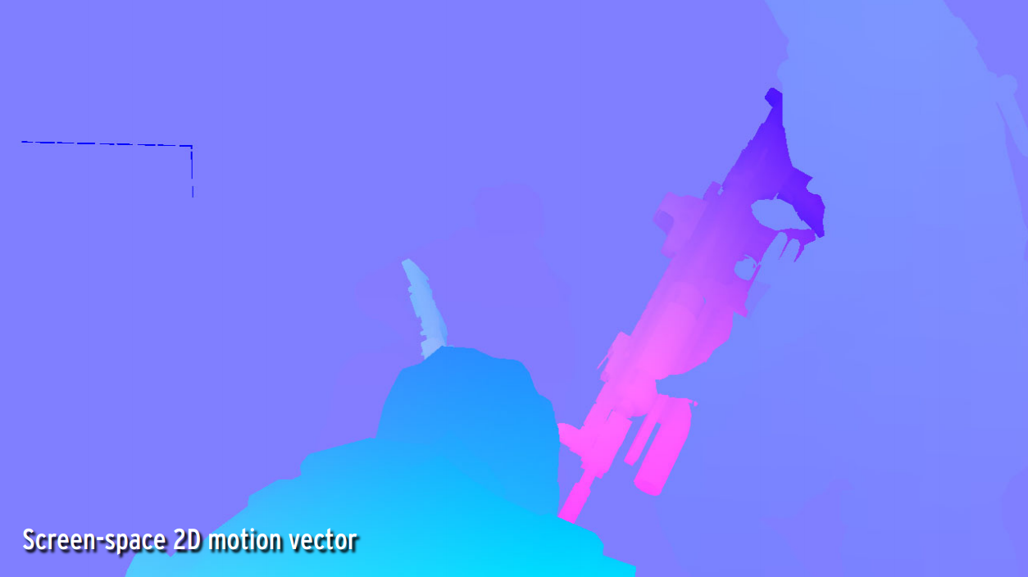
G-Buffer Layout in Killzone 2
Image from http://www.guerrilla-games.com/publications/dr_kz2_rsx_dev07.pdf

Slide 18
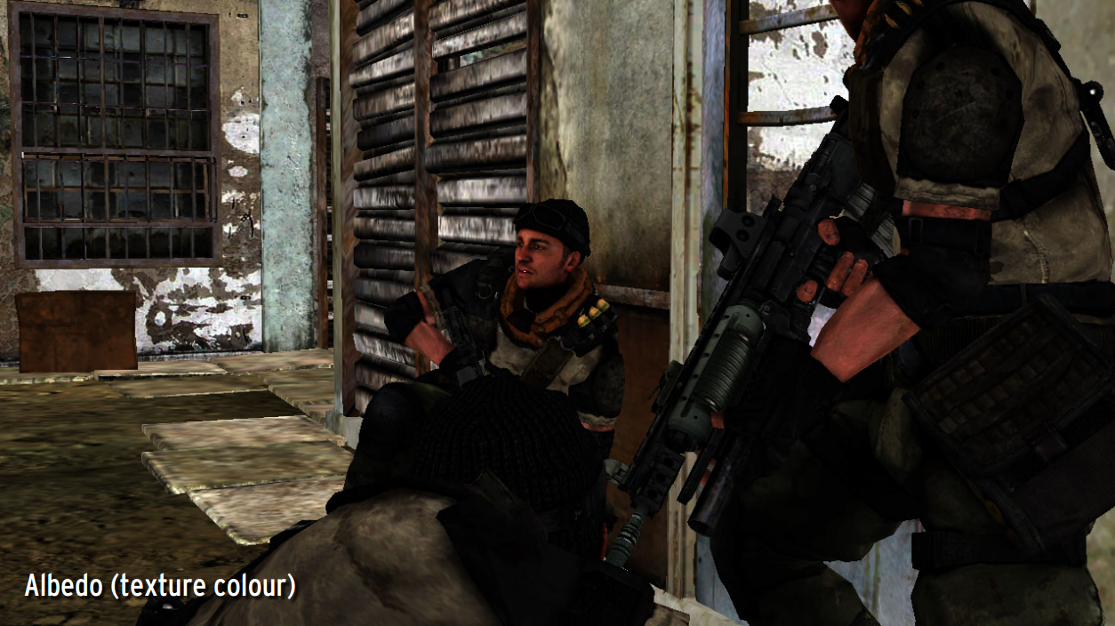
G-Buffer Layout in Killzone 2
Image from http://www.guerrilla-games.com/publications/dr_kz2_rsx_dev07.pdf

Slide 19
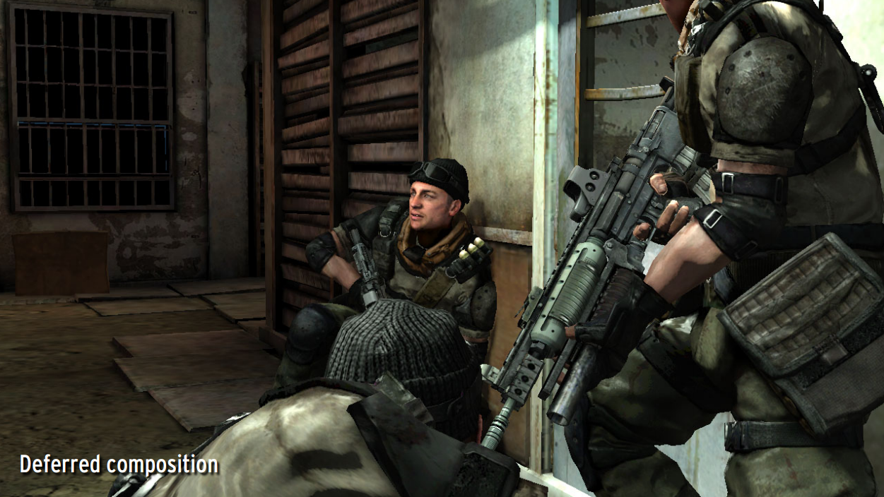
G-Buffer Layout in Killzone 2
Image from http://www.guerrilla-games.com/publications/dr_kz2_rsx_dev07.pdf

Slide 20
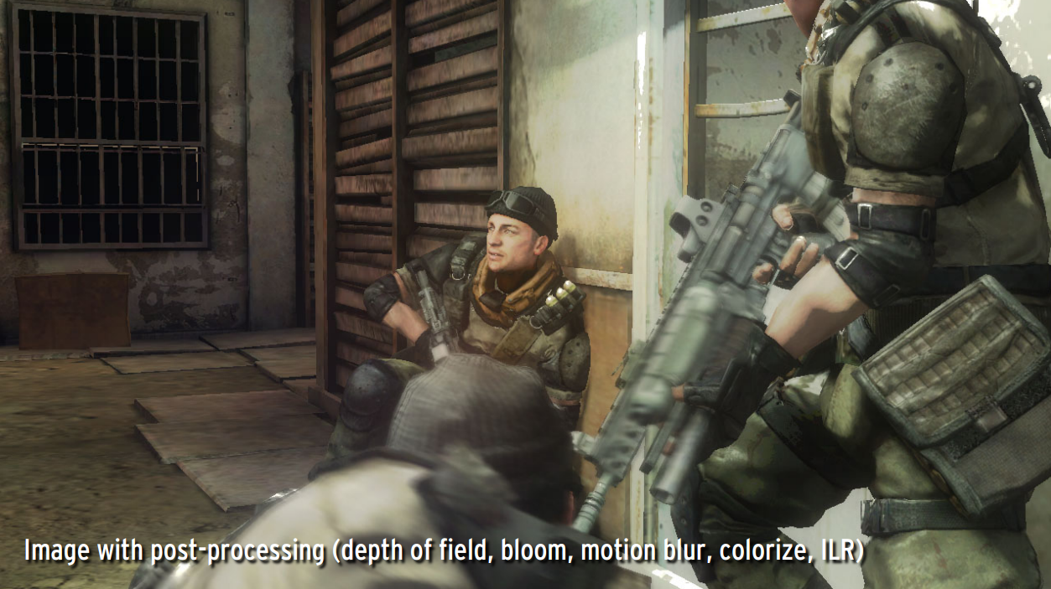
G-Buffer Layout in Killzone 2
Image from http://www.guerrilla-games.com/publications/dr_kz2_rsx_dev07.pdf

Slide 21
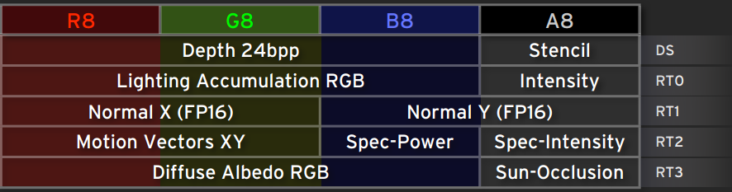
G-Buffer Layout in Killzone 2
Image from http://www.guerrilla-games.com/publications/dr_kz2_rsx_dev07.pdf
Notes:
* DS: 24-bit depth, 8-bit stencil
* RT0-RT3: 32-bit RGBA
* Light accumulation is output
* Normal Z is reconstructed since it is normalized
* Motion vector is in screen-space
* Specular power - stored as log2(original)/10.5 - High range and still high precision for low shininess
* Sun Occlusion - pre-rendered static sun shadows - Mixed with real-time sun shadow for higher quality

Slide 22
Light Accumulation Pass
Geometry for each light
  Full-screen quad/triangle
    with scissor/stencil test
  3D bounding geometry. Examples:
    Point light – sphere
    Spot light – cone
Image from http://marcinignac.com/blog/deferred-rendering-explained/
Notes:
Using geometry increases the vertex load but can decrease the fragment load since it can provide a tighter fit around the light’s area of influence. Some lights, like the sun, may not have bounding geometry and are better served by a full-screen quad.
Killzone 2 uses two passes and the stencil buffer to determine lit pixels, and a third pass to finally do lighting.
http://marcinignac.com/blog/deferred-rendering-explained/ - uses front facing culling and GREATER depth test

Slide 23
Optimizing Light Accumulation
Overlapping spheres: use additive blending
Images from http://marcinignac.com/blog/deferred-rendering-explained/

Slide 24
Optimizing Light Accumulation
Render backfaces only (use frontface culling)
Set depth test to GREATER
Now pixels need to belong to an object and be inside a sphere
Image from http://marcinignac.com/blog/deferred-rendering-explained/

Slide 25
Optimizing Light Accumulation
Demo: http://marcinignac.com/blog/deferred-rendering-explained/demo/

Slide 26
WebGL Demo
https://hacks.mozilla.org/2014/01/webgl-deferred-shading/
By Yuqin Shao and Sijie Tian, CIS 565 alumni

Slide 27
WEBGL_draw_buffers performance impact
Helps most when g-buffer pass is expensive
(high scene complexity)
Helps less when light accumulation pass is expensive
Notes:
On the left, MRT is ~4x better since the g-buffer pass is so expensive.
On the right, MRT is ~1.7x better since the light accumulation pass is so expensive.

Slide 28
Tile-Based Deferred Shading
Divide screen into 2D tiles, e.g., 16x16 pixels
Determine which lights influence which tiles light-tile info
  CPU or compute shader!
Light accumulation pass
  Read g-buffer once
    Save bandwidth compared
    to once per light
  Use light-tile info to find
  which lights affect a pixel
Notes:
Black tiles – no lights
White tiles – most lights

Slide 29
Tile-Based Deferred Shading
Divide screen into 2D tiles, e.g., 16x16 pixels
Determine which lights influence which tiles light-tile info
  CPU or compute shader!
Light accumulation pass
  Read g-buffer once
    Save bandwidth compared
    to once per light
  Use light-tile info to find
  which lights affect a pixel
Notes:
Black tiles – no lights
White tiles – most lights

Slide 30
Tile-Based Deferred Shading
Notes:
Left: 32x32 tiles
“Smaller tiles require more JavaScript overhead to create light-tile information, but less computation in the lighting shader?

Slide 31
References
Deferred Rendering in Killzone 2 – Michal Valient
  http://www.guerrilla-games.com/publications/dr_kz2_rsx_dev07.pdf
Deferred Rendering in Leadwerks Engine - Josh Klint
  http://www.leadwerks.com/files/Deferred_Rendering_in_Leadwerks_Engine.pdf
Light Pre-Pass – Wolfgang Engel
  http://www.slideshare.net/cagetu/light-prepass
Compact Normal Storage for Small G-Buffers – Aras Pranckevičius
  http://aras-p.info/texts/CompactNormalStorage.html
WebGL Deferred Shading
  https://hacks.mozilla.org/2014/01/webgl-deferred-shading/
Deferred Rendering Explained
  http://marcinignac.com/blog/deferred-rendering-explained/
WebGL Deferred Shading (Floored)
  http://www.floored.com/blog/2015webgl-deferred-shading-gbuffer-floating-point-texture/

