Slide 1
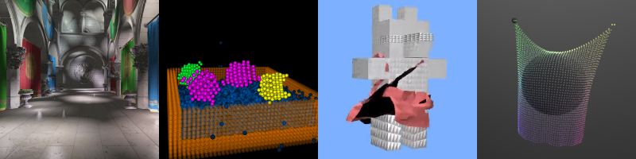
Introduction to CUDA. Part 1
Patrick Cozzi
University of Pennsylvania
CIS 565 - Fall 2016

Slide 2
Acknowledgements
Many slides are from David Kirk and Wen-mei Hwu’s UIUC course:
    http://courses.engr.illinois.edu/ece498/al/

Slide 3
GPU Computing History: APIs
2001/2002 – researchers see GPU as data-parallel coprocessor
  The GPGPU field is born
2007 – NVIDIA releases CUDA
  CUDA – Compute Uniform Device Architecture
  GPGPU shifts to GPU Computing
2008 – Khronos releases OpenCL specification
2013 – Khronos releases OpenGL compute shaders
2015 - Khronos releases Vulkan and SPIR-V
Notes:
Compute shaders have been in Direct3D for a while.
WebCL never caught on.

Slide 4
CUDA Terminology
Host – typically the CPU
  Code written in ANSI C
Device – typically the GPU (data-parallel)
  Code written in extended ANSI C
Host and device have separate memories
  Except for SoC
CUDA Program
  Contains both host and device code

Slide 5
CUDA Terminology
Kernel – data-parallel function
  Invoking a kernel creates lightweight threads on the device
  Threads are generated and scheduled with hardware
Similar to a shader in OpenGL/WebGL/Vulkan.

Slide 6
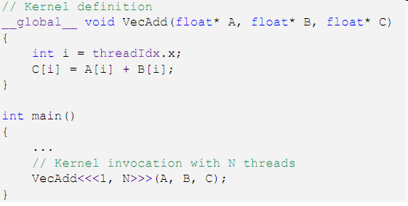
CUDA Kernels
Executed N times in parallel by N different CUDA threads
Thread Index
Declaration
Specifier
Execution
Configuration
Notes:
threadIdx is a 3-component vector

Slide 7
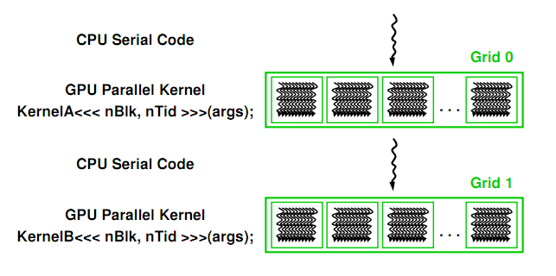
CUDA Program Execution
Image from: http://courses.engr.illinois.edu/ece498/al/textbook/Chapter2-CudaProgrammingModel.pdf

Slide 8
Thread Hierarchies
Grid – one or more thread blocks
  1D or 2D
Block – array of threads
  1D, 2D, or 3D
  Each block in a grid has the same number of threads
  Each thread in a block can
    Synchronize
    Access shared memory

Slide 9
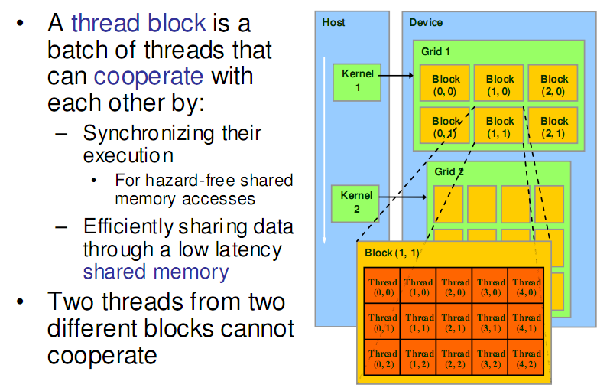
Thread Hierarchies
Image from: http://courses.engr.illinois.edu/ece498/al/textbook/Chapter2-CudaProgrammingModel.pdf

Slide 10
Thread Hierarchies
Block – 1D, 2D, or 3D
  Example: Index into vector, matrix, volume

Slide 11
Thread Hierarchies
Thread ID: Scalar thread identifier
Thread Index: threadIdx
1D: Thread ID == Thread Index
2D with size (D_{x}, D_{y})
  Thread ID of index (x, y) == x + y D_{x}
3D with size (D_{x}, D_{y,} D_{z})
  Thread ID of index (x, y, z) == x + y D_{x} + z D_{x} D_{y}

Slide 12
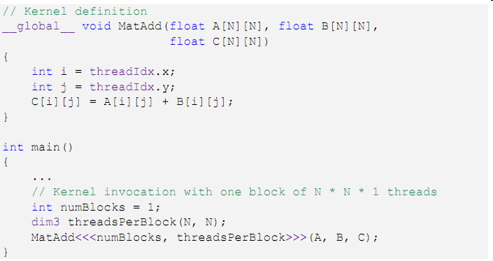
Thread Hierarchies
2D Index
1 Thread Block
2D Block
Notes:
Using 2D so does not need to explicitly compute 1D thread ID from x and y

Slide 13
Thread Hierarchies
Thread Block
  Group of threads
    G80 and GT200: Up to 512 threads
    Fermi, Kepler, Maxwell, Pascal: Up to 1024 threads
  Reside on same processor core
  Share memory of that core

Slide 14
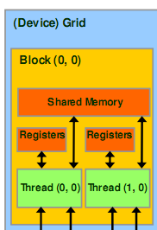
Thread Hierarchies
Thread Block
  Group of threads
    G80 and GT200: Up to 512 threads
    Fermi, Kepler, Maxwell, Pascal: Up to 1024 threads
  Reside on same processor core
  Share memory of that core
Image from: http://courses.engr.illinois.edu/ece498/al/textbook/Chapter2-CudaProgrammingModel.pdf

Slide 15
Thread Hierarchies
Block Index: blockIdx
Dimension: blockDim
  1D or 2D

Slide 16
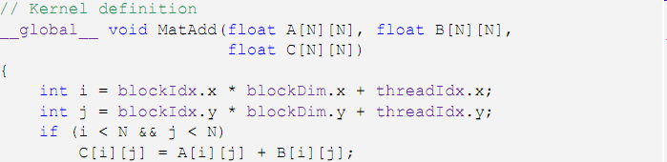
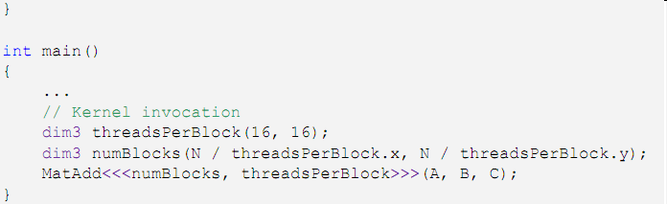
Thread Hierarchies
16x16
Threads per block
2D Grid
2D Thread Block

Slide 17
Thread Hierarchies
Example: N = 32
  16x16 threads per block (independent of N)
    threadIdx ([0, 15], [0, 15])
  2x2 thread blocks in grid
    blockIdx ([0, 1], [0, 1])
    blockDim = 16
i = [0, 1] * 16 + [0, 15]

Slide 18
Thread Hierarchies
Blocks execute independently
  In any order: parallel or series
  Scheduled in any order by any number of cores
    Allows code to scale with core count

Slide 19
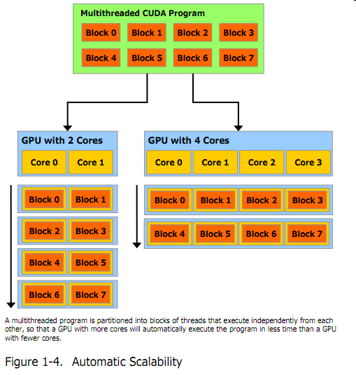
Thread Hierarchies
Image from: http://developer.download.nvidia.com/compute/cuda/3_2_prod/toolkit/docs/CUDA_C_Programming_Guide.pdf
Notes:
Scheduled by the CUDA runtime

Slide 20
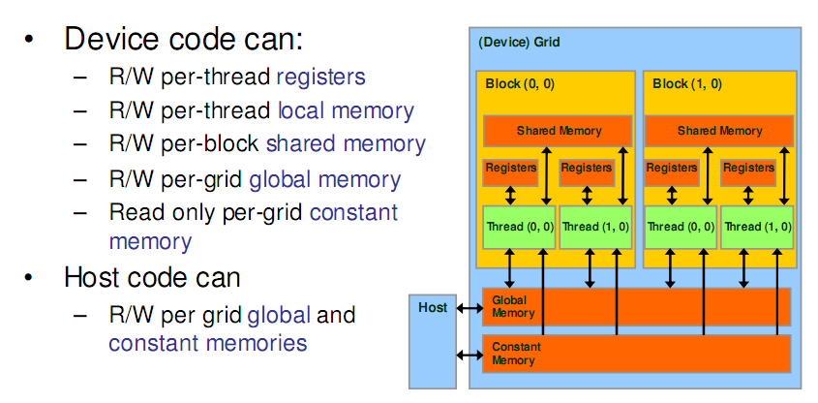
CUDA Memory Transfers
Image from: http://courses.engr.illinois.edu/ece498/al/textbook/Chapter2-CudaProgrammingModel.pdf

Slide 21
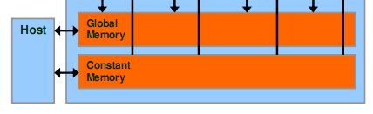
CUDA Memory Transfers
Host can transfer to/from device
  Global memory
  Constant memory
Image from: http://courses.engr.illinois.edu/ece498/al/textbook/Chapter2-CudaProgrammingModel.pdf

Slide 22
CUDA Memory Transfers
cudaMalloc()
  Allocate global memory on device
cudaFree()
  Frees memory
Image from: http://courses.engr.illinois.edu/ece498/al/textbook/Chapter2-CudaProgrammingModel.pdf

Slide 23
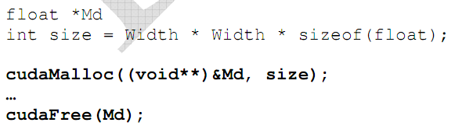
CUDA Memory Transfers
Code from: http://courses.engr.illinois.edu/ece498/al/textbook/Chapter2-CudaProgrammingModel.pdf

Slide 24
CUDA Memory Transfers
Size in bytes
Pointer to device memory
Code from: http://courses.engr.illinois.edu/ece498/al/textbook/Chapter2-CudaProgrammingModel.pdf

Slide 25
CUDA Memory Transfers
cudaMemcpy()
  Memory transfer
    Host to host
    Host to device
    Device to host
    Device to device
Host
Device
Global Memory

Slide 26
CUDA Memory Transfers
cudaMemcpy()
  Memory transfer
    Host to host
    Host to device
    Device to host
    Device to device
Host
Device
Global Memory

Slide 27
CUDA Memory Transfers
cudaMemcpy()
  Memory transfer
    Host to host
    Host to device
    Device to host
    Device to device
Host
Device
Global Memory

Slide 28
CUDA Memory Transfers
cudaMemcpy()
  Memory transfer
    Host to host
    Host to device
    Device to host
    Device to device
Host
Device
Global Memory

Slide 29
CUDA Memory Transfers
cudaMemcpy()
  Memory transfer
    Host to host
    Host to device
    Device to host
    Device to device
Host
Device
Global Memory

Slide 30
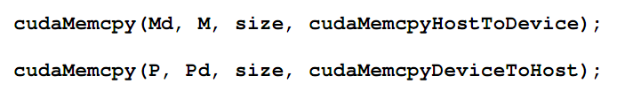
CUDA Memory Transfers
Destination (device)
Source (host)
Host to device
Host
Device
Global Memory
Code from: http://courses.engr.illinois.edu/ece498/al/textbook/Chapter2-CudaProgrammingModel.pdf

Slide 31
CUDA Memory Transfers
Host
Device
Global Memory
Code from: http://courses.engr.illinois.edu/ece498/al/textbook/Chapter2-CudaProgrammingModel.pdf

Slide 32
Matrix Multiply Reminder
Vectors
Dot products
Row major or column major?
Dot product per output element

Slide 33
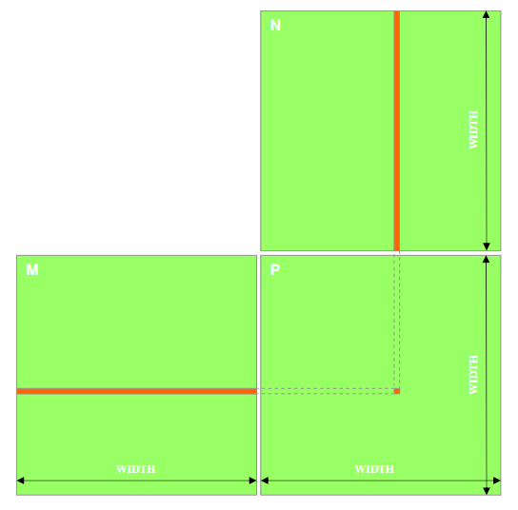
Matrix Multiply
P = M * N
Assume M and N are square for simplicity
Image from: http://courses.engr.illinois.edu/ece498/al/textbook/Chapter2-CudaProgrammingModel.pdf

Slide 34
Matrix Multiply
1,000 x 1,000 matrix
  1,000,000 dot products
    Each 1,000 multiples and 1,000 adds
Notes:
Or 999 adds depending on the code.

Slide 35
Matrix Multiply: CPU Implementation
void MatrixMulOnHost(float* M, float* N, float* P, int width)‏
{
for (int i = 0; i < width; ++i)‏
for (int j = 0; j < width; ++j)
{
float sum = 0;
for (int k = 0; k < width; ++k)
{
float a = M[i * width + k];
float b = N[k * width + j];
sum += a * b;
}
P[i * width + j] = sum;
}
}
Code from: http://courses.engr.illinois.edu/ece498/al/lectures/lecture3%20cuda%20threads%20spring%202010.ppt
Notes:
Row major. The inner most loop goes across a row of M, and down a column of N.

Slide 36
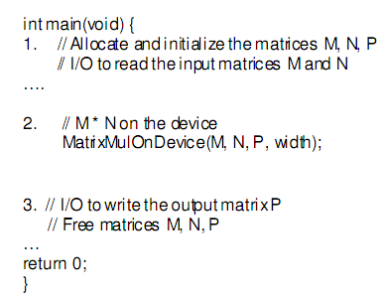
Matrix Multiply: CUDA Skeleton
Code from: http://courses.engr.illinois.edu/ece498/al/textbook/Chapter2-CudaProgrammingModel.pdf

Slide 37
Matrix Multiply
Step 1
  Add CUDA memory transfers to the skeleton

Slide 38
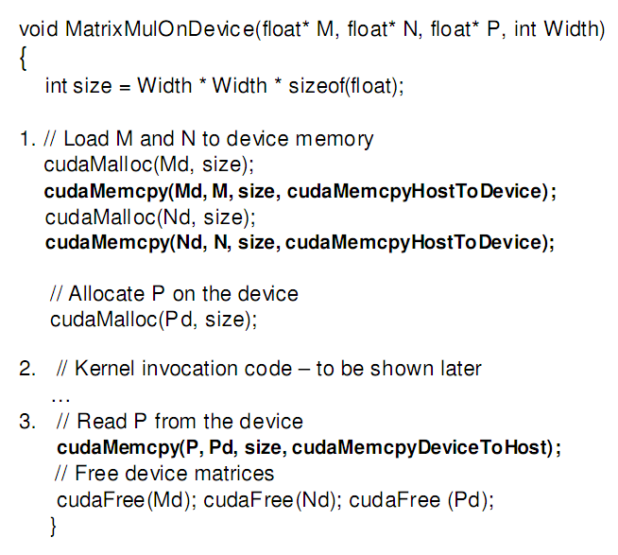
Matrix Multiply: Data Transfer
Allocate input
Code from: http://courses.engr.illinois.edu/ece498/al/textbook/Chapter2-CudaProgrammingModel.pdf
Notes:
Error in cudaMalloc calls: should pass address of point, e.g., “(void *)&Md”

Slide 39
Matrix Multiply: Data Transfer
Allocate output
Code from: http://courses.engr.illinois.edu/ece498/al/textbook/Chapter2-CudaProgrammingModel.pdf

Slide 40
Matrix Multiply: Data Transfer
Code from: http://courses.engr.illinois.edu/ece498/al/textbook/Chapter2-CudaProgrammingModel.pdf

Slide 41
Matrix Multiply: Data Transfer
Read back from device
Code from: http://courses.engr.illinois.edu/ece498/al/textbook/Chapter2-CudaProgrammingModel.pdf

Slide 42
Matrix Multiply
Step 2
  Implement the kernel in CUDA C

Slide 43
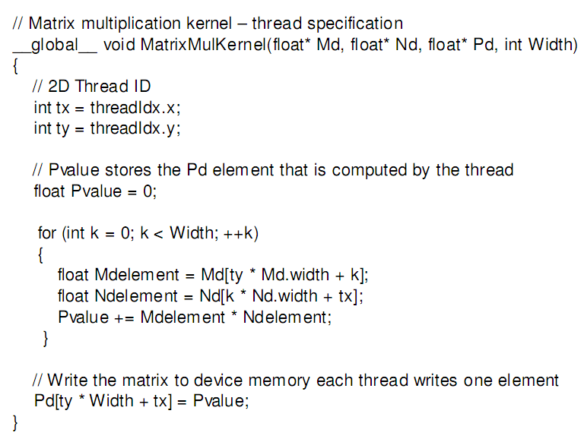
Matrix Multiply: CUDA Kernel
Accessing a matrix, so using a 2D block
Code from: http://courses.engr.illinois.edu/ece498/al/textbook/Chapter2-CudaProgrammingModel.pdf

Slide 44
Matrix Multiply: CUDA Kernel
Each kernel computes one output
Code from: http://courses.engr.illinois.edu/ece498/al/textbook/Chapter2-CudaProgrammingModel.pdf

Slide 45
Matrix Multiply: CUDA Kernel
Where did the two outer for loops in the CPU implementation go?
Code from: http://courses.engr.illinois.edu/ece498/al/textbook/Chapter2-CudaProgrammingModel.pdf

Slide 46
Matrix Multiply: CUDA Kernel
No locks or synchronization, why?
Code from: http://courses.engr.illinois.edu/ece498/al/textbook/Chapter2-CudaProgrammingModel.pdf

Slide 47
Matrix Multiply
Step 3
  Invoke the kernel in CUDA C

Slide 48
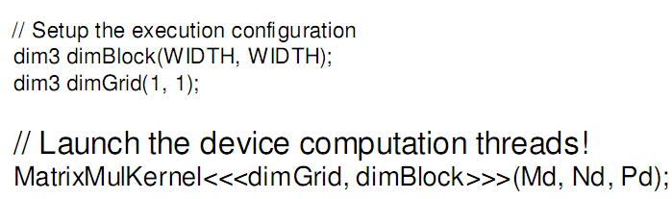
Matrix Multiply: Invoke Kernel
One block with width by width threads
Code from: http://courses.engr.illinois.edu/ece498/al/textbook/Chapter2-CudaProgrammingModel.pdf

Slide 49
Matrix Multiply
What is the major performance problem with our implementation?
What is the major limitation?
Notes:
Global memory access
Matrix size is limited by block size

Slide 50







Matrix Multiply
Nd
Grid 1
One Block of threads compute matrix Pd
  Each thread computes one element of Pd
Each thread
  Loads a row of matrix Md
  Loads a column of matrix Nd
  Perform one multiply and addition for each pair of Md and Nd elements
  Compute to off-chip memory access ratio close to 1:1 (not very high)‏
Size of matrix limited by the number of threads allowed in a thread block
Block 1
Thread
(2, 2)‏
48
WIDTH
Md
Pd
Slide from: http://courses.engr.illinois.edu/ece498/al/lectures/lecture2%20cuda%20spring%2009.ppt

