Slide 1

GPU Architecture Overview
Patrick Cozzi
University of Pennsylvania
CIS 565 - Fall 2016

Slide 2
Acknowledgements
CPU slides
  Varun Sampath, NVIDIA. Penn alumnus
GPU slides
  Kayvon Fatahalian, CMU
  Mike Houston, NVIDIA

Slide 3
CPU and GPU Trends
FLOPS – FLoating-point OPerations per Second
GFLOPS - One billion (10⁹) FLOPS
TFLOPS – 1,000 GFLOPS
Notes:
FLOPS are not a perfect measurement because of memory access, instruction mix, branches, etc. Peak FLOPS are idealistic, but not often reached in practice. FMA is one instruction.
TFLOPS – 1,000 GFLOPS / 1 trillion FLOPS

Slide 4
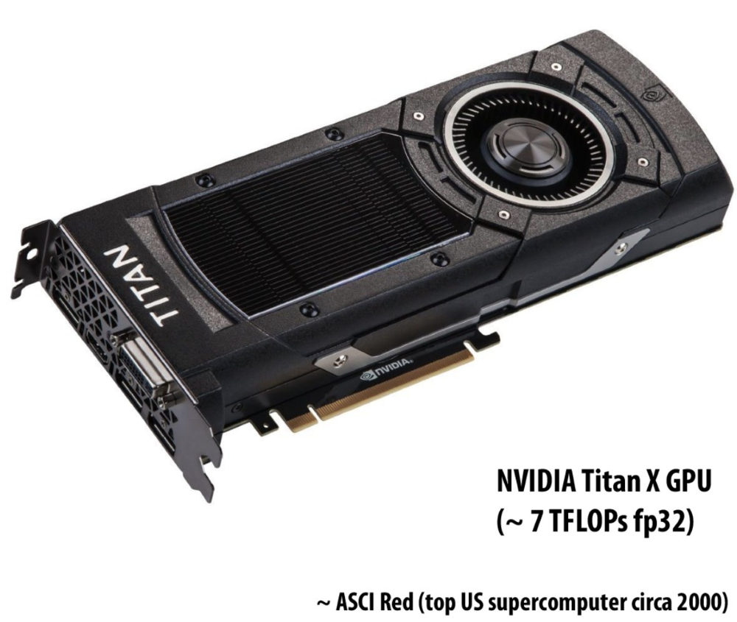
Slide from: http://graphics.cs.cmu.edu/courses/15769/fall2016/lecture/introhwreview/slide_014

Slide 5
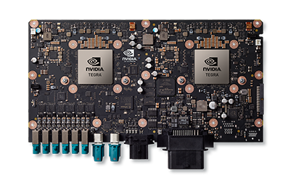
7.5 TFLOPS in your car!
NVIDIA DRIVE PX 2
  Up to
    2 Tegra SoCs (2.5 TFLOPS)
    2 Pascal GPUs (5 TFLOPS)
Image from: http://www.nvidia.com/object/drive-px.html
Notes:
Note that this is multiple GPUs, not one like the Titan on the previous slide.
Fuse data from 12 cameras, lidar, radar, and ultrasonic sensors.
Deep Neural Networks (DNN) for detection and classification.

Slide 6
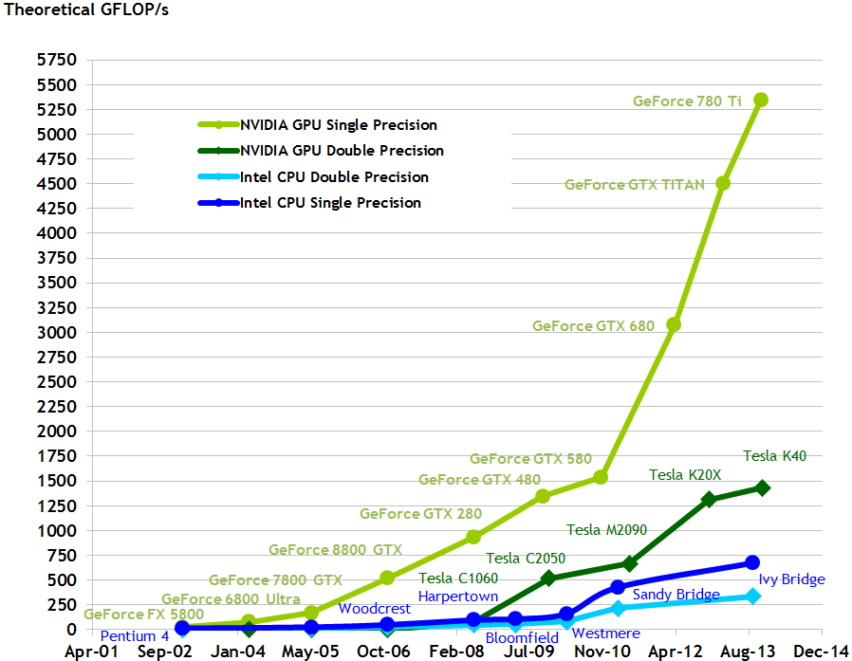
CPU and GPU Compute Trends
Chart from: http://docs.nvidia.com/cuda/cuda-c-programming-guide/
Notes:
Moore’s Law – the number of transistors on a chip will double about every two year (not 18 months, that was reference to performance)

Slide 7
FLOP per…
Single-core performance slowing since 2003
  Power and heat limits
GPUs delivery higher FLOP per
  watt
  mm
  dollar
Notes:
See http://www.gotw.ca/publications/concurrency-ddj.htm

Slide 8
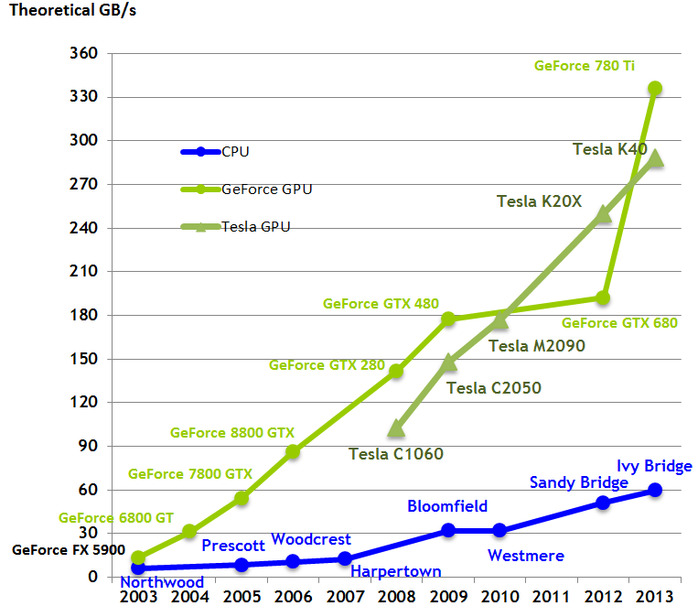
CPU and GPU Compute Trends
Chart from: http://docs.nvidia.com/cuda/cuda-c-programming-guide/
Notes:
PCI-E Gen3 is 8 GB/s in each direction
2012 CPU: 6-8 core CPU with several MB on-chip cache
Over 400 million CUDA-capable GPUs

Slide 9
CPU Review
What are the major components in a CPU die?
Notes:
Cache, branch predicator, out-of-order logic, ALUs, …

Slide 10
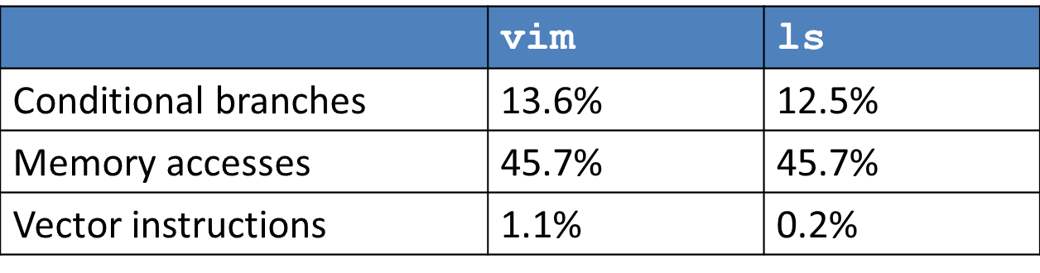
CPU Review
Desktop Applications
  Lightly threaded
  Lots of branches
  Lots of memory accesses
Profiled with psrun on ENIAC
Slide from Varun Sampath
Notes:
Software likes “serial,” hardware likes “parallel.”
Branch prediction accuracy
96.7% - vim
98.9% - ls

Slide 11
A Simple CPU Core
+
4
PC
Register
File
I$
D$
s1
s2
d
control
Fetch → Decode → Execute → Memory → Writeback
Image: Penn CIS501
Notes:
Clocked. All of these steps occur in one clock period.
Clock period bound by datapath delay.
Bad utilization.

Slide 12
Pipelining
+
4
Register
File
PC
Insn
Mem
Data
Mem
s1
s2
d
T_{insn-mem}
T_{regfile}
T_{ALU}
T_{data-mem}
T_{regfile}
T_{singlecycle}
Image: Penn CIS501
Notes:
About 12-25 gates per-stage, plus 3-5 gates for the latch.
Capitalize on instruction-level parallelism (ILP)
+ Significantly reduced clock period
– Slight latency & area increase (pipeline latches)
? Dependent instructions
? Branches
Alleged Pipeline Lengths:
Core 2: 14 stages
Pentium 4 (Prescott): > 20 stages
Sandy Bridge: in between
Pipelining allows much higher clock speeds.
Pipeline length source: Agner Fog’s Microarchitecture Guide

Slide 13
Branches
IR
Register
File
A
B
IR
O
B
IR
O
D
IR
Data
Mem
a
s1
s2
d
d
S
X
F/D
D/X
X/M
M/W
nop
???
???
jeq loop
Image: Penn CIS501
Notes:
We don’t know what instructions will execute after the branch until the branch is executed. We could either stall until it is, or “speculate” and flush on a misprediction.

Slide 14
Branch Prediction
+ Modern predictors > 90% accuracy
  Raise performance and energy efficiency
– Area increase
– Potential fetch stage latency increase
Notes:
96.7% accurate on vim example
Flushing a pipeline means a waste of all executed instructions. Area increase potentially even greater for tournament predictors.
Predication avoids explicitly branches completely since the instruction is always fetched and conditionally executed.

Slide 15
Memory Hierarchy
Memory: the larger it gets, the slower it gets
Rough numbers:
 | Latency | Bandwidth | Size
SRAM (L1, L2, L3) | 1-2ns | 200GBps | 1-20MB
DRAM (memory) | 70ns | 20GBps | 1-20GB
Flash (disk) | 70-90µs | 200MBps | 100-1000GB
HDD (disk) | 10ms | 1-150MBps | 500-3000GB
Notes:
SRAM & DRAM latency, and DRAM bandwidth for Sandy Bridge from Lostcircuits
Flash and HDD latencies from AnandTech
Flash and HDD bandwidth from AnandTech Bench
SRAM bandwidth guesstimated.

Slide 16
Caching
Keep data we need close
Exploit:
  Temporal locality
    Chunk just used likely to be used again soon
  Spatial locality
    Next chunk to use is likely close to previous

Slide 17
Cache Hierarchy
I$
D$
Hardware-managed
  L1 Instruction/Data caches
  L2 unified cache
  L3 unified cache
Software-managed
  Main memory
  Disk
L2
Larger
Faster
L3
Main Memory
Disk
(not to scale)
Notes:
LRU-esque eviction algorithms used for caches. Could be inclusive, exclusive, or neither. OS manages virtual memory.
L1 and L2 generally on-chip. L3 off-chip.

Slide 18
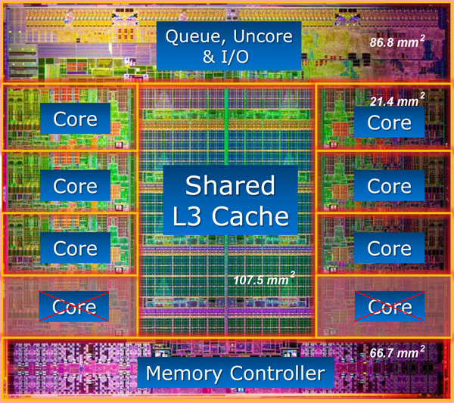
Intel Core i7 3960X – 15MB L3 (25% of die). 4-channel Memory Controller, 51.2GB/s total
^{Source: www.lostcircuits.com}
Notes:
Look at caches – 24.7% of die is L3 cache – 15MB
32KB I$ and 32KB D$
256KB L2 per core
Memory controller – 15% of die; 4 channels, each supporting DDR3-1600 → 12.8GB/s

Slide 19
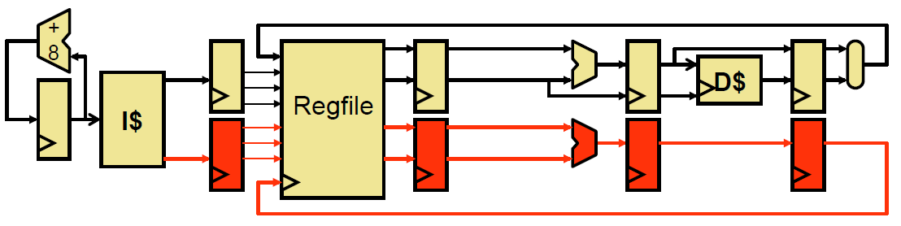
Improving IPC
IPC (instructions/cycle) bottlenecked at 1 instruction / clock
Superscalar – increase pipeline width
Image: Penn CIS371
Notes:
Duplicate pipeline registers, execution resources, ports

Slide 20
Scheduling
Consider instructions:
xor r1,r2 -> r3
add r3,r4 -> r4
sub r5,r2 -> r3
addi r3,1 -> r1
add is dependent on xor (Read-After-Write, RAW)
sub and addi are dependent (RAW)
xor and sub are not (Write-After-Write, WAW)

Slide 21
Register Renaming
How about this instead:
xor p1,p2 -> p6
add p6,p4 -> p7
sub p5,p2 -> p8
addi p8,1 -> p9
xor and sub can now execute in parallel

Slide 22
Out-of-Order Execution
Reordering instructions to maximize throughput
Fetch → Decode → Rename → Dispatch → Issue → Register-Read → Execute → Memory → Writeback → Commit
Reorder Buffer (ROB)
  Keeps track of status for in-flight instructions
Physical Register File (PRF)
Issue Queue/Scheduler
  Chooses next instruction(s) to execute
Notes:
New pipeline. 3 Principal data structures.
High power-usage since the fetch/decode logic is always executing – and is not powered down like other FUs.
“dispatch logic scales somewhere between quadratically and exponentially with the issue-width” - http://www.lighterra.com/papers/modernmicroprocessors/

Slide 23
Parallelism in the CPU
Covered Instruction-Level (ILP) extraction
  Superscalar
  Out-of-order
Data-Level Parallelism (DLP)
  Vectors
Thread-Level Parallelism (TLP)
  Simultaneous Multithreading (SMT)
  Multicore

Slide 24
Vectors Motivation
for (int i = 0; i < N; i++)
A[i] = B[i] + C[i];
Notes:
How do we make this go fast?

Slide 25
CPU Data-Level Parallelism
Single Instruction Multiple Data (SIMD)
  Let’s make the execution unit (ALU) really wide
  Let’s make the registers really wide too
for (int i = 0; i < N; i+= 4) {
// in parallel
A[i] = B[i] + C[i];
A[i+1] = B[i+1] + C[i+1];
A[i+2] = B[i+2] + C[i+2];
A[i+3] = B[i+3] + C[i+3];
}

Slide 26
Vector Operations in x86
SSE2
  4-wide packed float and packed integer instructions
  Intel Pentium 4 onwards
  AMD Athlon 64 onwards
AVX
  8-wide packed float and packed integer instructions
  Intel Sandy Bridge
  AMD Bulldozer
Notes:
Sandy Bridge can issue 2 AVX ops per cycle

Slide 27
Thread-Level Parallelism
Thread Composition
  Instruction streams
  Private PC, registers, stack
  Shared globals, heap
Created and destroyed by programmer
Scheduled by programmer or by OS

Slide 28
Simultaneous Multithreading
Instructions can be issued from multiple threads
Requires partitioning of ROB, other buffers
+ Minimal hardware duplication
+ More scheduling freedom for OoO
– Cache and execution resource contention can reduce single-threaded performance
Notes:
Register state, return stack buffer, and large page ITLB only replicated stuff: http://www.anandtech.com/show/2594/8

Slide 29
Multicore
Replicate full pipeline
Sandy Bridge-E: 6 cores
+ Full cores, no resource sharing other than last-level cache
+ Easier way to take advantage of Moore’s Law
– Utilization

Slide 30
CPU Conclusions
CPU optimized for sequential programming
  Pipelines, branch prediction, superscalar, OoO
  Reduce execution time with high clock speeds and high utilization
Slow memory is a constant problem
Parallelism
  Sandy Bridge-E great for 6-12 active threads
  How about 32K threads?
Notes:
A lot of effort put into improving IPC, and avoiding memory latencies. Attacking throughput is an entirely different game.
GeForce GTX 980 – 32K threads

Slide 31
How did this happen?

Slide 32
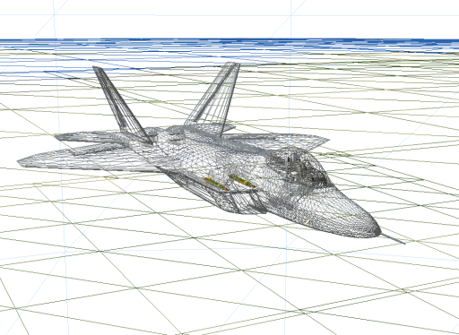


Graphics Workloads
Triangles/vertices and pixels/fragments
Right image from http://http.developer.nvidia.com/GPUGems3/gpugems3_ch14.html

Slide 33
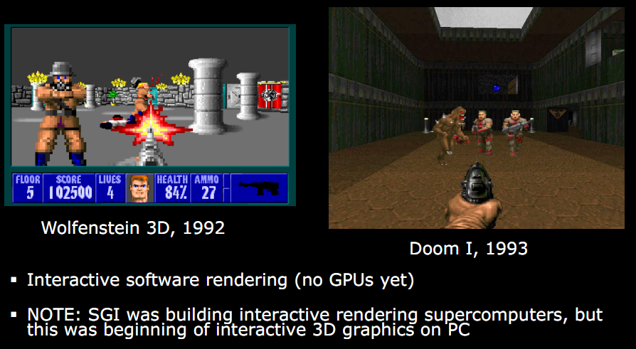
Early 90s – Pre GPU
Slide from http://s09.idav.ucdavis.edu/talks/01-BPS-SIGGRAPH09-mhouston.pdf
Notes:
Wolf 3D – 2.5D. No ceiling and floor height changes (or textures). No rolling walls. No lighting. Enemies always face viewer. Ray casting. Pre-computed texture coordinates.
Doom – Based on BSP tree (Bruce Naylor). Texture mapped all surfaces. Lighting. Varying floor altitudes. Rolling walls.

Slide 34
Why GPUs?
Graphics workloads are embarrassingly parallel
  Data-parallel
  Pipeline-parallel
CPU and GPU execute in parallel
Hardware: texture filtering, rasterization, etc.

Slide 35
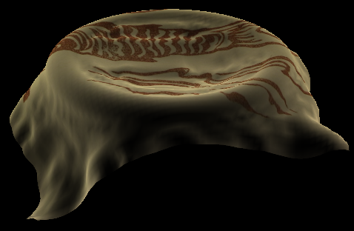
Data Parallel
Beyond Graphics
  Cloth simulation
  Particle system
  Matrix multiply
Image from: https://plus.google.com/u/0/photos/100838748547881402137/albums/5407605084626995217/5581900335460078306
Notes:
Data Parallel – The same program running on multiple data (SPMD).
Cloth is modeled with a mass-spring-damper system obeying Hook’s Law. The force on each mass is computed independently at each time step.
Each particle in a particle system has forces like gravity and wind. Integrating from f = ma to position can be done independently at each time step.
Can an application have more than one type of parallelism?

Slide 36
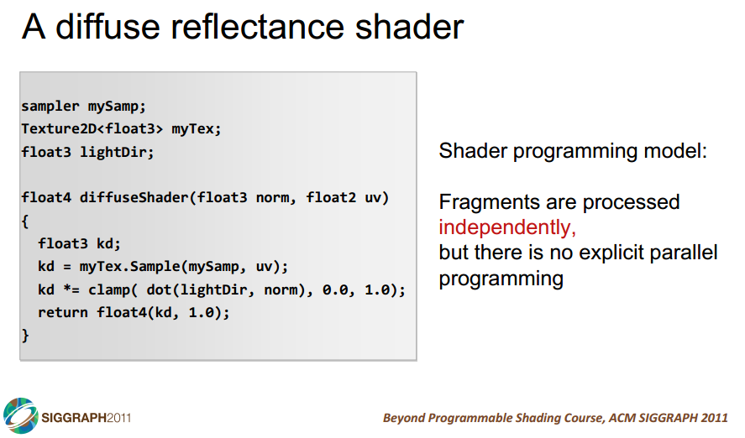

Slide 37
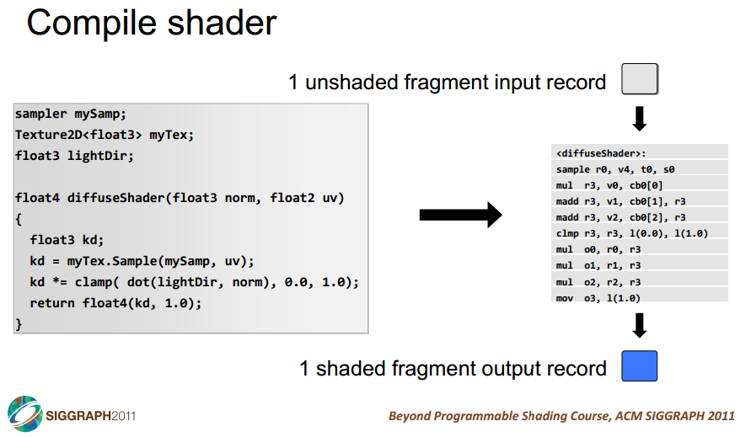

Slide 38
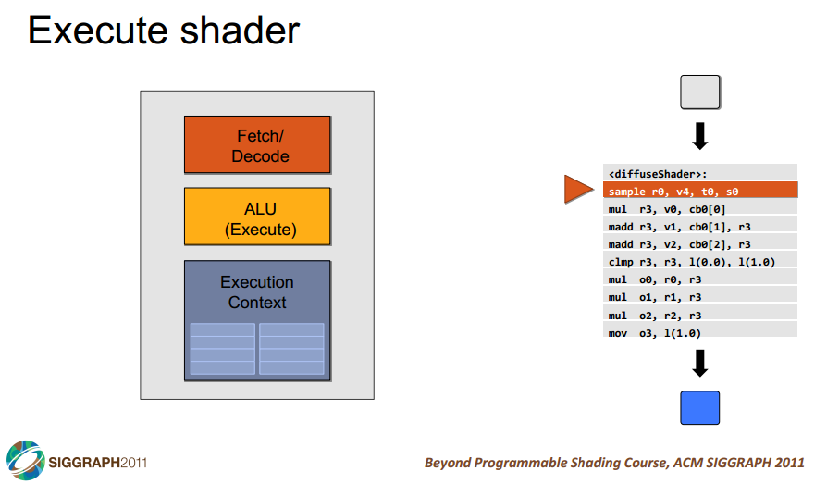

Slide 39
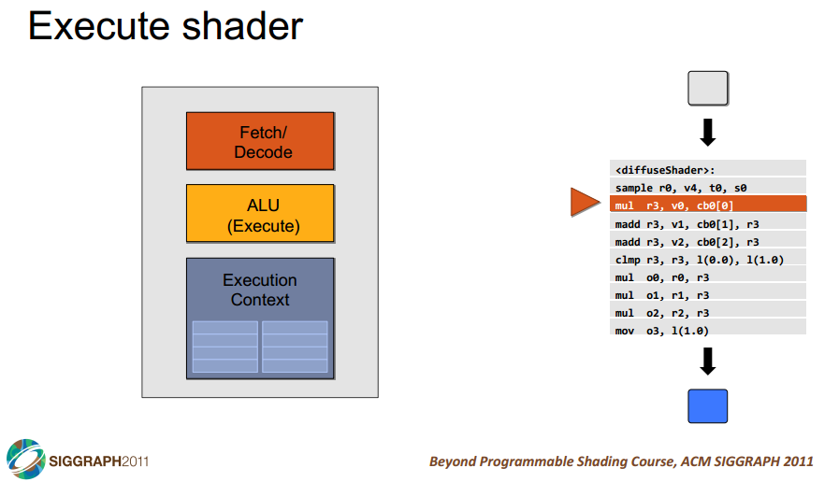

Slide 40
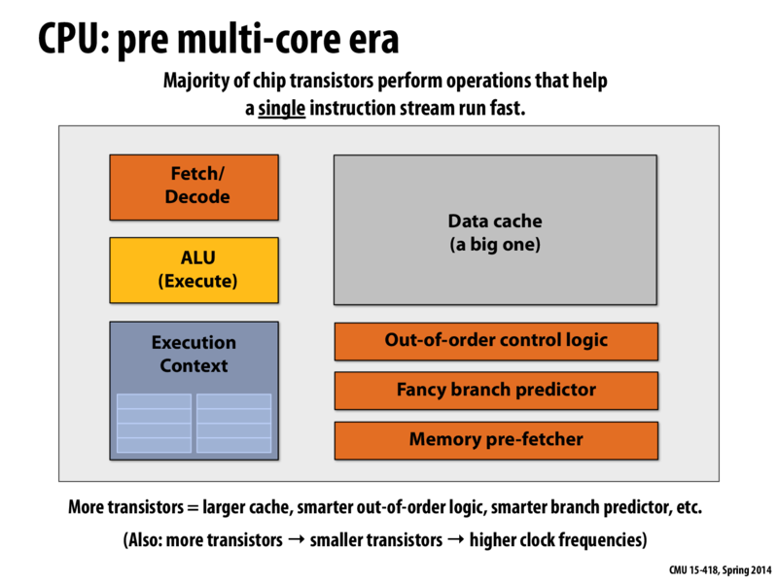

Slide 41
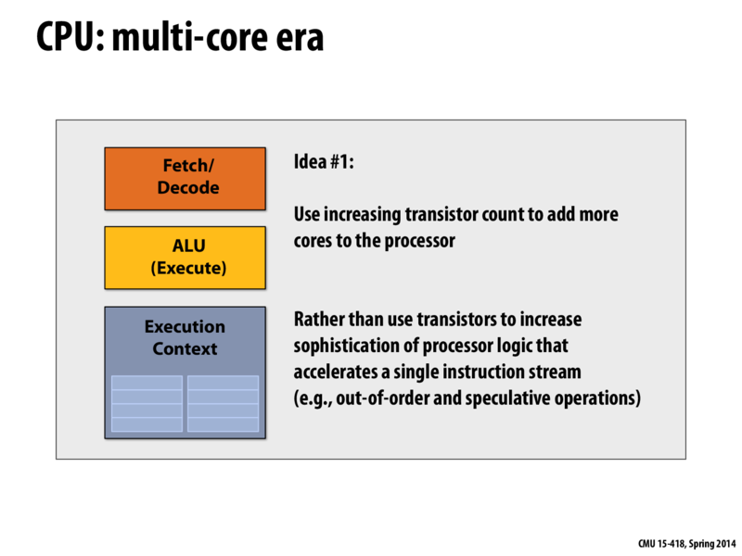

Slide 42
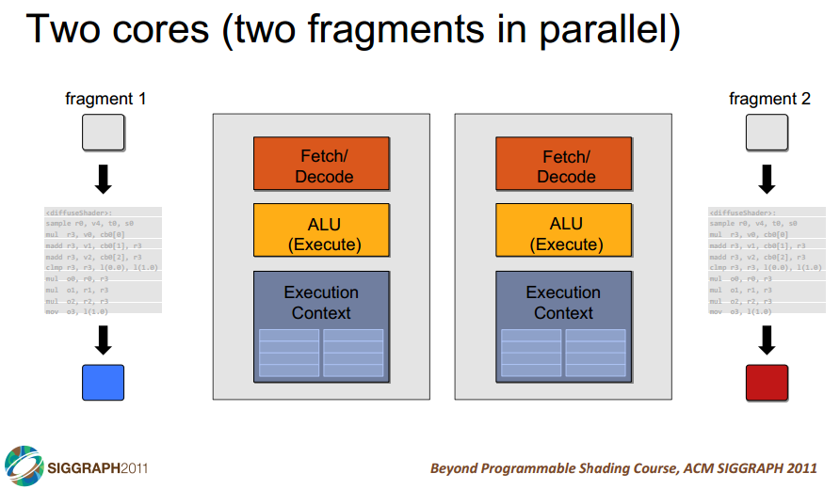

Slide 43
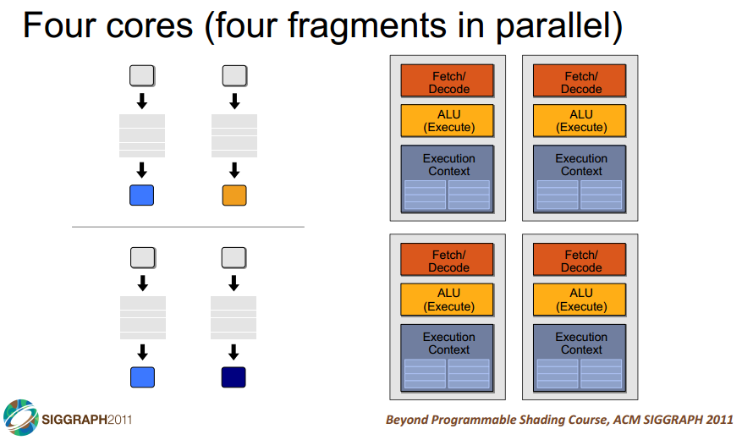

Slide 44
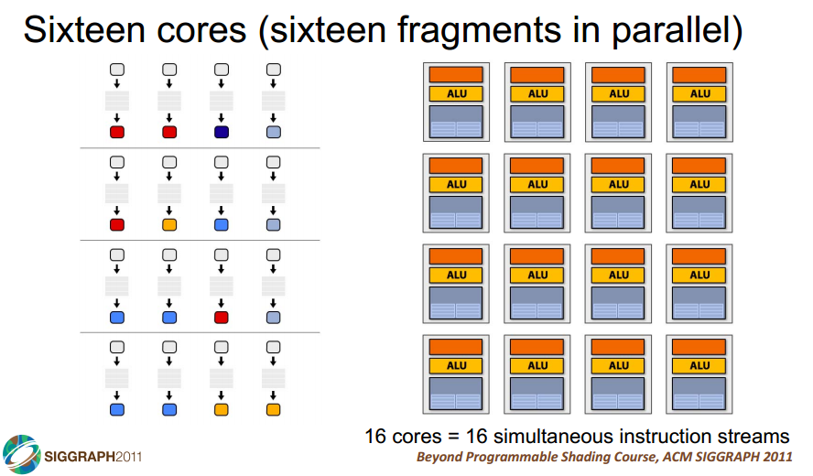

Slide 45
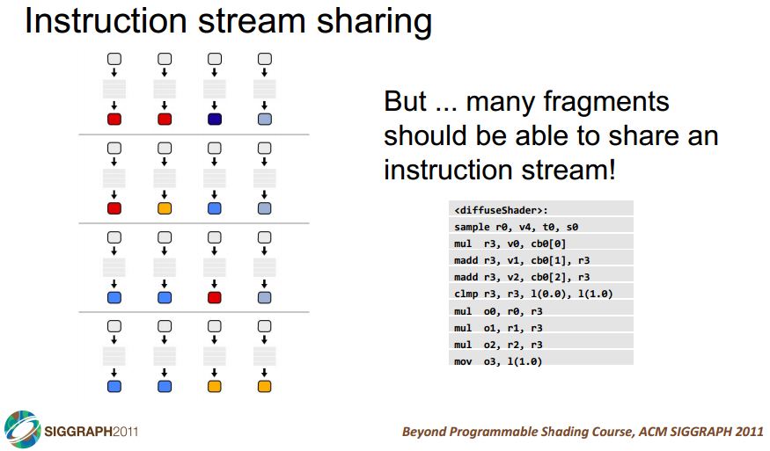

Slide 46
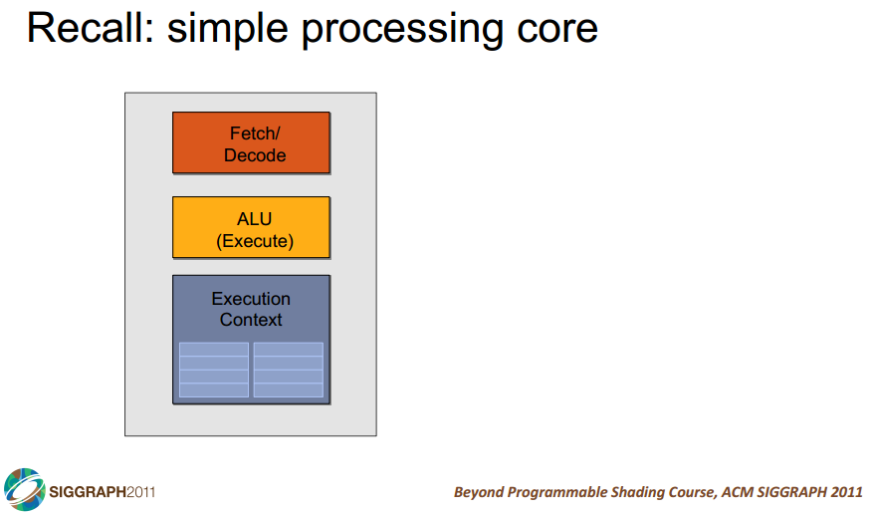

Slide 47
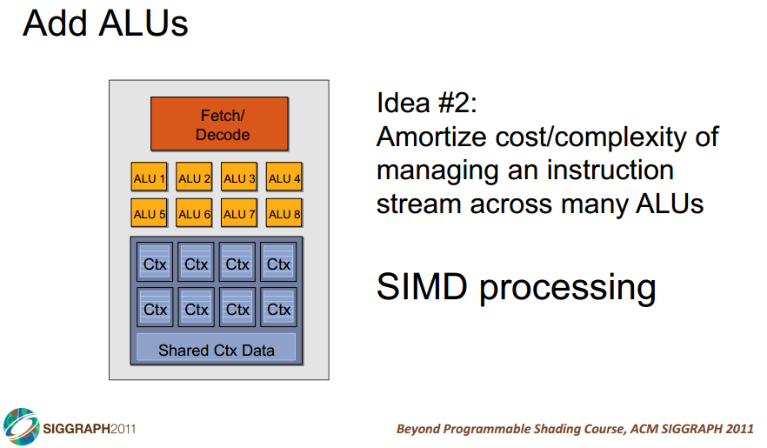

Slide 48
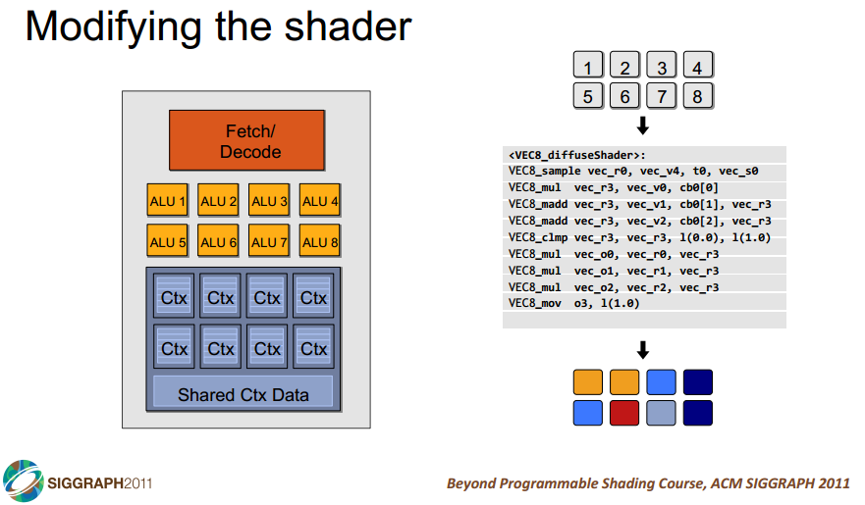

Slide 49
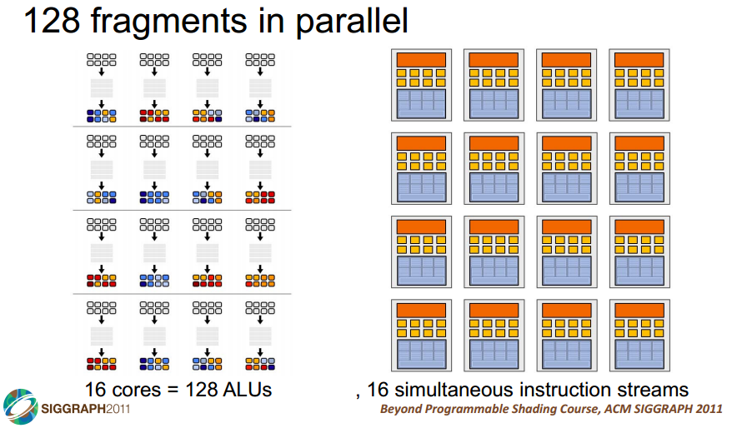

Slide 50
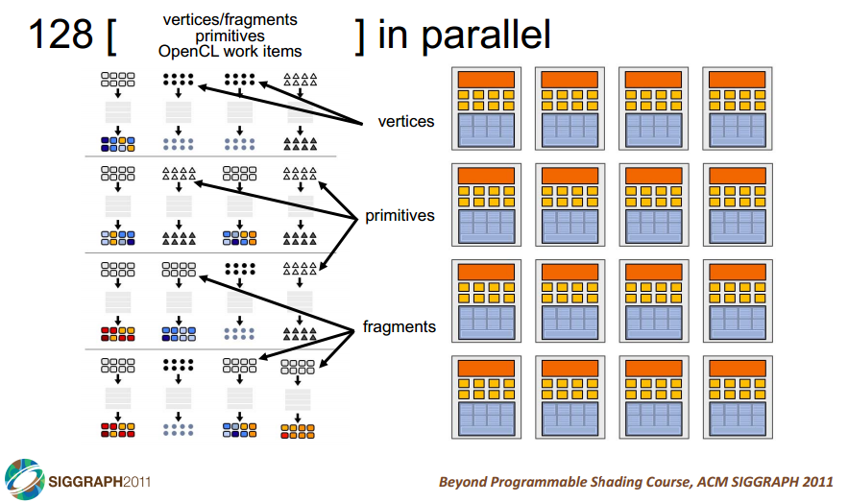
Notes:
128 CUDA kernels in parallel

Slide 51
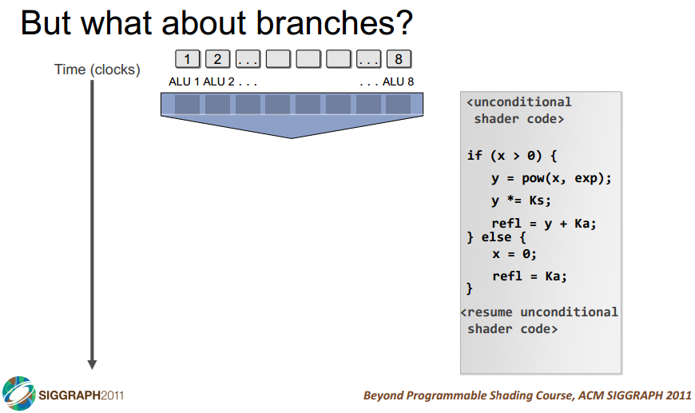

Slide 52
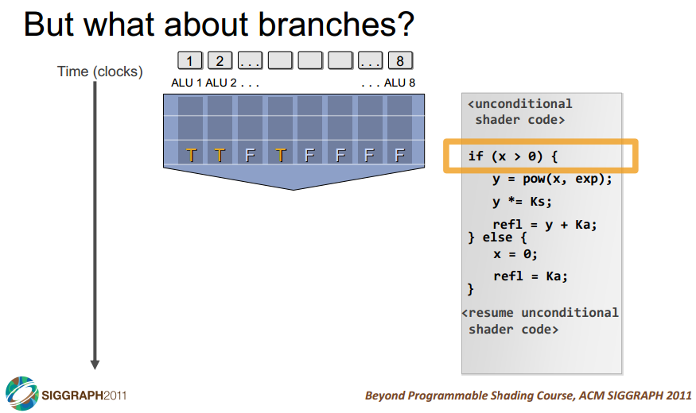

Slide 53
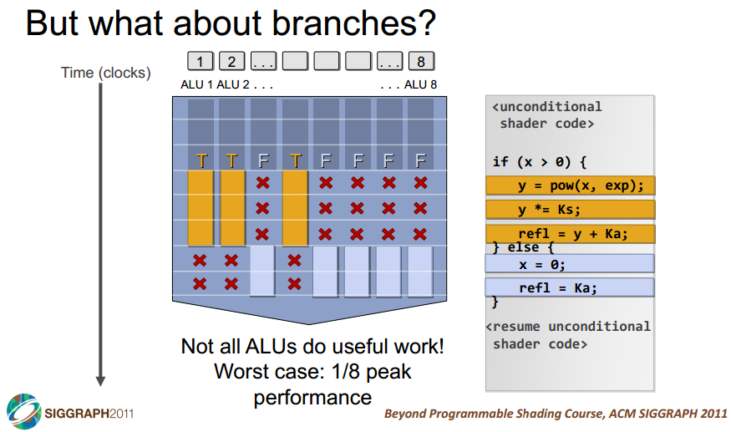

Slide 54
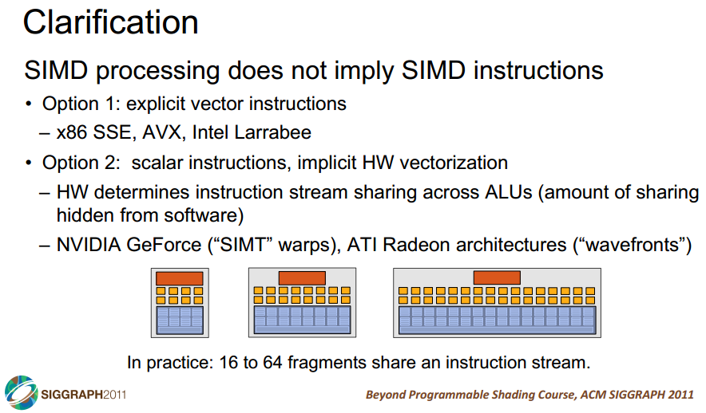

Slide 55
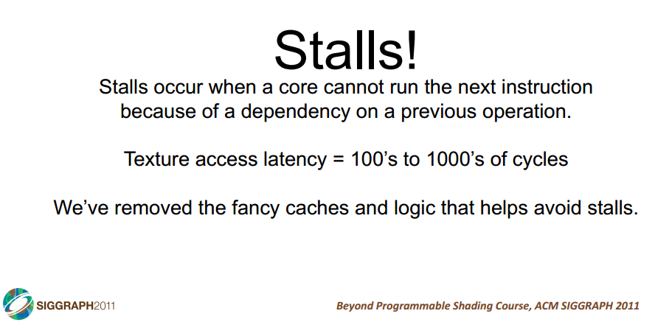

Slide 56
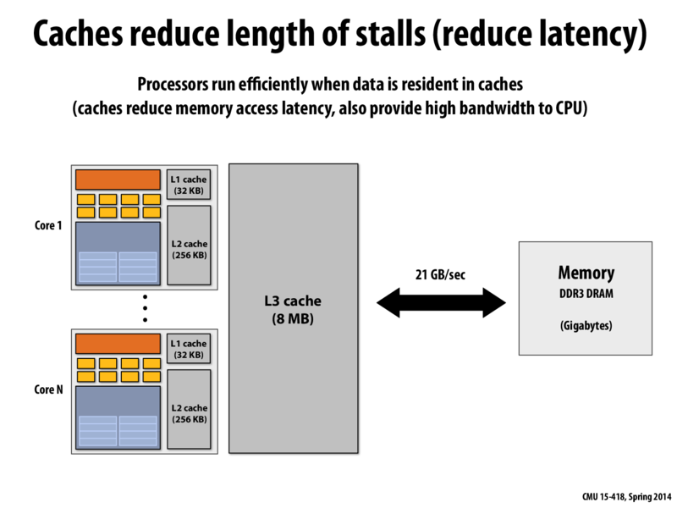

Slide 57
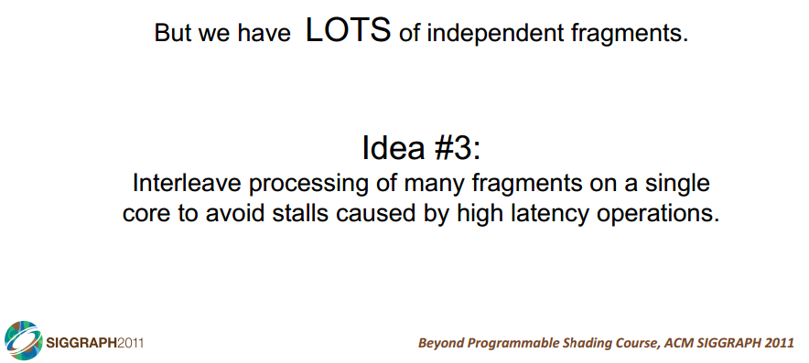

Slide 58
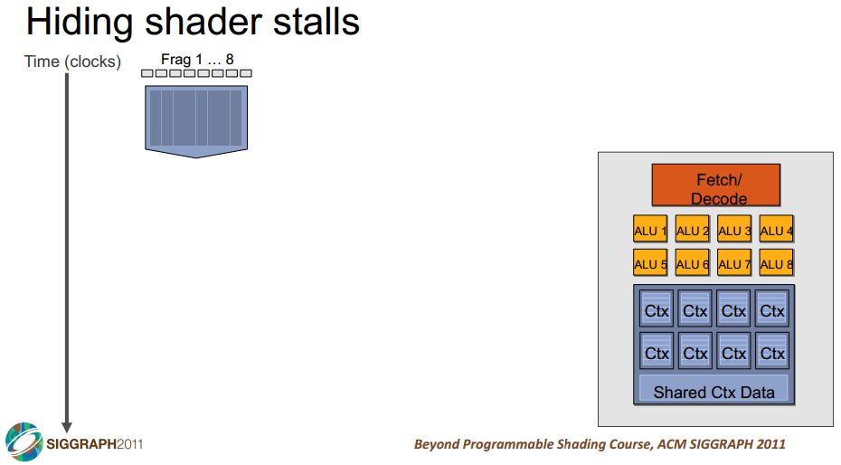

Slide 59
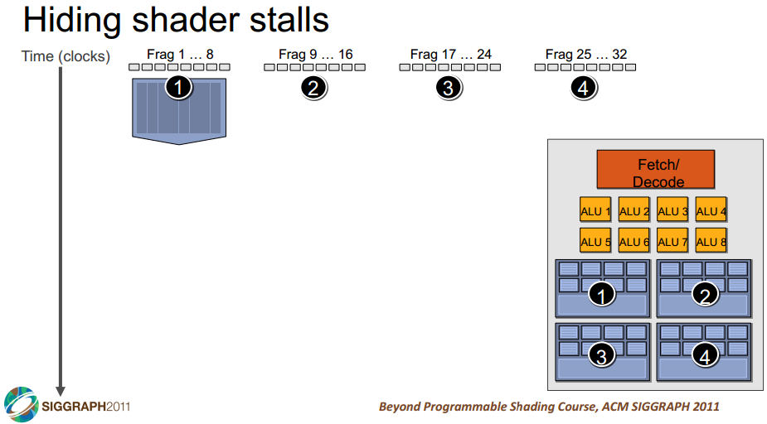

Slide 60
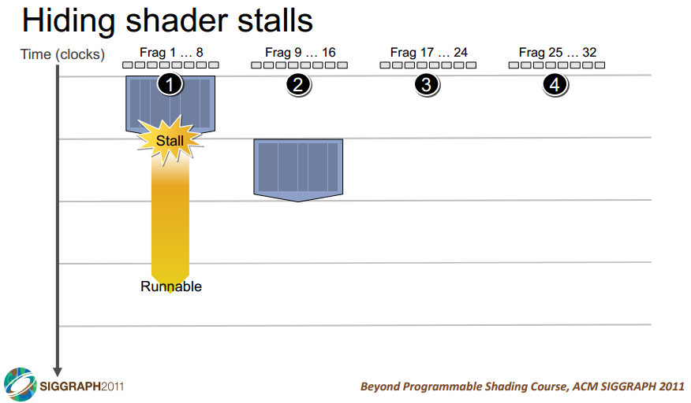

Slide 61
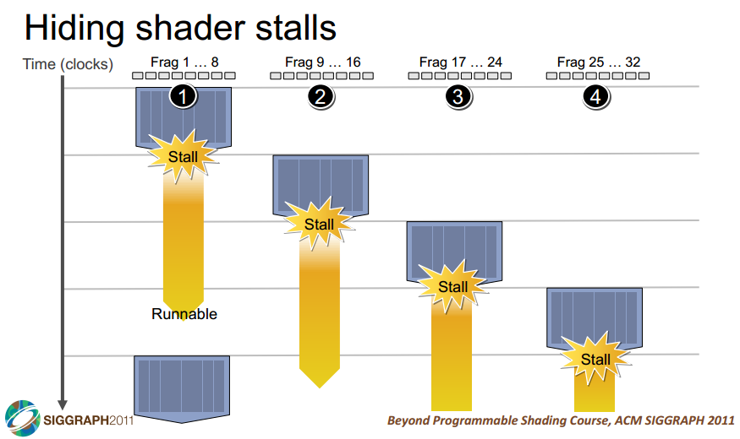

Slide 62
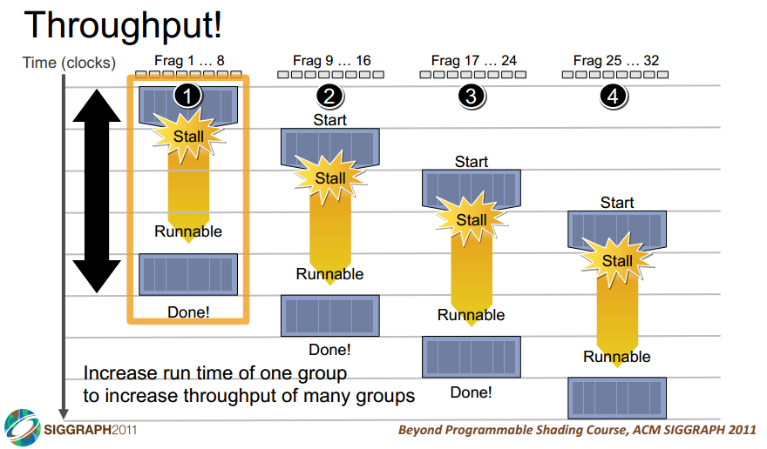

Slide 63
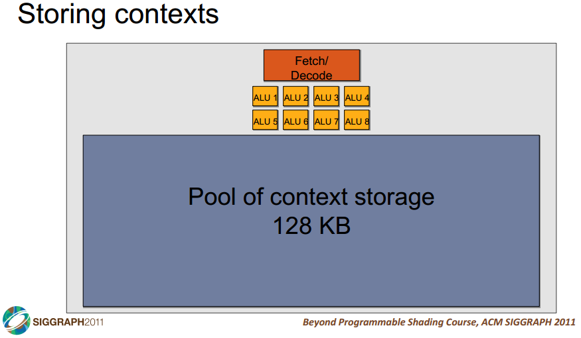

Slide 64
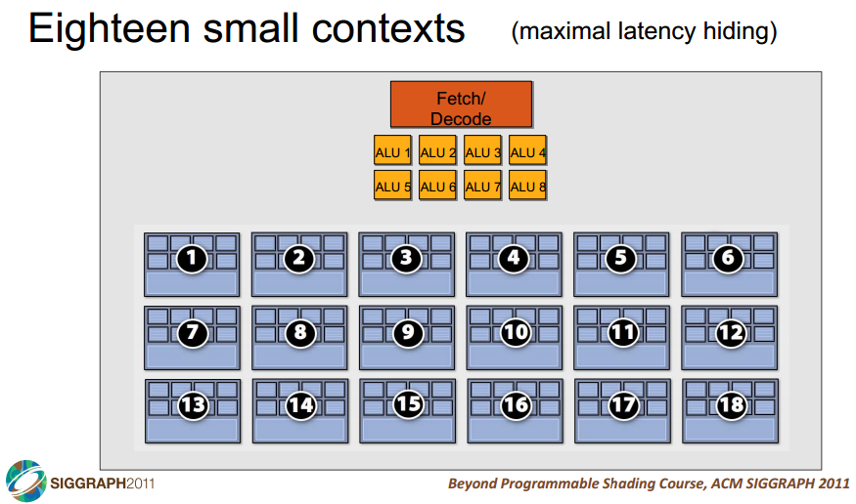

Slide 65
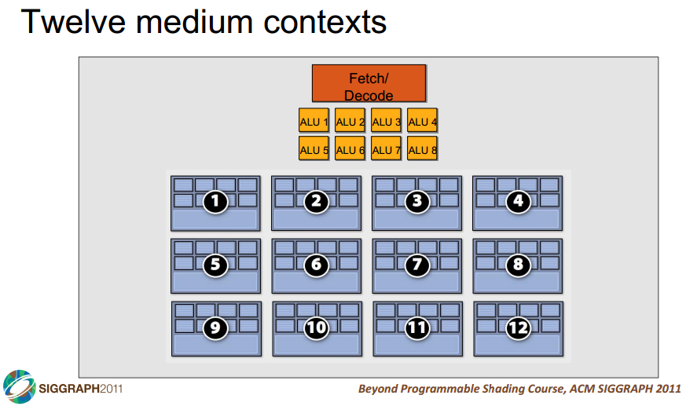

Slide 66
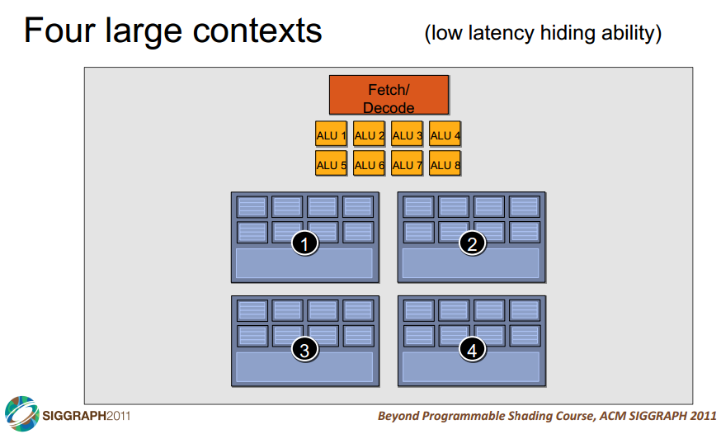

Slide 67
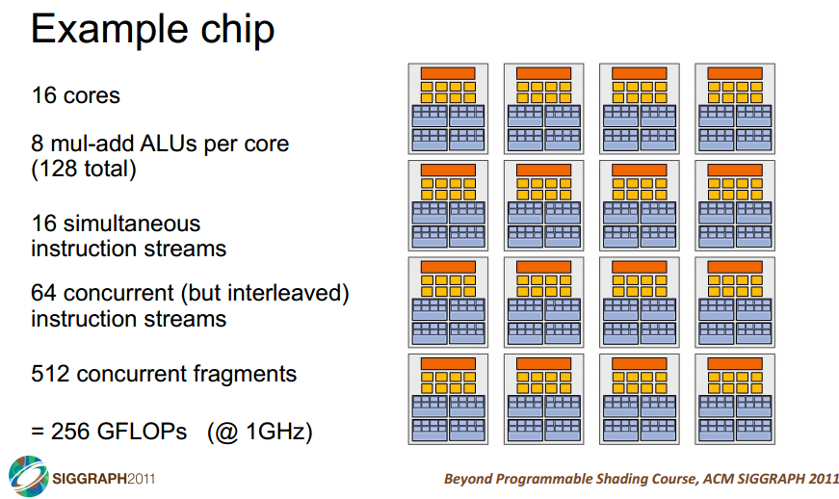

Slide 68
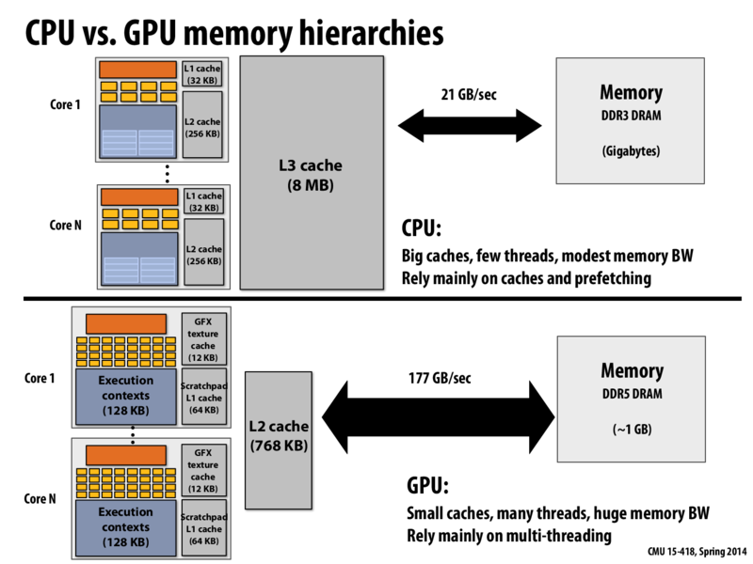

Slide 69
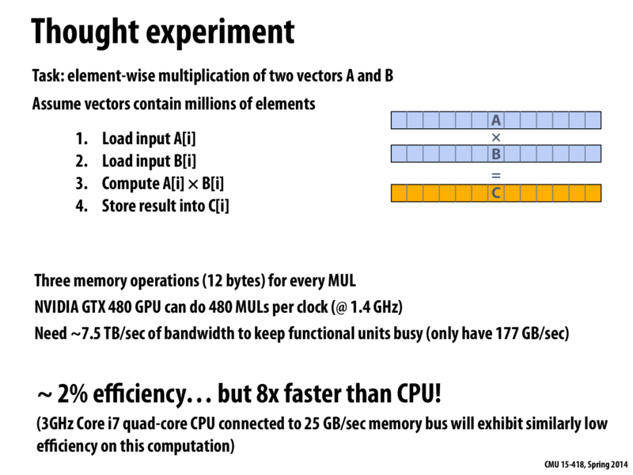

Slide 70


Slide 71
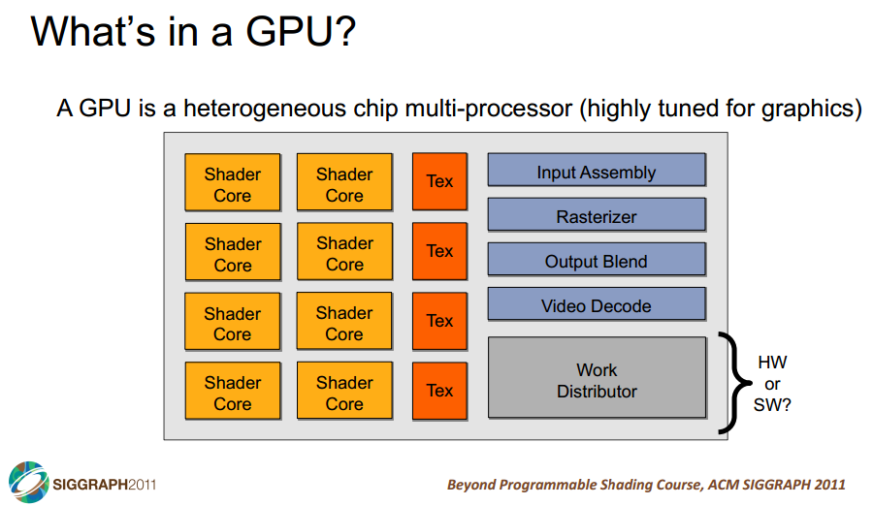
Notes:
Highlight fixed and programmable components

Slide 72
