Slide 1
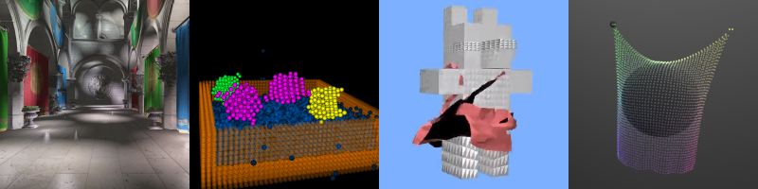
The Graphics Pipeline
Patrick Cozzi
University of Pennsylvania
CIS 565 - Fall 2016

Slide 2
Agenda
Graphics Pipeline
Mapping the Graphics Pipeline to Hardware

Slide 3
Graphics Taxonomy
Graphics
Modeling
Rendering
Animation
…
…
Real-Time Rendering
…

Slide 4
Graphics Review: Rendering
Rendering
  Goal: Assign color to pixels
Two Parts
  Visible surfaces
    What is in front of what for a given view
  Shading
    Simulate the interaction of material and light to produce a pixel color

Slide 5
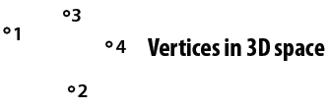

Graphics Pipeline Walkthrough
Vertex Assembly
Vertex Shader
Primitive Assembly
Rasterizer
Fragment Shader
Per-Fragment Tests
Blend
Framebuffer
Images from http://www.cs.cmu.edu/afs/cs.cmu.edu/academic/class/15869-f11/www/lectures/01_intro.pdf

Slide 6
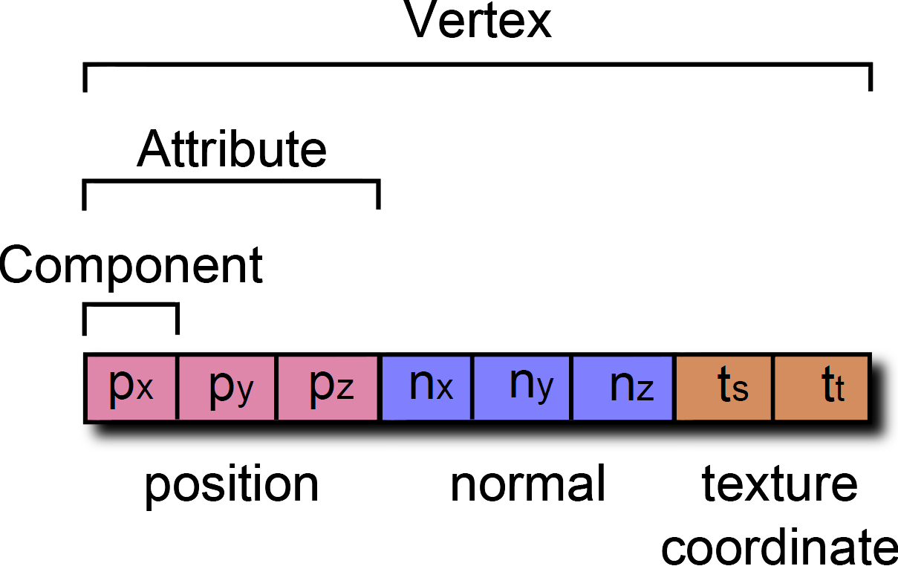
Vertex Assembly
Vertex Assembly
Pull together a vertex from one or more buffers
Also called primitive processing (GL ES) or input assembler (D3D)
Vertex Shader
Primitive Assembly
Rasterizer
Fragment Shader
Per-Fragment Tests
Blend
Framebuffer
Image from http://www.virtualglobebook.com/

Slide 7
Vertex Assembly
Vertex Assembly
OpenGL provides lots of flexibility for pulling vertex attributes from different buffers
For example (no indices):
Vertex Shader
Primitive Assembly
positions
Rasterizer
texture coordinates
Fragment Shader
normal, binormal, bitagent
...
Per-Fragment Tests
Vertex 0
Blend
Framebuffer
Notes:
Each attribute can come from a different buffer. Multiple attributes can be interleaved in the same buffer.
What are binormals and bitagents?
What are they used for? Bump mapping, normal mapping. Anything that needs to work in tangent space.
Why do we not need to store all three normal, binormal, and bitagent in the buffer? Because we can compute one from the other two with a cross product.

Slide 8
Vertex Assembly
Vertex Assembly
OpenGL provides lots of flexibility for pulling vertex attributes from different buffers
For example (no indices):
Vertex Shader
Primitive Assembly
positions
Rasterizer
texture coordinates
Fragment Shader
normal, binormal, bitagent
...
Per-Fragment Tests
Vertex 0
Blend
Framebuffer

Slide 9
Vertex Assembly
Vertex Assembly
OpenGL provides lots of flexibility for pulling vertex attributes from different buffers
For example (no indices):
Vertex Shader
Primitive Assembly
positions
Rasterizer
texture coordinates
Fragment Shader
normal, binormal, bitagent
...
Per-Fragment Tests
Vertex 1
Blend
Framebuffer
Notes:
Lots more on buffer organization after spring break

Slide 10
Vertex Shader
Vertex Assembly
Transform incoming vertex position from model to clip coordinates
Perform additional per-vertex computations; modify, add, or remove attributes passed down the pipeline
Formerly called the Transform and Lighting (T&L) stage. Why?
Vertex Shader
Primitive Assembly
Rasterizer
vertex
P_{model}
Fragment Shader
Vertex Shader
Vertex Shader
Per-Fragment Tests
modified vertex
P_{clip}
Blend
P_{clip} = (M_{model-view-projection})(P_{model})
Framebuffer

Slide 11
Vertex Shader
Vertex Assembly
Model to clip coordinates requires three transforms:
  model to world
  world to eye
  eye to clip
Use 4x4 matrices passed to the vertex shader as uniforms
Vertex Shader
Primitive Assembly
Rasterizer
P_{world} = (M_{model})(P_{model})
P_{eye} = (M_{view}) (P_{world})
P_{clip} = (M_{projection}) (P_{eye})
Fragment Shader
Per-Fragment Tests
vertex
Blend
uniforms, e.g.,
matrices, etc.
Vertex Shader
Framebuffer
modified vertex

Slide 12
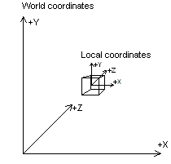
Vertex Shader
Vertex Assembly
Model to world:
P_{world} = (M_{model})(P_{model})
Vertex Shader
Primitive Assembly
Rasterizer
Fragment Shader
Per-Fragment Tests
Blend
Framebuffer
Image from http://msdn.microsoft.com/en-us/library/windows/desktop/bb206365(v=vs.85).aspx

Slide 13
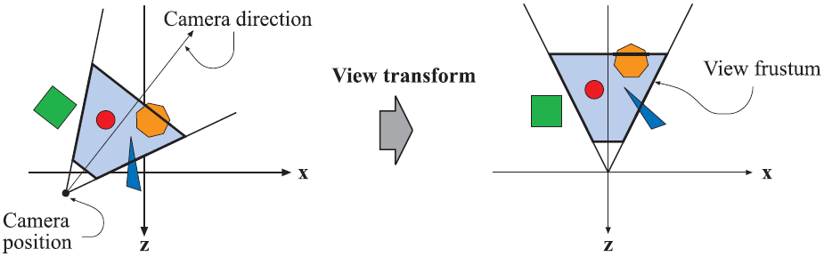
Vertex Shader
Vertex Assembly
  World to eye:
P_{eye} = (M_{view}) (P_{world})
Vertex Shader
Primitive Assembly
Rasterizer
Fragment Shader
Per-Fragment Tests
Blend
Framebuffer
Image from http://www.realtimerendering.com/

Slide 14
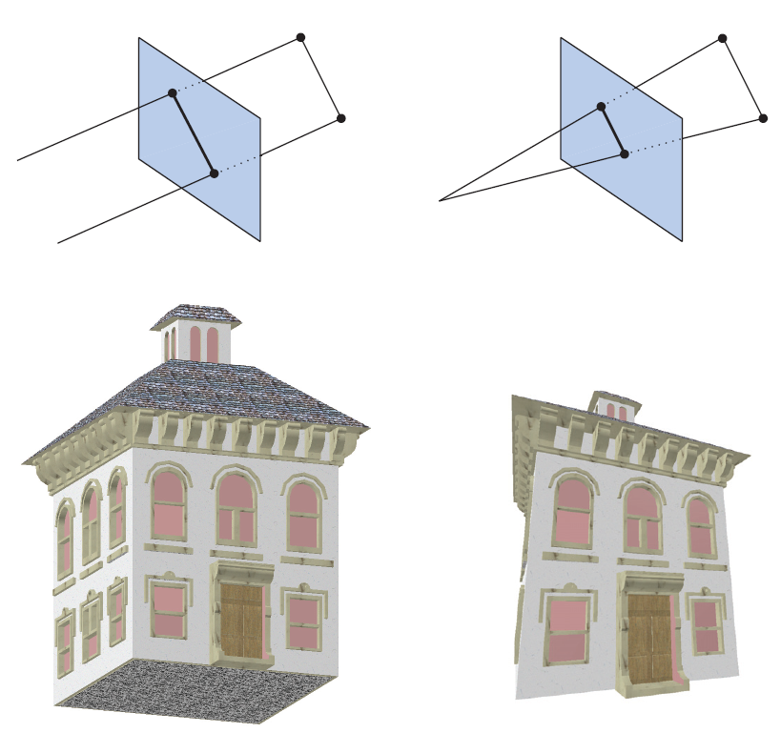
Vertex Shader
Vertex Assembly
  Eye to clip coordinates:
P_{clip} = (M_{projection}) (P_{eye})
Vertex Shader
Primitive Assembly
Rasterizer
Fragment Shader
Per-Fragment Tests
Blend
Framebuffer
Image from http://www.realtimerendering.com/

Slide 15
Vertex Shader
Vertex Assembly
In practice, the model, view, and projection matrices are commonly burnt into one matrix? Why?
Vertex Shader
Primitive Assembly
P_{clip} = (M_{projection})(M_{view})(M_{model})(P_{model})
P_{clip} = (M_{model-view-projection})(P_{model})
Rasterizer
Fragment Shader
Per-Fragment Tests
Blend
Framebuffer

Slide 16
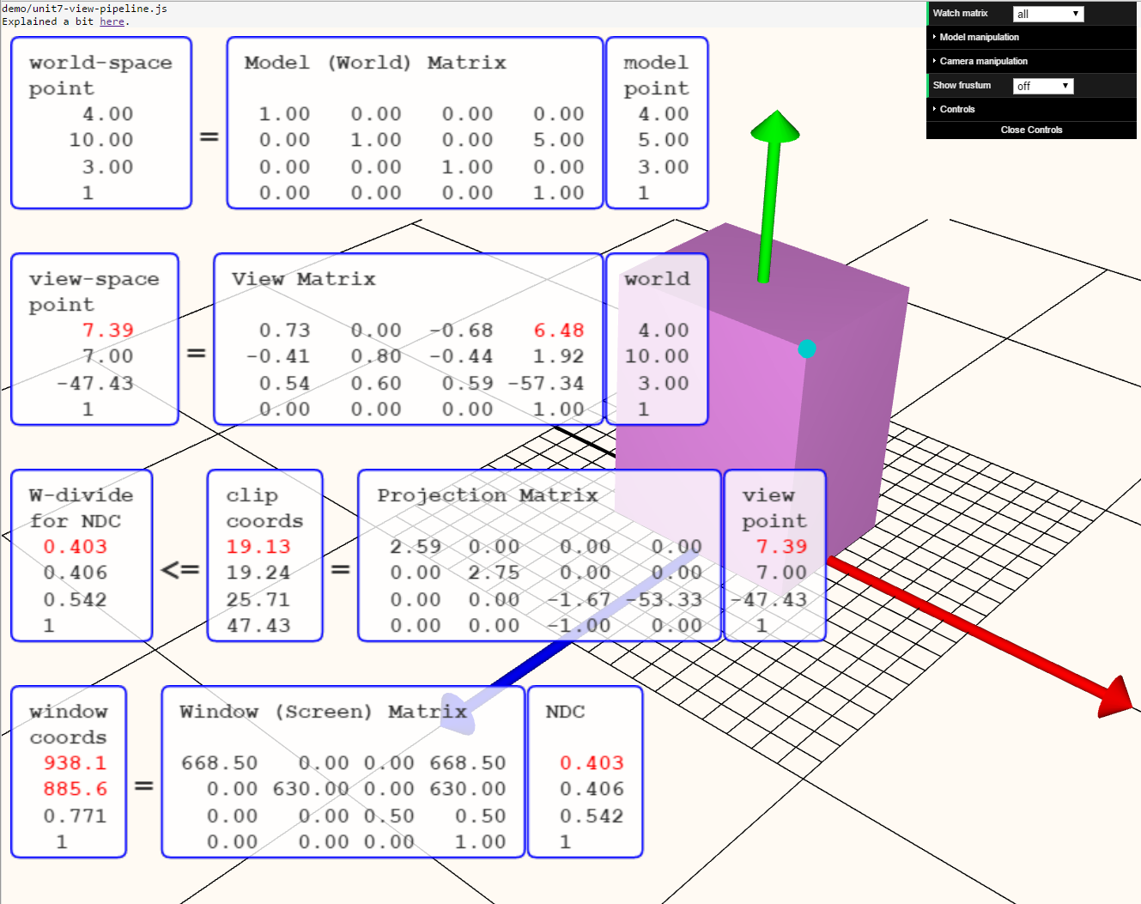
Vertex Shader
Vertex Assembly
Vertex Shader
Primitive Assembly
Rasterizer
Fragment Shader
Per-Fragment Tests
Blend
Transforms demo
Framebuffer
Screenshot and demo by Eric Haines.
Notes:
Demo and details: http://www.realtimerendering.com/blog/improved-graphics-transforms-demo/

Slide 17
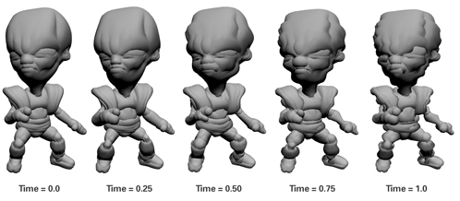
Vertex Shader
Vertex Assembly
Model to clip coordinate transformation is just one use for the vertex shader.
Another use: animation.
How would you implement pulsing?
Vertex Shader
Primitive Assembly
Rasterizer
Fragment Shader
Per-Fragment Tests
Blend
Framebuffer
Image from http://http.developer.nvidia.com/CgTutorial/cg_tutorial_chapter06.html

Slide 18
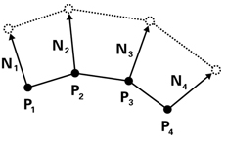
Vertex Shader
Vertex Assembly
How would you implement pulsing?
Displace position along surface normal over time
How do we compute the displacement?
Vertex Shader
Primitive Assembly
Rasterizer
Fragment Shader
Per-Fragment Tests
Blend
Framebuffer
Image from http://http.developer.nvidia.com/CgTutorial/cg_tutorial_chapter06.html
Notes:
In what coordinate system do you move the vertex? Model coordinates

Slide 19
Vertex Shader
Vertex Assembly
How do we compute the displacement?
Consider:
What are the shortcomings?
Vertex Shader
Primitive Assembly
Rasterizer
float displacement =
0.5 * (sin(u_time) + 1.0);
Fragment Shader
Per-Fragment Tests
Blend
Framebuffer
Image from http://http.developer.nvidia.com/CgTutorial/cg_tutorial_chapter06.html
Notes:
Is [0.0, 1.0] the right displacement range?

Slide 20
Vertex Shader
Vertex Assembly
How do we compute the displacement?
Consider:
What are the other shortcomings?
Vertex Shader
Primitive Assembly
Rasterizer
float displacement =
u_scaleFactor * 0.5 * (sin(u_frequency * u_time) + 1.0);
Fragment Shader
Per-Fragment Tests
Blend
Framebuffer
Image from http://http.developer.nvidia.com/CgTutorial/cg_tutorial_chapter06.html
Notes:
Scale and bias sin() from -1.0 to 1.0.
Amplitude may not be enough or too much. Same for frequency.

Slide 21
Vertex Shader
Vertex Assembly
How do we get the varying bulge?
Vertex Shader
Primitive Assembly
Rasterizer
Fragment Shader
Per-Fragment Tests
Blend
Framebuffer
Image from http://http.developer.nvidia.com/CgTutorial/cg_tutorial_chapter06.html

Slide 22
Vertex Shader
Vertex Assembly
How do we get the varying bulge?
Consider
Vertex Shader
Primitive Assembly
Rasterizer
Fragment Shader
float displacement =
u_scaleFactor * 0.5 * (sin(position.y * u_frequency * u_time) + 1.0);
Per-Fragment Tests
Blend
Framebuffer
Image from http://http.developer.nvidia.com/CgTutorial/cg_tutorial_chapter06.html

Slide 23
Vertex Shader
Vertex Assembly
What varies per-vertex and what does not?
Vertex Shader
float displacement =
u_scaleFactor * 0.5 * (sin(position.y * u_frequency * u_time) + 1.0);
Primitive Assembly
Rasterizer
Fragment Shader
Per-Fragment Tests
Blend
Framebuffer
Notes:
Only position.y varies per-vertex. u_scaleFactor * 0.5 can be pre-computed. u_frequency * u_time can be pre-computed.

Slide 24
Vertex Shader
Vertex Assembly
On all modern GPUs, vertex shaders can read from textures as well as uniform variables.
What is this useful for?
Vertex Shader
Primitive Assembly
vertex
Rasterizer
uniforms
Vertex Shader
Fragment Shader
textures
modified vertex
Per-Fragment Tests
Blend
Framebuffer

Slide 25
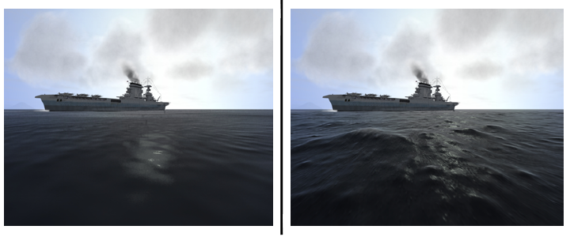
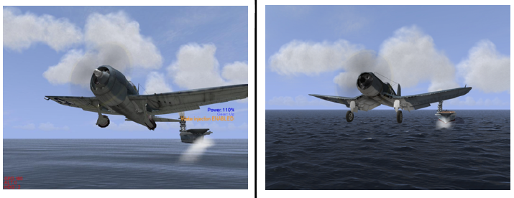
Vertex Shader
Vertex Assembly
Example: Textures can provide height maps for displacement mapping
Vertex Shader
Primitive Assembly
Rasterizer
Fragment Shader
Per-Fragment Tests
Blend
Framebuffer
Images from http://developer.nvidia.com/content/vertex-texture-fetch

Slide 26
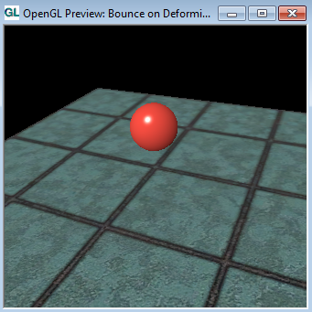
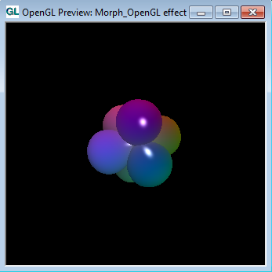
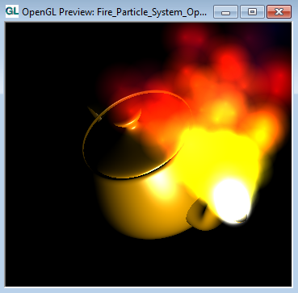
Vertex Shader
Vertex Assembly
RenderMonkey Demos
Vertex Shader
Bounce
Primitive Assembly
Morph
Rasterizer
Particle System
Fragment Shader
Per-Fragment Tests
Blend
Framebuffer
RenderMonkey: http://developer.amd.com/archive/gpu/rendermonkey/pages/default.aspx

Slide 27
Primitive Assembly
Vertex Assembly
A vertex shader processes one vertex. Primitive assembly groups vertices forming one primitive, e.g., a triangle, line, etc.
Vertex Shader
Primitive Assembly
Rasterizer
Fragment Shader
VS
Per-Fragment Tests
Blend
Framebuffer
Notes:
Perhaps vertices are processed one at a time. Primitive assembly needs to buffer them to form primitives after all vertices for a primitive have been processed
Also called triangle setup

Slide 28
Primitive Assembly
Vertex Assembly
A vertex shader processes one vertex. Primitive assembly groups vertices forming one primitive, e.g., a triangle, line, etc.
Vertex Shader
Primitive Assembly
Rasterizer
Fragment Shader
VS
Per-Fragment Tests
Blend
Framebuffer

Slide 29
Primitive Assembly
Vertex Assembly
A vertex shader processes one vertex. Primitive assembly groups vertices forming one primitive, e.g., a triangle, line, etc.
Vertex Shader
Primitive Assembly
Rasterizer
Fragment Shader
VS
Per-Fragment Tests
Blend
Framebuffer

Slide 30
Primitive Assembly
Vertex Assembly
A vertex shader processes one vertex. Primitive assembly groups vertices forming one primitive, e.g., a triangle, line, etc.
Vertex Shader
Primitive Assembly
Rasterizer
Fragment Shader
VS
Per-Fragment Tests
Blend
Framebuffer

Slide 31
Primitive Assembly
Vertex Assembly
A vertex shader processes one vertex. Primitive assembly groups vertices forming one primitive, e.g., a triangle, line, etc.
Vertex Shader
Primitive Assembly
Rasterizer
Fragment Shader
VS
Per-Fragment Tests
Blend
Primitive Assembly
Framebuffer

Slide 32
Primitive Assembly
Vertex Assembly
A vertex shader processes one vertex. Primitive assembly groups vertices forming one primitive, e.g., a triangle, line, etc.
Vertex Shader
Primitive Assembly
Rasterizer
Fragment Shader
VS
Per-Fragment Tests
Blend
Framebuffer
Notes:
Perhaps vertices are processed in parallel

Slide 33
Primitive Assembly
Vertex Assembly
A vertex shader processes one vertex. Primitive assembly groups vertices forming one primitive, e.g., a triangle, line, etc.
Vertex Shader
Primitive Assembly
Rasterizer
Fragment Shader
VS
Per-Fragment Tests
Blend
Framebuffer

Slide 34
Primitive Assembly
Vertex Assembly
A vertex shader processes one vertex. Primitive assembly groups vertices forming one primitive, e.g., a triangle, line, etc.
Vertex Shader
Primitive Assembly
Rasterizer
Fragment Shader
VS
Per-Fragment Tests
Blend
Primitive Assembly
Framebuffer

Slide 35
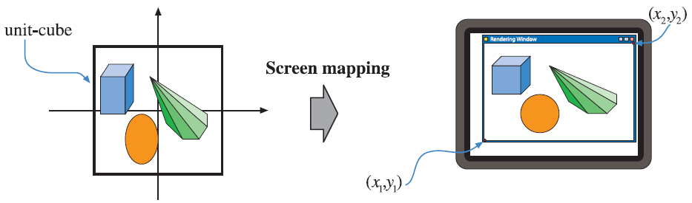
Perspective Division and Viewport Transform
Vertex Assembly
There are a series of stages between primitive assembly and rasterization.
  Perspective division
  Viewport transform
Vertex Shader
Primitive Assembly
P_{ndc} = (P_{clip}).xyz / (P_{clip}).w
Rasterizer
P_{window} = (M_{viewport-transform})(P_{ndc})
Fragment Shader
Per-Fragment Tests
Blend
Framebuffer
Image from http://www.realtimerendering.com/
Notes:
What is the z component of window coordinates used for?

Slide 36
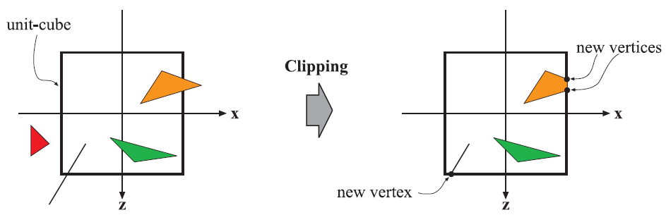
Clipping
Vertex Assembly
There are a series of stages between primitive assembly and rasterization.
  Clipping
Vertex Shader
Primitive Assembly
Rasterizer
Fragment Shader
Per-Fragment Tests
Blend
Framebuffer
Image from http://www.realtimerendering.com/
Notes:
Clipping may happen sooner in the pipeline, but GL 4.2 shows it as happening after the viewport transform

Slide 37
Rasterization
Vertex Assembly
Determine what pixels a primitive overlaps
How would you implement this?
What about aliasing?
What happens to non-position vertex attributes during rasterization?
What is the triangle-to-fragment ratio?
Vertex Shader
Primitive Assembly
Rasterizer
Fragment Shader
Per-Fragment Tests
Blend
Framebuffer
Notes:
Attributes are interpolated across the primitive (unless explicitly told otherwise).
There are usually many more fragments than triangles creating an irregular workload.
Rasterization can be done with a scanline algorithm or hierarchically (or recursive flood fill, in theory).
Demo with AA and more: http://acko.net/files/fullfrontal/fullfrontal/webglmath/pixels.html
From Larrabee (http://www.student.chemia.uj.edu.pl/~mrozek/USl/wyklad/Nowe_konstrukcje/Siggraph_Larrabee_paper.pdf):
“Our algorithm is a highly optimized version of the recursive descent algorithm described by Greene [1996]. The basic idea is to convert clipped triangles to screen space, then compute a halfplane equation for each triangle edge [Pineda 1988]. This lets us determine if a rectangular block is entirely inside the triangle, entirely outside the triangle, or partially covered by the triangle. In the latter case, the algorithm subdivides the block recursively until it is reduced to an individual pixel or sample position. “

Slide 38
Fragment Shader
Vertex Assembly
Shades the fragment by simulating the interaction of light and material
Loosely, the combination of a fragment shader and its uniform inputs is a material
Also called a Pixel Shader (D3D)
Fragment shaders can be computationally intense
What exactly is the fragment input?
What are examples of useful uniforms? Useful textures?
Vertex Shader
Primitive Assembly
Rasterizer
fragment
uniforms
Fragment Shader
Fragment Shader
textures
Per-Fragment Tests
fragment’s color
Blend
Framebuffer
Notes:
Fragment input: (x_window, y_window, z_window a.k.a. depth) and interpolated varyings (attributes) from rasterization
Useful uniforms: lights, time, etc.
Useful textures: diffuse map, bump map, specular, map, etc.

Slide 39
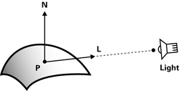
Fragment Shader
Vertex Assembly
Example: Blinn-Phong Lighting
Vertex Shader
Primitive Assembly
Rasterizer
Fragment Shader
float diffuse =
max(dot(N, L), 0.0);
Per-Fragment Tests
Blend
Framebuffer
Image from http://http.developer.nvidia.com/CgTutorial/cg_tutorial_chapter05.html
Notes:
Diffuse light scatters in all directions; rough surfaces.

Slide 40
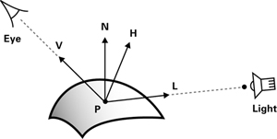
Fragment Shader
Vertex Assembly
Example: Blinn-Phong Lighting
Why not evaluate per-vertex and interpolate during rasterization?
Vertex Shader
Primitive Assembly
Rasterizer
Fragment Shader
float specular =
max(pow(dot(H, N), u_shininess), 0.0);
Per-Fragment Tests
Blend
Framebuffer
Image from http://http.developer.nvidia.com/CgTutorial/cg_tutorial_chapter05.html
Notes:
H = (V + L) / 2. Constant for all fragments for a directional light source.
Specular light is for mirror reflection; shiny and smooth surfaces. Shininess controls the tightest of the specular bump.

Slide 41
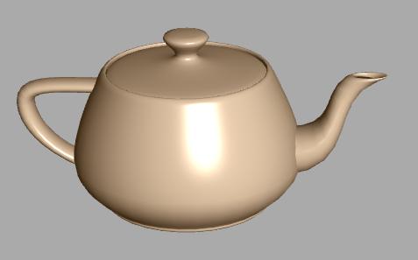
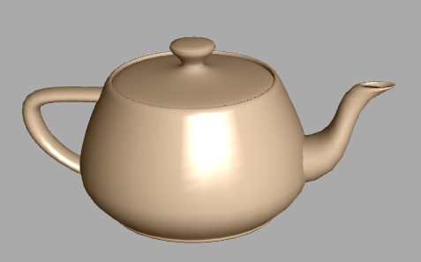
Fragment Shader
Vertex Assembly
Per-fragment vs. per-vertex lighting
Which is which?
Vertex Shader
Primitive Assembly
Rasterizer
Fragment Shader
Per-Fragment Tests
Blend
Framebuffer
Screenshot and demo by Eric Haines and Gundega Dekena. Udacity Interactive 3D Graphics.
Notes:
Per-fragment on left
Demo: http://www.realtimerendering.com/udacity/?load=demo/unit1-teapot-demo.js

Slide 42
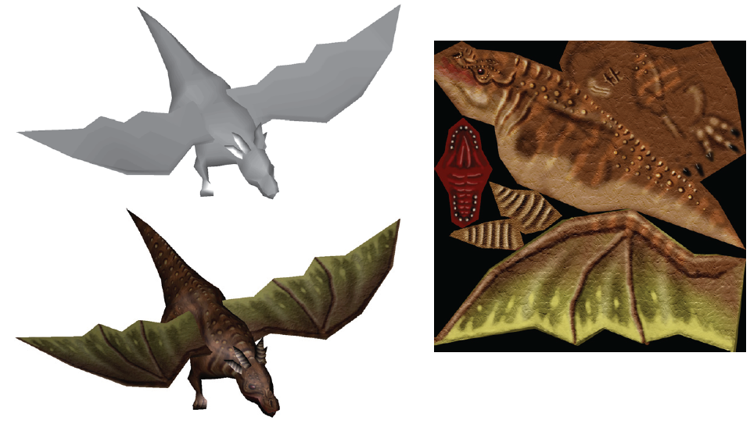
Fragment Shader
Vertex Assembly
Example: Texture Mapping
Vertex Shader
Primitive Assembly
Rasterizer
Fragment Shader
Per-Fragment Tests
Blend
Framebuffer
Image from http://www.realtimerendering.com/

Slide 43
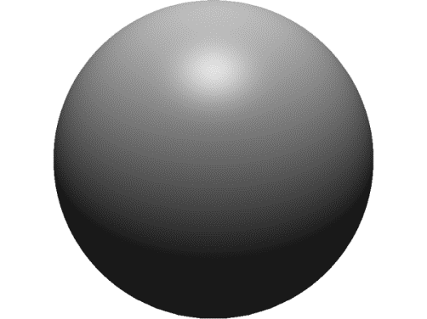
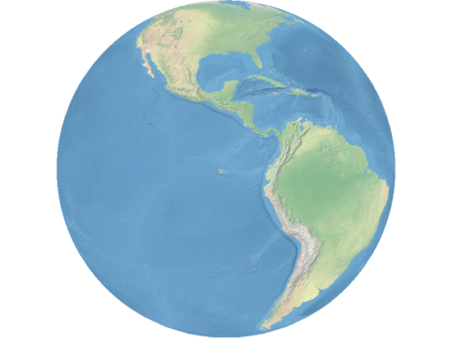
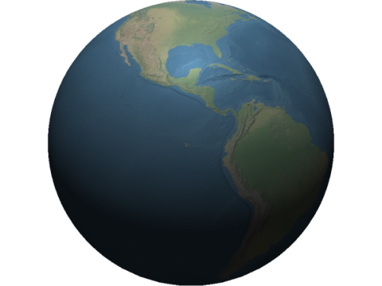
Fragment Shader
Vertex Assembly
Lighting and texture mapping
Vertex Shader
Primitive Assembly
Rasterizer
Fragment Shader
Per-Fragment Tests
Blend
Framebuffer
Image from http://www.virtualglobebook.com/

Slide 44
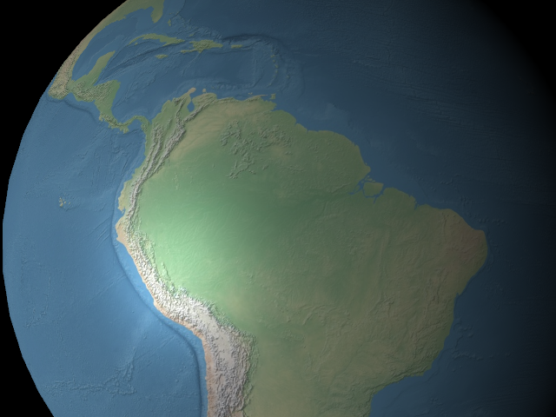
Fragment Shader
Vertex Assembly
Example: Bump mapping
Vertex Shader
Primitive Assembly
Rasterizer
Fragment Shader
Per-Fragment Tests
Blend
Framebuffer

Slide 45

Fragment Shader
Vertex Assembly
Example: Bump mapping
Vertex Shader
Primitive Assembly
Rasterizer
Fragment Shader
Per-Fragment Tests
Blend
Framebuffer

Slide 46
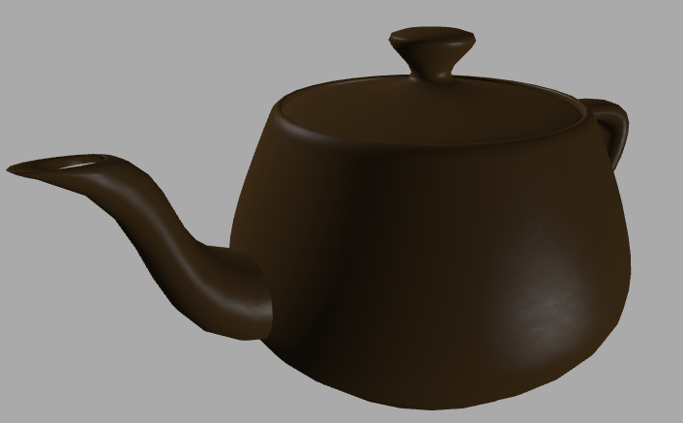
Fragment Shader
Vertex Assembly
Example: Specular map
Vertex Shader
Primitive Assembly
Rasterizer
Fragment Shader
Per-Fragment Tests
Blend
Framebuffer
Screenshot and demo by Eric Haines and Gundega Dekena. Udacity Interactive 3D Graphics.
Notes:
Demo: http://www.realtimerendering.com/udacity/index_solutions.html?load=unit8/ps-specular-mapping_sol.js

Slide 47
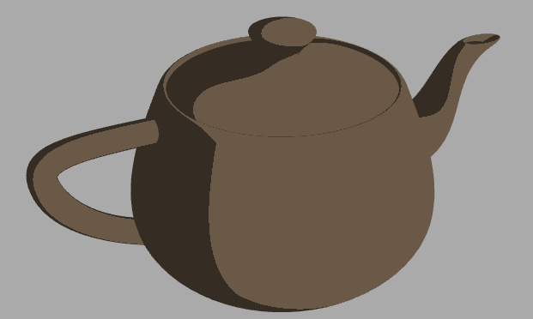
Fragment Shader
Vertex Assembly
Example: Non-Photorealistic Rendering (NPR)
Vertex Shader
Primitive Assembly
Rasterizer
Fragment Shader
Per-Fragment Tests
Blend
Framebuffer
Screenshot and demo by Eric Haines and Gundega Dekena. Udacity Interactive 3D Graphics.
Notes:
Two-tone shading.
Also common to shade silhouettes.
Demo: http://www.realtimerendering.com/udacity/unit9/two-tone-shading_sol/index.html

Slide 48
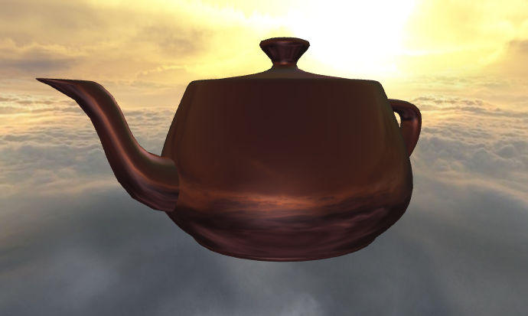
Fragment Shader
Vertex Assembly
Example: Reflection mapping
Vertex Shader
Primitive Assembly
Rasterizer
Fragment Shader
Per-Fragment Tests
Blend
Framebuffer
Screenshot and demo by Eric Haines and Gundega Dekena. Udacity Interactive 3D Graphics.
Notes:
Demo: http://www.realtimerendering.com/udacity/index_solutions.html?load=unit8/ps-reflection-mapping_sol.js

Slide 49
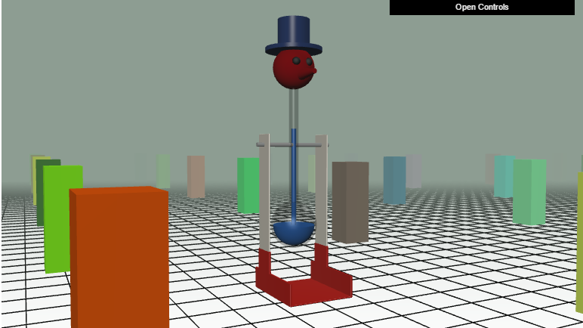
Fragment Shader
Vertex Assembly
More examples
Vertex Shader
Primitive Assembly
Rasterizer
Fragment Shader
Fog
Per-Fragment Tests
Blend
Framebuffer
Screenshot and demo by Eric Haines and Gundega Dekena. Udacity Interactive 3D Graphics.
Notes:
Fog demo: https://www.udacity.com/course/viewer#!/c-cs291/l-124106593/m-170440734

Slide 50
Fragment Shader
Vertex Assembly
A fragment shader can output color, but what else would be useful?
Vertex Shader
Primitive Assembly
Rasterizer
Fragment Shader
Per-Fragment Tests
Blend
Framebuffer

Slide 51
Fragment Shader
Vertex Assembly
A fragment shader can output color, but what else would be useful?
  Discard the fragment. Why?
  Depth. Why?
  Multiple colors. Why?
Vertex Shader
Primitive Assembly
Rasterizer
Fragment Shader
Per-Fragment Tests
Blend
Framebuffer

Slide 52
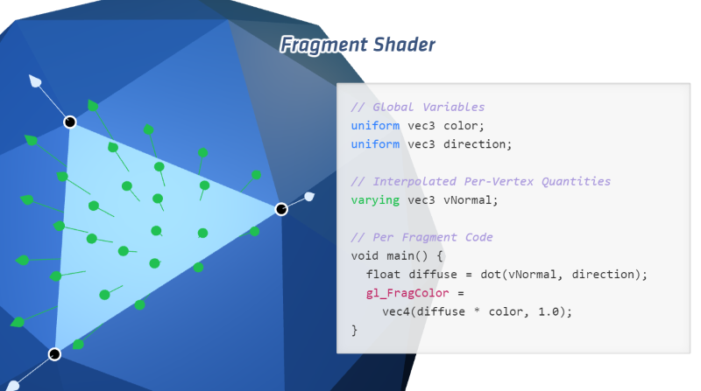
Vertex and Fragment Shader Examples
By Steven Wittens, @unconed
Notes:
Demo: http://acko.net/files/fullfrontal/fullfrontal/webglmath/shaders.html

Slide 53
Per-Fragment Tests
Vertex Assembly
A fragment must go through a series of tests to make to the framebuffer
  What tests are useful?
Vertex Shader
Primitive Assembly
Rasterizer
Fragment Shader
Per-Fragment Tests
Blend
Framebuffer

Slide 54
Scissor Test
Vertex Assembly
Discard a fragment if it is within a rectangle defined in window coordinates
  Why is this useful?
  Does this need to happen after fragment shading?
Vertex Shader
Primitive Assembly
Rasterizer
Fragment Shader
Scissor Test
Per-Fragment Tests
Stencil Test
Blend
Depth Test
Framebuffer

Slide 55
Scissor Test
Vertex Assembly
The scissor test is useful for “scissoring out” parts of the window that do not need to be shaded
  For performance. Why?
  Post-processing effects
  Multipass rendering
Vertex Shader
Primitive Assembly
Rasterizer
Fragment Shader
Scissor Test
Per-Fragment Tests
Stencil Test
Blend
Depth Test
Framebuffer
Notes:
Scissor out area that affects a light or a post-processing effect, e.g., fixing cracks in screen-space. Project bounding volume onto near plane.

Slide 56
Stencil Test
Vertex Assembly
The stencil test can discard arbitrary areas of the window, and count per-fragment
A stencil is written to the stencil buffer, and later fragments can be tested against this buffer
What is this useful for?
Vertex Shader
Primitive Assembly
Rasterizer
Fragment Shader
Scissor Test
Per-Fragment Tests
Stencil Test
Blend
Depth Test
Framebuffer
Notes:
Multi-pass avoid z-fighting (decaling)
Stencil shadow volumes – inc on entrance, dec on exit.

Slide 57
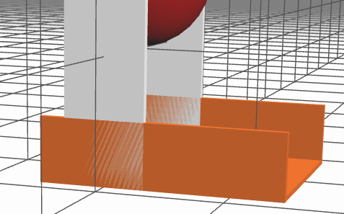
Depth Test
Vertex Assembly
Finds visible surfaces
Once called “ridiculously expensive”
Also called the z-test
  Does it need to be after fragment shading?
Vertex Shader
Primitive Assembly
Rasterizer
Fragment Shader
Scissor Test
Per-Fragment Tests
Stencil Test
Blend
Depth Test
z-fighting
Framebuffer
Screenshot and demo by Eric Haines and Gundega Dekena. Udacity Interactive 3D Graphics.
Notes:
Memory densities went up. Cost went down. Z-buffer is efficient to implement in hardware. Has lots of optimizations.
z-fighting demo: http://www.realtimerendering.com/udacity/?load=demo/unit2-z-fighting.js

Slide 58
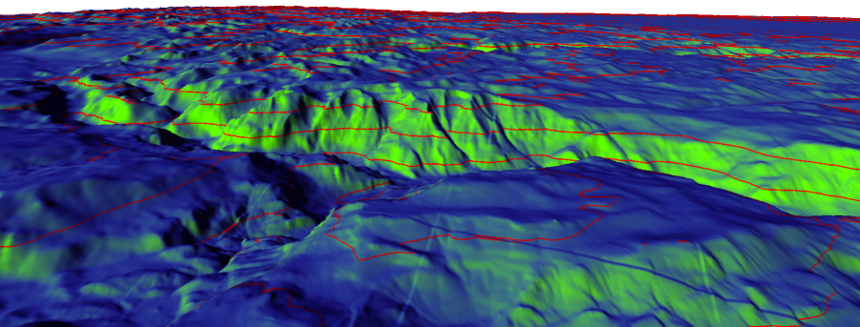
Depth Test
Image from http://www.virtualglobebook.com/

Slide 59
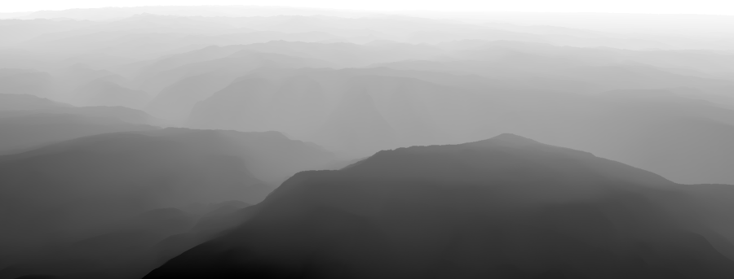
Depth Test
Image from http://www.virtualglobebook.com/

Slide 60
Blending
Vertex Assembly
Combine fragment color with framebuffer color
  Can weight each color
  Can use different operations: +, -, etc.
Why is this useful?
Vertex Shader
Primitive Assembly
Rasterizer
Fragment Shader
Per-Fragment Tests
Blend
Framebuffer

Slide 61
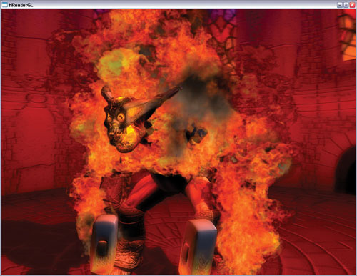
Blending
Vertex Assembly
Example: Translucency
Additive Blending
Alpha Blending
Vertex Shader
C_{dest} = (C_{source}.rgb)(C_{source}.a) + (C_{dest}.rgb);
Primitive Assembly
Rasterizer
C_{dest} = (C_{source}.rgb)(C_{source}.a) +
(C_{dest}.rgb) (1 - C_{source}.a);
Fragment Shader
Per-Fragment Tests
Blend
Framebuffer
Image from http://http.developer.nvidia.com/GPUGems/gpugems_ch06.html
Notes:
Also see this demo: http://www.andersriggelsen.dk/glblendfunc.php

Slide 62
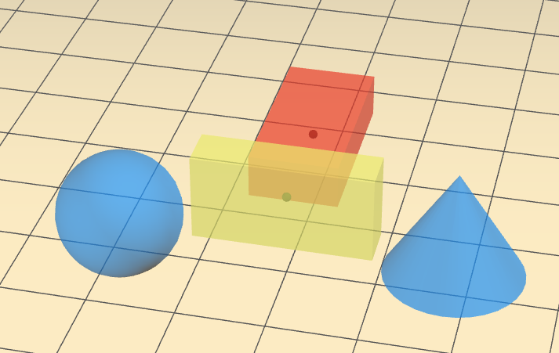
Blending
Vertex Assembly
Alpha Blending sorting
Vertex Shader
Primitive Assembly
Rasterizer
Fragment Shader
Per-Fragment Tests
Blend
Framebuffer
Screenshot and demo by Eric Haines and Gundega Dekena. Udacity Interactive 3D Graphics.
Notes:
Alpha Blending requires sorting back to front
Demo: http://www.realtimerendering.com/udacity/?load=demo/unit3-transparency.js

Slide 63
Graphics Pipeline Walkthrough
Vertex Assembly
After all that, write to the framebuffer!
Vertex Shader
Primitive Assembly
Rasterizer
Fragment Shader
Per-Fragment Tests
Blend
Framebuffer
Images from http://www.cs.cmu.edu/afs/cs.cmu.edu/academic/class/15869-f11/www/lectures/01_intro.pdf

Slide 64
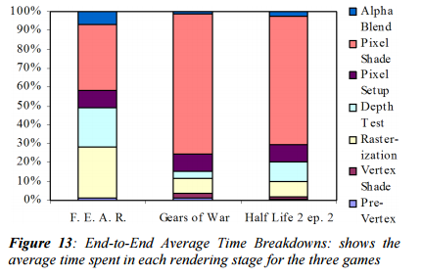
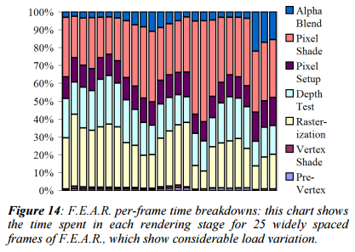
Example Performance Analysis
Images from http://www.student.chemia.uj.edu.pl/~mrozek/USl/wyklad/Nowe_konstrukcje/Siggraph_Larrabee_paper.pdf
Notes:
F.E.A.R -> stencil shadows. Less fragment shading load, but more rasterization and depth test. Dynamically allocating compute resources benefits this.
Pixel setup = interpolation.

Slide 65
Evolution of the Programmable Graphics Pipeline
Pre GPU
Fixed function GPU
Programmable GPU
Unified Shader Processors

Slide 66
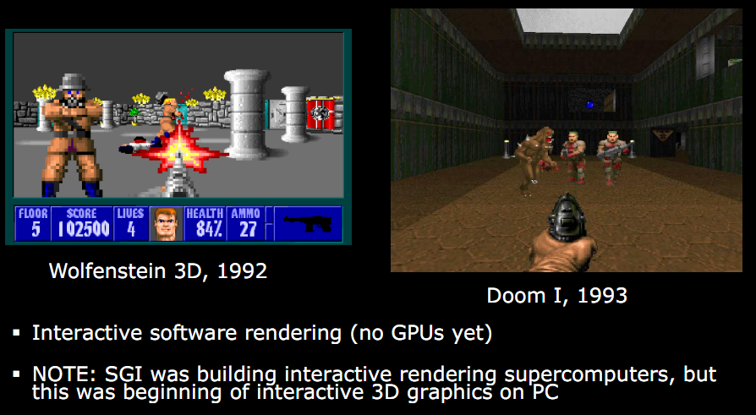
Early 90s – Pre GPU
Slide from http://s09.idav.ucdavis.edu/talks/01-BPS-SIGGRAPH09-mhouston.pdf
Notes:
Wolf 3D – 2.5D. No ceiling and floor height changes (or textures). No rolling walls. No lighting. Enemies always face viewer. Ray casting. Pre-computed texture coordinates.
Doom – Based on BSP tree (Bruce Naylor). Texture mapped all surfaces. Lighting. Varying floor altitudes. Rolling walls.

Slide 67
Why GPUs?
Exploit Parallelism
  Pipeline parallel
  Data-parallel
  CPU and GPU executing in parallel
Hardware:
  Texture filtering, rasterization, alpha blending, …
  MAD, sqrt, ...
Notes:
Rasterization and interpolation.

Slide 68
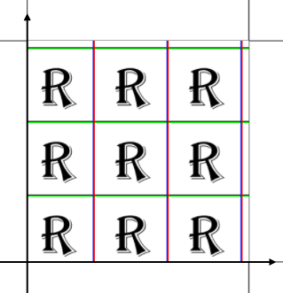
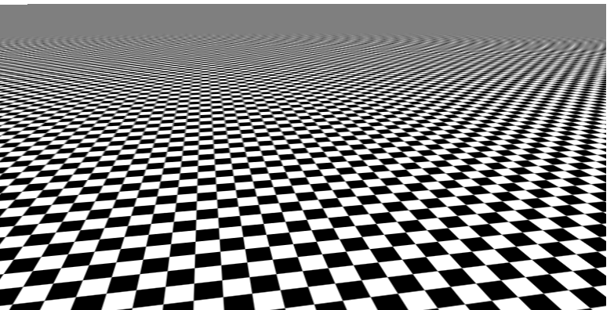
Texture Hardware
Software is 12-40x slower (Larrabee)
Wrap modes
Texture filtering
Screenshot and demo by Eric Haines and Gundega Dekena. Udacity Interactive 3D Graphics.
Notes:
Wrap mode demos: https://www.udacity.com/course/viewer#!/c-cs291/l-124106595/m-176364092
Filtering demo: https://www.udacity.com/course/viewer#!/c-cs291/l-124106595/m-176452098
Bonus – anisotropy: https://www.udacity.com/course/viewer#!/c-cs291/l-124106595/m-176170989
Larrabee paper: http://www.student.chemia.uj.edu.pl/~mrozek/USl/wyklad/Nowe_konstrukcje/Siggraph_Larrabee_paper.pdf
“Larrabee includes texture filter logic because this operation cannot be efficiently performed in software on the cores. Our analysis shows that software texture filtering on our cores would take 12x to 40x longer than our fixed function logic, depending on whether decompression is required. There are four basic reasons:
* Texture filtering still most commonly uses 8-bit color components, which can be filtered more efficiently in dedicated logic than in the 32-bit wide VPU lanes.
* Efficiently selecting unaligned 2x2 quads to filter requires a specialized kind of pipelined gather logic.
* Loading texture data into the VPU for filtering requires an impractical amount of register file bandwidth.
* On-the-fly texture decompression is dramatically more efficient in dedicated hardware than in CPU code.
The Larrabee texture filter logic is internally quite similar to typical GPU texture logic. It provides 32KB of texture cache per core and supports all the usual operations, such as DirectX 10 compressed texture formats, mipmapping, anisotropic filtering, etc. Cores pass commands to the texture units through the L2 cache and receive results the same way. The texture units perform virtual to physical page translation and report any page misses to the core, which retries the texture filter command after the page is in memory. Larrabee can also perform texture operations directly on the cores when the performance is fast enough in software. “

Slide 69
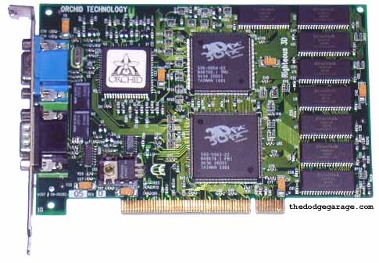
3dfx Voodoo (1996)
Vertex Assembly
In hardware:
Fixed-function rasterization, texture mapping, depth testing, etc.
4 - 6 MB memory
PCI bus
$299
Vertex Shader
Still
Software
Primitive Assembly
Rasterizer
Fragment Shader
Hardware
Per-Fragment Tests
Blend
Framebuffer
Image from http://www.thedodgegarage.com/3dfx/v1.htm
Notes:
Voodoo was started by SGI alums in 1994. IP acquired by NVIDIA in 2002.
Could only read from one texture
Required separate VGA card for 2D

Slide 70
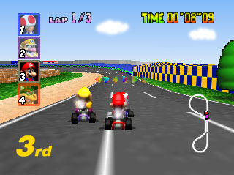
Aside: Mario Kart 64
High fragment load / low vertex load
Image from http://www.gamespot.com/users/my_shoe/
Notes:
Release Dec, 1996 (Japan). Same era as Voodoo
Used SGI chip. Even though the vertex load is low, it is done in hardware

Slide 71
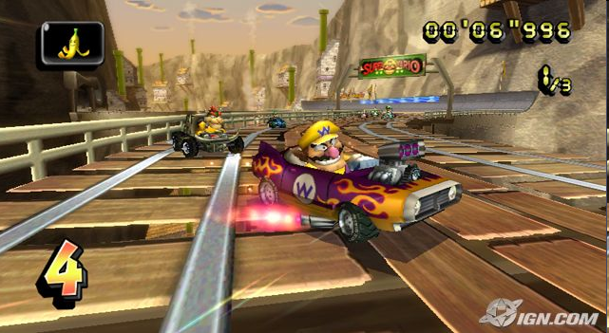
Aside: Mario Kart Wii
High fragment load / low vertex load?
Image from http://wii.ign.com/dor/objects/949580/mario-kart-wii/images/

Slide 72
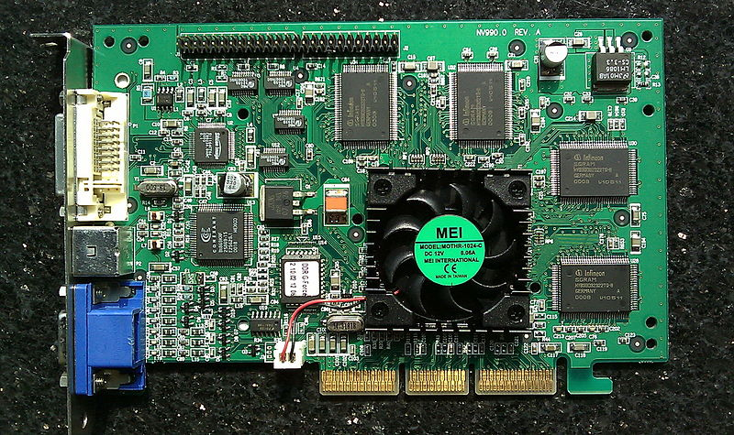
NVIDIA GeForce 256 (1999)
Vertex Assembly
In hardware:
Fixed-function vertex shading (T&L)
Multi-texturing: bump maps, light maps, etc.
10 million polygons per second
Direct3D 7
AGP bus
Vertex Shader
Primitive Assembly
Rasterizer
Hardware
Fragment Shader
Per-Fragment Tests
Blend
Framebuffer
Image from http://en.wikipedia.org/wiki/File:VisionTek_GeForce_256.jpg
Notes:
Not all games use hardware T&L

Slide 73
NVIDIA GeForce 3 (2001)
Vertex Assembly
Optionally bypass fixed-function T&L with a programmable vertex shader
Optionally bypass fixed-function fragment shading with a programmable fragment shader (register combiners)
Many programming limits
Direct3D 8
Pentium IV – 20 stages
GeForce 3 – 600-800 stages
Vertex Shader
Primitive Assembly
Rasterizer
Hardware
Fragment Shader
Per-Fragment Tests
Fixed-function stage
Blend
Programmable stage
Framebuffer

Slide 74
NVIDIA GeForce 6 (2004)
Vertex Assembly
Much better programmable fragment shaders
Vertex shader can read textures
Dynamic branches
Multiple render targets
PCIe bus
OpenGL 2 / Direct3D 9
Vertex Shader
textures
Primitive Assembly
Rasterizer
Hardware
Fragment Shader
Per-Fragment Tests
Blend
Framebuffer

Slide 75
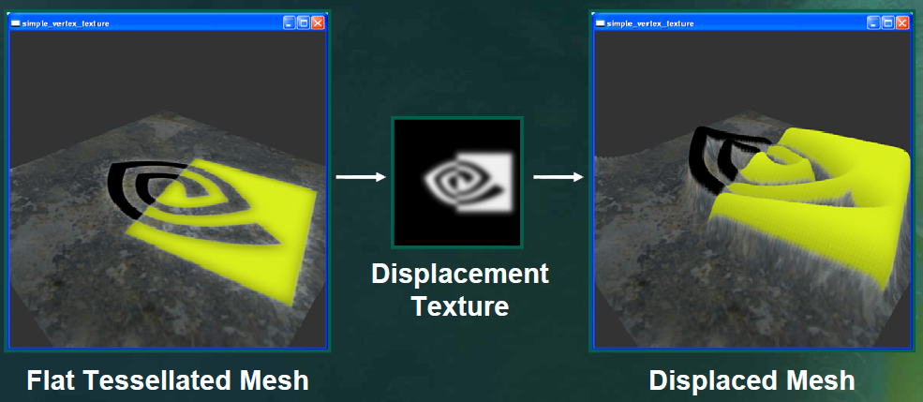
NVIDIA GeForce 6 (2004)
Vertex Assembly
Vertex shader can read textures
Dynamic branches
Multiple render targets
PCIe bus
OpenGL 2 / Direct3D 9
Vertex Shader
Primitive Assembly
Rasterizer
Fragment Shader
Per-Fragment Tests
Blend
Framebuffer
Image from ftp://download.nvidia.com/developer/presentations/2004/GPU_Jackpot/Shader_Model_3.pdf

Slide 76
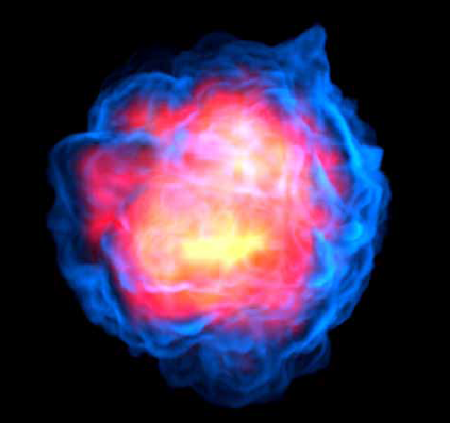
NVIDIA GeForce 6 (2004)
Vertex Assembly
Vertex shader can read textures
Dynamic branches
Multiple render targets
PCIe bus
OpenGL 2 / Direct3D 9
Vertex Shader
Primitive Assembly
Rasterizer
Fragment Shader
Per-Fragment Tests
Blend
Framebuffer
Image from ftp://download.nvidia.com/developer/presentations/2004/GPU_Jackpot/Shader_Model_3.pdf
Notes:
Application only renders a single quad
Pixel shader calculates intersection between view ray
and bounding box, discards pixels outside
Marches along ray between far and near intersection
points, accumulating color and opacity
Looks up in 3D texture, or evaluates procedural function at
each sample
Compiles to REP/ENDREP loop
Allows us to exceed the 512 instruction PS2.0 limit
All blending is done at fp32 precision in the shader
100 steps is interactive on 6800 Ultra

Slide 77
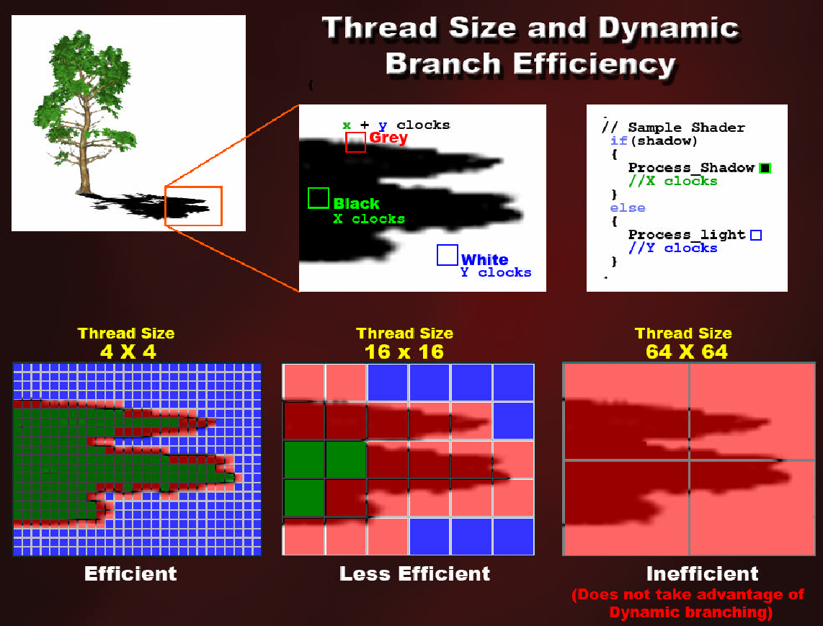
Dynamic Branches
Image from http://developer.amd.com/media/gpu_assets/03_Clever_Shader_Tricks.pdf

Slide 78
Dynamic Branches
For best performance, fragment shader dynamic branches should be coherent in screen-space
How does this relate to warp partitioning in CUDA?

Slide 79
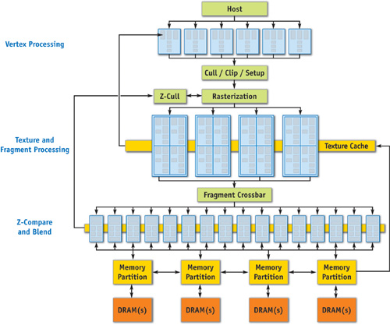
NVIDIA GeForce 6 (2004)
6 vertex
shader processors
16 fragment
shader processors
Image from http://http.developer.nvidia.com/GPUGems2/gpugems2_chapter30.html

Slide 80
NVIDIA GeForce 8 (2006)
Vertex Assembly
Ground-up GPU redesign
Geometry Shaders
Transform-feedback
OpenGL 3 / Direct3D 10
Unified shader processors
Support for GPU Compute
Vertex Shader
Geometry Shader
Primitive Assembly
Rasterizer
Fragment Shader
Per-Fragment Tests
Blend
Framebuffer

Slide 81
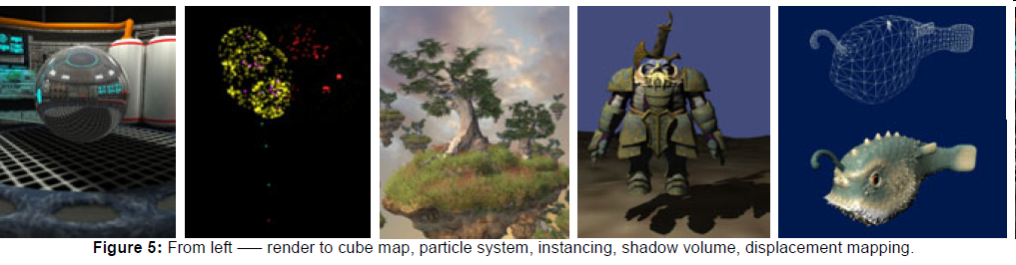
Geometry Shaders
Image from David Blythe : http://download.microsoft.com/download/f/2/d/f2d5ee2c-b7ba-4cd0-9686-b6508b5479a1/direct3d10_web.pdf

Slide 82
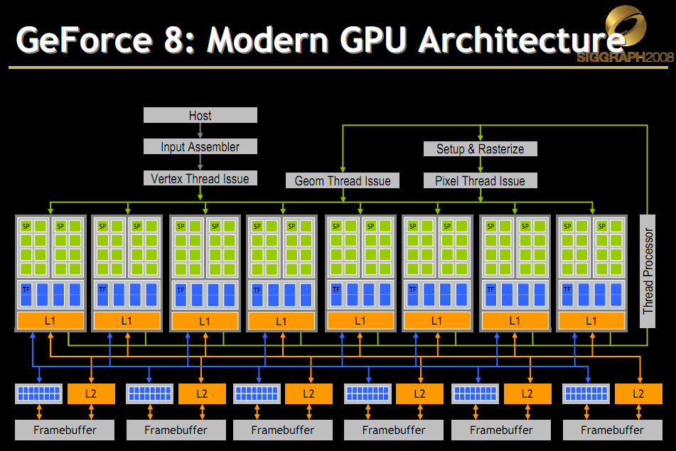
NVIDIA G80 Architecture
Slide from http://s08.idav.ucdavis.edu/luebke-nvidia-gpu-architecture.pdf

Slide 83

Why Unify Shader Processors?
Slide from http://s08.idav.ucdavis.edu/luebke-nvidia-gpu-architecture.pdf

Slide 84

Why Unify Shader Processors?
Slide from http://s08.idav.ucdavis.edu/luebke-nvidia-gpu-architecture.pdf

Slide 85

Evolution of the Programmable Graphics Pipeline
Slide from Mike Houston: http://s09.idav.ucdavis.edu/talks/01-BPS-SIGGRAPH09-mhouston.pdf

Slide 86

Evolution of the Programmable Graphics Pipeline
Slide from Mike Houston: http://s09.idav.ucdavis.edu/talks/01-BPS-SIGGRAPH09-mhouston.pdf
Notes:
Mobile made fixed function important again: fewer transistors, lower power, better performance.

