Slide 1
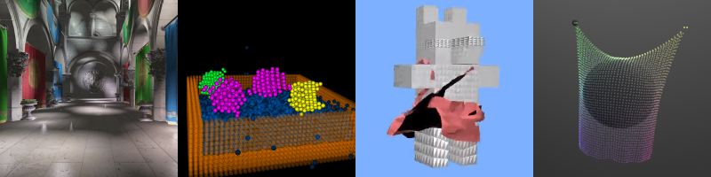
Introduction to GLSL
Patrick Cozzi
University of Pennsylvania
CIS 565 - Fall 2016

Slide 2
Agenda
Fixed vs. Programmable Pipeline Example
GLSL

Slide 3
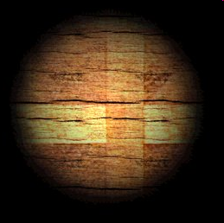
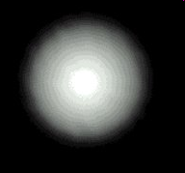
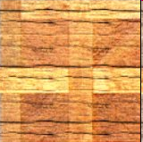
Light Map
x
=
Precomputed light
Surface color
“lit” surface
Multiple two textures component-wise
Images from: http://zanir.wz.cz/?p=56&lang=en

Slide 4
Light Map: Fixed Function
GLuint lightMap;
GLuint surfaceMap;
// ...
glEnable(GL_TEXTURE_2D);
glActiveTexture(GL_TEXTURE0);
glBindTexture(GL_TEXTURE_2D, lightMap);
glTexEnvf(GL_TEXTURE_ENV, GL_TEXTURE_ENV_MODE, GL_MODULATE);
glActiveTexture(GL_TEXTURE1);
glBindTexture(GL_TEXTURE_2D, surfaceMap);
glTexEnvf(GL_TEXTURE_ENV, GL_TEXTURE_ENV_MODE, GL_MODULATE);
glDraw*(...);
Tell fixed function we are
using texture mapping
Tell fixed function how to combine textures

Slide 5
Light Map: Fixed Function
In general, the fixed function
  is configurable
  is limited
  leads to a bloated API

Slide 6
Light Map: Programmable
Write a fragment shader:
uniform sampler2D lightMap;
uniform sampler2D surfaceMap;
varying vec2 fs_txCoord;
void main(void)
{
float intensity = texture2D(lightMap, fs_txCoord).r;
vec3 color = texture2D(surfaceMap, fs_txCoord).rgb;
gl_FragColor = vec4(intensity * color, 1.0);
}
Textures (input)
Per-fragment input
one channel intensity
Three channel color
modulate

Slide 7
Light Map: Programmable
Recall the fixed function light map:
GLuint lightMap;
GLuint surfaceMap;
// ...
glEnable(GL_TEXTURE_2D);
glActiveTexture(GL_TEXTURE0);
glBindTexture(GL_TEXTURE_2D, lightMap);
glTexEnvf(GL_TEXTURE_ENV, GL_TEXTURE_ENV_MODE, GL_MODULATE);
glActiveTexture(GL_TEXTURE1);
glBindTexture(GL_TEXTURE_2D, surfaceMap);
glTexEnvf(GL_TEXTURE_ENV, GL_TEXTURE_ENV_MODE, GL_MODULATE);
glDraw*(...);

Slide 8
Light Map: Programmable
GLuint lightMap;
GLuint surfaceMap;
GLuint program;
// ...
glActiveTexture(GL_TEXTURE0);
glBindTexture(GL_TEXTURE_2D, lightMap);
glActiveTexture(GL_TEXTURE1);
glBindTexture(GL_TEXTURE_2D, surfaceMap);
glUseProgram(program); // Later: pass uniform variables
glDraw*(...);

Slide 9
Programmable Shading
In general:
  Write a shader: a small program that runs on the GPU
  Tell OpenGL to execute your shader
  Write less CPU code / API calls

Slide 10
Shader Execution Model
For any shader type:
Uniform (constant) input
Shader
Streaming input
Output
Streaming input and output examples: vertices, primitives, fragments, …
Uniform input examples: matrices, textures, time, …

Slide 11
Shader Execution Model
Shaders run in parallel on the GPU
Uniform (constant) input
Shader
Shader
Streaming input
Output
Shader
Shader

Slide 12
Shader Execution Model
Each shader
  Shares the same read-only uniform inputs
  Has different read-only input from a stream
  Writes it own output
  Has no side effects*
  Executes independently without communicating with other shaders*
Uniform (constant) input
Shader
Streaming input
Shader
Output
Shader
Shader
* Except in OpenGL 4.2+

Slide 13
Shader Execution Model
Parallelism is implicit
  Calling glDraw* invokes a parallel processor – the GPU
  The driver/hardware takes care of scheduling and synchronizing
  Users write parallel applications without even knowing it!

Slide 14
Shaders in the Pipeline
Vertex Assembly
Classic OpenGL 2 / OpenGL ES 2 / WebGL / Direct3D 9 Pipeline
Newer pipelines also have programmable geometry, tessellation, and shaders
Vertex Shader
Primitive Assembly
Rasterizer
Fragment Shader
Per-Fragment Tests
Blend
Framebuffer

Slide 15
Vertex Shaders in the Pipeline
A simple vertex shader:
The same model-view transform is used for each vertex in a particular glDraw* call.
uniform mat4 u_modelViewProjection;
attribute vec4 position;
void main(void)
{
gl_Position = u_modelViewProjection * position;
}
Each vertex shader executes in a different thread with a different position.
4x4 matrix times a 4-element vector; transform from model to clip coordinates.
gl_Position is the GLSL built-in vertex shader position output. We must write to it.

Slide 16
Vertex Shaders in the Pipeline
A vertex shader with two input attributes:
uniform mat4 u_modelViewProjection;
attribute vec4 position;
attribute vec3 color;
varying vec3 fs_color;
void main(void)
{
fs_color = color;
gl_Position = u_modelViewProjection * position;
}
Each vertex shader executes in a different thread with a different position and color.
This vertex shader outputs a vec3 color in addition to gl_Position.

Slide 17
Fragment Shaders in the Pipeline
Recall:
  Input
    Fragment position in screen space: gl_FragCoord.xy
    Fragment depth: gl_FragCoord.z
    Interpolated vertex shader outputs
    Uniforms
  Output
    Fragment color
    Optional: fragment depth: gl_FragDepth*
    Optional: multiple “colors” to multiple textures*
    discard
    Can’t change gl_FragCoord.xy. Why?
* When supported

Slide 18

Fragment Shaders in the Pipeline
A simple fragment shader:
void main(void)
{
gl_FragColor = vec4(1.0, 0.0, 0.0, 1.0);
}
Each fragment shader executes in a different thread and outputs the color for a different fragment.
Result:
Shade solid red.

Slide 19
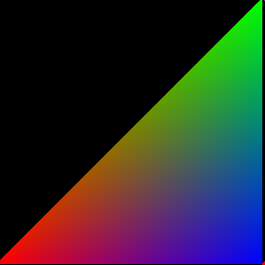
Fragment Shaders in the Pipeline
A slightly less simple fragment shader:
varying vec3 fs_color;
void main(void)
{
gl_FragColor = vec4(fs_color, 1.0);
}
Fragment shader input from vertex shader output after rasterization.
Pass color through.
Result:
How?

Slide 20
GLSL Syntax
GLSL is like C without
  pointers
  recursion
  dynamic memory allocation
GLSL is like C with
  Built-in vector, matrix, and sampler types
  Constructors
  A great math library
Language features allow us to write concise, efficient shaders.

Slide 21
GLSL Syntax
GLSL has a preprocessor
#ifdef FAST_EXACT_METHOD
FastExact();
#else
SlowApproximate();
#endif
#line 0
// ... many others
All shaders have main()
void main(void)
{
}

Slide 22
GLSL Syntax: Vectors
Scalar types: float, int, uint, and bool
Vectors are also built-in types:
  vec2, vec3, and vec4
  Also ivec[2-4], uvec[2-4], and bvec[2-4]
Access components three ways:
  .x, .y, .z, .w
  .r, .g, .b, .a
  .s, .t, .p, .q
Position or direction
Color
Texture coordinate

Slide 23
GLSL Syntax: Vectors
Vectors have constructors
vec3 xyz = vec3(1.0, 2.0, 3.0);
vec3 xyz = vec3(1.0); // [1.0, 1.0, 1.0]
vec3 xyz = vec3(vec2(1.0, 2.0), 3.0);

Slide 24
GLSL Syntax: Swizzling
Swizzle: select or rearrange components
vec4 c = vec4(0.5, 1.0, 0.8, 1.0);
vec3 rgb = c.rgb; // [0.5, 1.0, 0.8]
vec3 bgr = c.bgr; // [0.8, 1.0, 0.5]
vec3 rrr = c.rrr; // [0.5, 0.5, 0.5]
c.a = 0.5; // [0.5, 1.0, 0.8, 0.5]
c.rb = 0.0; // [0.0, 1.0, 0.0, 0.5]
float g = rgb[1]; // 0.5, indexing, not swizzling
Try it – you’ll love it.

Slide 25
GLSL Syntax: Matrices
Matrices are built-in types:
  Square: mat2, mat3, and mat4
  Rectangular: matmxn. m columns, n rows
Stored column major.

Slide 26
GLSL Syntax: Matrices
Matrix Constructors
mat3 i = mat3(1.0); // 3x3 identity matrix
mat2 m = mat2(1.0, 2.0, // [1.0 3.0]
3.0, 4.0); // [2.0 4.0]
Accessing Elements
Treat matrix as array of column vectors
float f = m[column][row];
float x = m[0].x; // x component of first column
vec2 yz = m[1].yz; // yz components of second column
Can swizzle too!

Slide 27
GLSL Syntax: Vectors and Matrices
Matrix and vector operations are easy and fast:
vec3 xyz = // ...
vec3 v0 = 2.0 * xyz; // scale
vec3 v1 = v0 + xyz; // component-wise
vec3 v2 = v0 * xyz; // component-wise
mat3 m = // ...
mat3 v = // ...
mat3 mv = v * m; // matrix * matrix
mat3 xyz2 = mv * xyz; // matrix * vector
mat3 xyz3 = xyz * mv; // vector * matrix

Slide 28
GLSL Syntax: attribute / varying / uniform
Recall:
uniform: shader input constant across glDraw*
uniform mat4 u_modelViewProjection;
attribute vec4 position;
attribute vec3 color;
varying vec3 fs_color;
void main(void)
{
fs_color = color;
gl_Position = u_modelViewProjection * position;
}
attribute: shader input varies per vertex attribute
varying: shader output
Notes:
Modern desktop GL uses in/out

Slide 29
GLSL Syntax: Samplers
Opaque types for accessing textures
uniform sampler2D diffuseMap; // 2D texture
vec3 color = texture2D(diffuseMap, vec2(0.5, 0.5)).rgb;
// Also samplerCube.

Slide 30
GLSL Syntax: Samplers
Opaque types for accessing textures
uniform sampler2D diffuseMap; // 2D texture
vec3 color = texture2D(diffuseMap, vec2(0.5, 0.5)).rgb;
// Also samplerCube.
Samplers must be uniforms

Slide 31
GLSL Syntax: Samplers
Opaque types for accessing textures
uniform sampler2D diffuseMap; // 2D texture
vec3 color = texture2D(diffuseMap, vec2(0.5, 0.5)).rgb;
// Also samplerCube.
texture() returns a vec4; extract the components you need
2D texture uses 2D texture coordinates for lookup

Slide 32
GLSL Syntax: Samplers
Textures
  Usually, but not always:
    Textures are square, e.g., 256x256
    Dimensions are a power of two
  Coordinates are usually normalized, i.e., in the range [0, 1]
  Texel: a pixel in a texture
  texture2D() does filtering using fixed function hardware

Slide 33
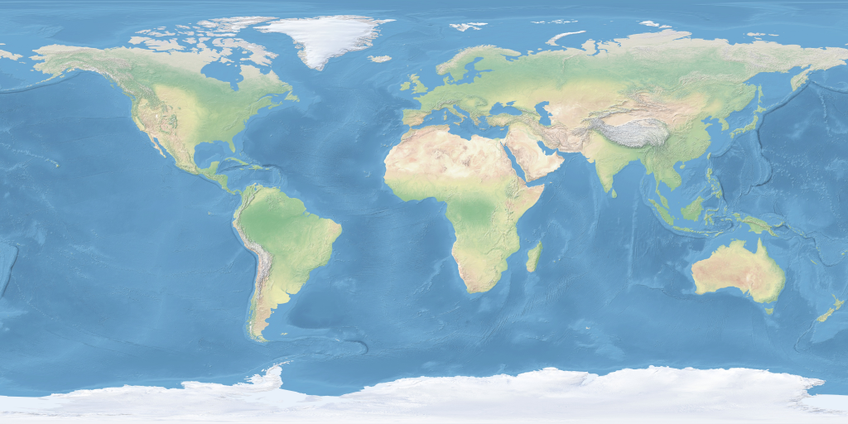
GLSL Syntax: Samplers
t
(1, 1)
s
(0, 0)
Images from: http://www.naturalearthdata.com/

Slide 34
GLSL Built-in Functions
Selected Trigonometry Functions
float s = sin(theta);
float c = cos(theta);
float t = tan(theta);
float as = asin(theta);
// ...
vec3 angles = vec3(/* ... */);
vec3 vs = sin(angles);
Works on vectors component-wise.

Slide 35
GLSL Built-in Functions
Exponential Functions
float xToTheY = pow(x, y);
float eToTheX = exp(x);
float twoToTheX = exp2(x);
float l = log(x); // ln
float l2 = log2(x); // log2
float s = sqrt(x);
float is = inversesqrt(x);
One GPU instruction!
Notes:
CUDA Guide says inversesqrt is 16 clock cycles for 32 thread warp – 4x the cost of other instructions.

Slide 36
GLSL Built-in Functions
Selected Common Functions
float ax = abs(x); // absolute value
float sx = sign(x); // -1.0, 0.0, 1.0
float m0 = min(x, y); // minimum value
float m1 = max(x, y); // maximum value
float c = clamp(x, 0.0, 1.0);
// many others: floor(), ceil(),
// step(), smoothstep(), ...

Slide 37
GLSL Built-in Functions
Rewrite with one function call
float minimum = // ...
float maximum = // ...
float x = // ...
float f = min(max(x, minimum), maximum);
Notes:
float f= clamp(x, minimum, maximum);

Slide 38
GLSL Built-in Functions
Rewrite this without the if statement
float x = // ...
float f;
if (x > 0.0)
{
f = 2.0;
}
else
{
f = -2.0;
}
Notes:
For x != 0:
float f = 2.0 * sign(x);

Slide 39
GLSL Built-in Functions
Rewrite this without the if statement
float root1 = // ...
float root2 = // ...
if (root1 < root2)
{
return vec3(0.0, 0.0, root1);
}
else
{
return vec3(0.0, 0.0, root2);
}
Notes:
return vec3(0.0, 0.0, min(root1, root2));

Slide 40
GLSL Built-in Functions
Rewrite this without the if statement
bool b = // ...
vec3 color;
if (b)
{
color = vec3(1.0, 0.0, 0.0);
}
else
{
color = vec3(0.0, 1.0, 0.0);
}
Hint: no built-in functions required for this one.
Notes:
vec3 color = vec3(b, !b, 0.0);

Slide 41
GLSL Built-in Functions
Selected Geometric Functions
vec3 l = // ...
vec3 n = // ...
vec3 p = // ...
vec3 q = // ...
float f = length(l); // vector length
float d = distance(p, q); // distance between points
float d2 = dot(l, n); // dot product
vec3 v2 = cross(l, n); // cross product
vec3 v3 = normalize(l); // normalize
vec3 v3 = reflect(l, n); // reflect
// also: faceforward() and refract()

Slide 42


GLSL Built-in Functions
reflect(-l, n)
  Given l and n, find r. Angle in equals angle out
n
l
r
Notes:
Observe: 2(dot(n, l)) = l + r, therefore r = 2(dot(n, l)) – l
Also refect()

Slide 43
GLSL Built-in Functions
Rewrite without length.
vec3 p = // ...
vec3 q = // ...
vec3 v = length(p – q);
Notes:
vec3 v =distance(p, q);

Slide 44
GLSL Built-in Functions
What is wrong with this code?
vec3 n = // ...
normalize(n);
Notes:
Normalize returns a new vector

Slide 45
GLSL Built-in Functions
Selected Vector Relational Functions
vec3 p = vec3(1.0, 2.0, 3.0);
vec3 q = vec3(3.0, 2.0, 1.0);
bvec3 b = equal(p, q); // (false, true, false)
bvec3 b2 = lessThan(p, q); // (true, false, false)
bvec3 b3 = greaterThan(p, q); // (false, false, true)
bool b4 = any(b); // true
bool b5 = all(b); // false

Slide 46
GLSL Built-in Functions
Rewrite this in one line of code
bool foo(vec3 p, vec3 q)
{
if (p.x < q.x)
{
return true;
}
else if (p.y < q.y)
{
return true;
}
else if (p.z < q.z)
{
return true;
}
return false;
}
Notes:
return any(lessThan(p, q));

Slide 47
GLSL Syntax and Built-in Functions
We didn’t cover:
  Arrays
  Structs
  Function calls
  const
  if / while / for
  dFdX, dFdy, fwidth
  …
Notes:
Screen space partial derivatives impact fragment shading scheduling. More later.

Slide 48
GLSL Resources
OpenGL ES/GLSL Quick Reference Card
  http://www.khronos.org/opengles/sdk/2.0/docs/reference_cards/OpenGL-ES-2_0-Reference-card.pdf
GLSL Man Pages
  http://www.opengl.org/sdk/docs/manglsl/
NShader: Visual Studio GLSL syntax highlighting
  http://nshader.codeplex.com/

